Slide 1
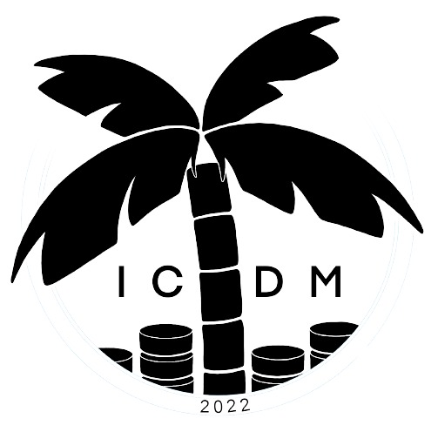
22nd IEEE International Conference on Data Mining, Nov. 28 – Dec. 1, 2022, Orlando, FL, USA
Multi-view POI-level Cellular Trajectory Reconstruction for Digital Contact Tracing of Infectious Diseases
Dongmin Park, Junhyeok Kang(presenter), Hwanjun Song, Susik Yoon, Jae-Gil Lee*
Data Mining Lab, KAIST
This work was supported by Institute of Information & Communications Technology Planning & Evaluation (IITP) grant funded by the Korea government (MSIT) (No. 2022-0-00157, Robust, Fair, Extensible Data-Centric Continual Learning).
Notes:
I’m gonna explain our paper named, “Multi-view POI-level Cellular Trajectory Reconstruction for Digital Contact Tracing of Infectious Diseases”

Slide 2
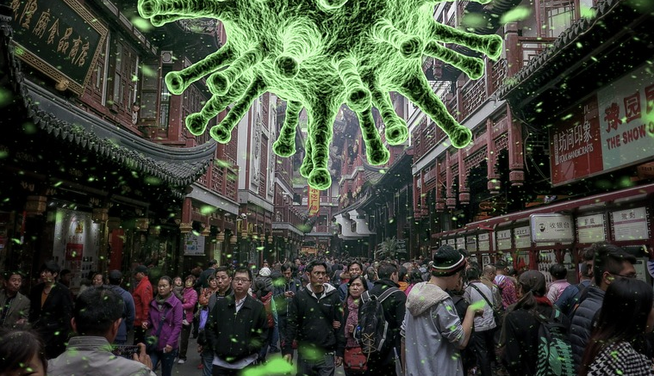
The impact of infectious diseases
The emergence and spread of infectious diseases with pandemic potential, such as flu and COVID-19, have persistently occurred throughout the human history.
A global pandemic totally collapses public health and economic systems.
with COVID-19, the world has surpassed 6.6 million deaths.
Notes:
The emergence and spread of infectious diseases with pandemic potential, such as cholera, flu, and COVID-19, have persistently occurred throughout the human history.
When an infectious disease becomes a global pandemic, it totally collapses public health and economic systems.
For example, with COVID-19, the world has surpassed 6.6 million deaths.

Slide 3
Digital contact tracing to control infectious diseases
Digital contact tracing is the process of identifying persons who may have contact with a confirmed case through an automated tracking system.
A typical approach is to download an app on the user’s mobile device which records the locations where the user visited using Bluetooth and GPS. → Low adoption rate due to privacy concerns.
Notes:
In order to prevent such a pandemic situation, digital contact tracing plays an important role.
Digital contact tracing is the process of identifying persons who may have contact with a confirmed case through an automated tracking system.
So, it enables potentially contagious people to start self-quarantine immediately and thus helps stop the transmission.
Digital contact tracing application has been actively developed to assist contact tracers such as public health authorities and global IT companies.
A typical approach for digital contact tracing is to download an app on the user’s mobile device.
Then, these app records the locations where the user visited or other people whom they spent time with, using Bluetooth and GPS.
Unfortunately, to stop the epidemic, this approach requires more than 60% uptake in the population.
However, due to privacy concerns, the low user adoption rate of contact tracing apps limits the potential benefits expected on epidemic control.

Slide 4
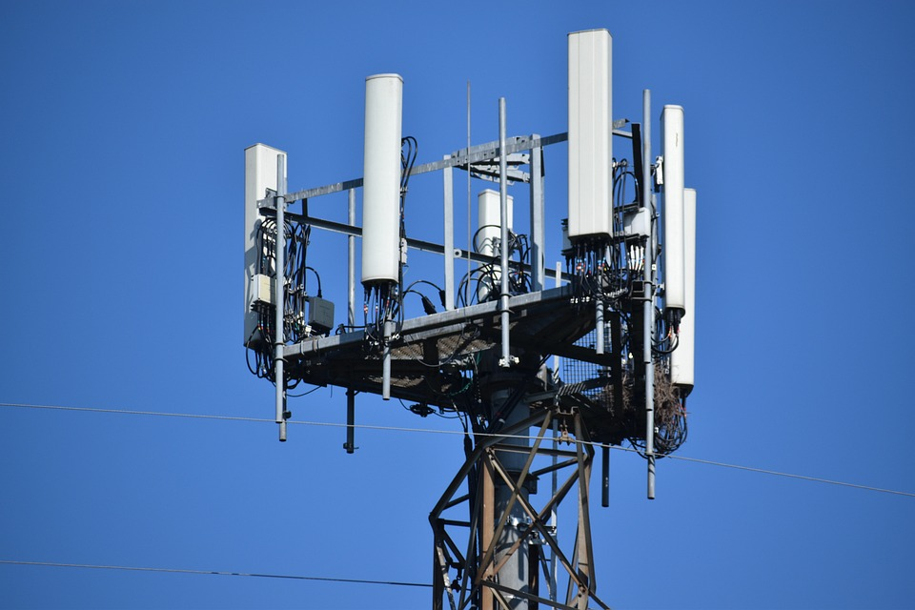
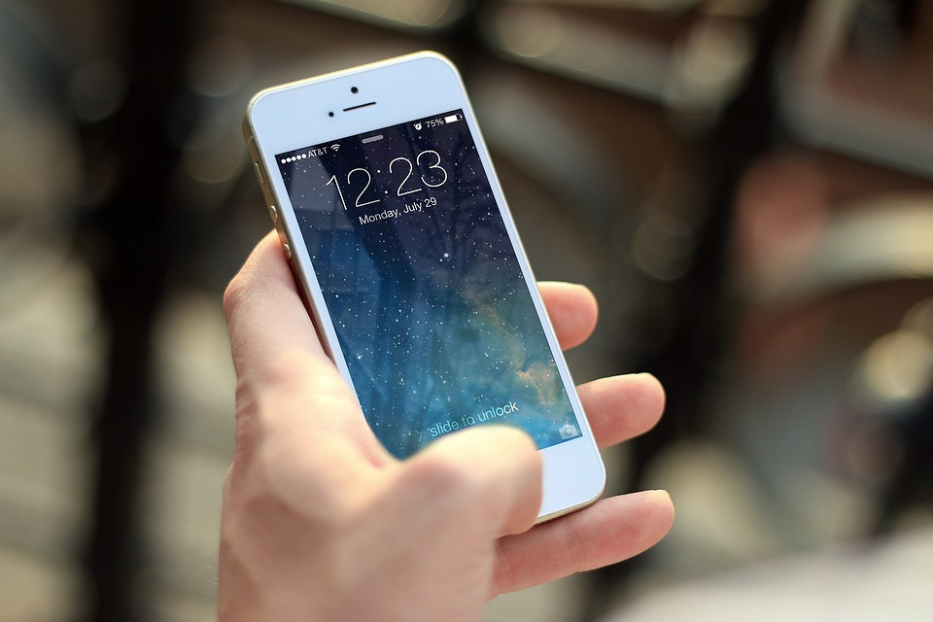
Cellular network data is free from the low adoption issue
Cellular network data, which is generated by interactions between mobile devices and cell towers, has become a good alternative resource.
A large collection of cellular trajectories from mobile subscribers can be an out-of-the-box solution that is free from the low adoption issue → However, it has been overlooked due to its low spatial resolution.
Notes:
This situation highlights the importance of a complementary tracing system that can cover a wide range of users.
In this regard, cellular network data, which is generated by interactions between mobile devices and cell towers, has become a good alternative resource for digital contact tracing,
Cell towers collect the location of a large population without any additional efforts such as app installation.
Nevertheless, the use of cellular network data is still hindered by its low spatial resolution,

Slide 5
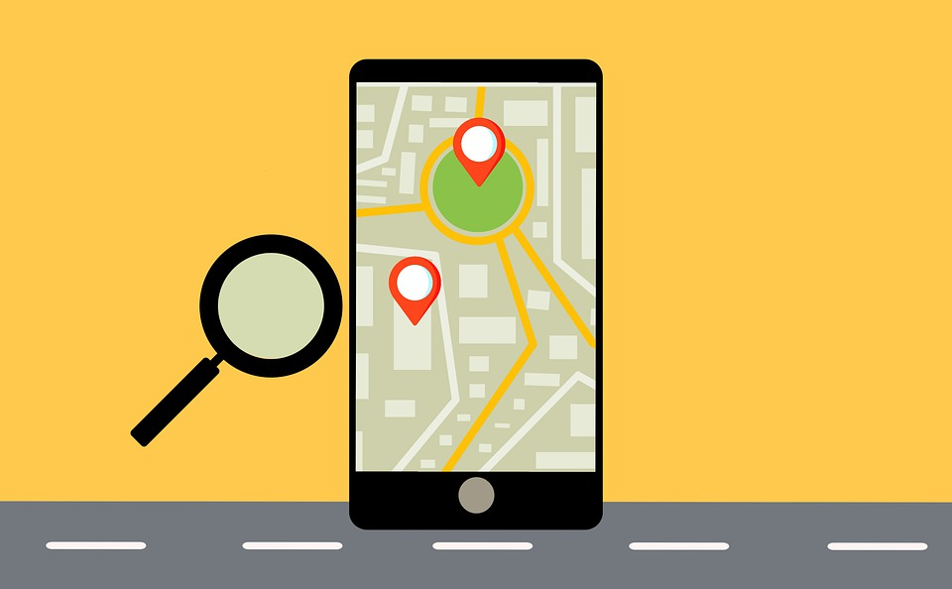
New problem: POI-level cellular trajectory reconstruction
Goal: Estimating truly visited point-of-interests(POIs) from a cellular trajectory
Challenges
1. Each user has a complex POI visiting pattern
→ How to capture the complex POI visiting patterns?
2. Low spatial resolution of a cellular trajectory
→ How to conduct fine-grained POI estimation?
⇒ Proposed Method: Pincette
It comprises multi-view feature extraction and GCN-LSTM-based POI estimation
Notes:
To pursue fine-grained contact tracing of the infectious disease, the reconstruction should configure the point-of-interest (POI) where users stay together with others.
In this paper, we first present a new problem, named “POI-level cellular trajectory reconstruction”, which aims to estimate truly visited POIs from a cellular trajectory.
We tried to configure the point-of-interest(POI) where users stay together with others, because the infectious disease spreads primarily by indoor transmission.
However, there are two main challenges for this problem.
First, each user has a complex POI visiting pattern.
Second, the coarse-grained positioning ability of a cellular trajectory makes dozens of POI candidates.
To precisely capture the complex POI visiting pattern and conduct fine-grained POI estimation, we propose a novel framework, named Pincette.
Pincette comprises multi-view feature extraction and GCN-LSTM-based POI estimation by leveraging various external data including road networks, public transport routes, and POI contexts.

Slide 6
Intuition of Pincette
Multi-view feature extraction
Efficiency-view: People tend to take the most efficient path when they visit POIs
Periodicity-view: People have spatio-temporal periodic patterns when they visit POIs
Popularity-view: People tend to visit popular POIs more often than unpopular ones
Notes:
Pincette leverages the complementary information between the three multi-view features: efficiency-view, periodicity-view and popularity view
Suppose that a user visits a food area to eat dinner at 6 pm after leaving Office before going back home.
In this situation, POI-level cellular trajectory reconstruction means finding visited POI among places in cell connection range.
In the efficiency-view,
People tend to take the most efficient path when they visit POIs
So, the user may not visit p1 since his cellular trajectory is not efficient to get to p1.
We utilized features such as transportation mode and some distances.
In the periodicity-view,
People have spatio-temporal periodic patterns when they visit POIs
So, the user may not visit p2 since it is an office and thus out of periodicity.
#We utilized features such as Industry-type frequency vector of a cell.
In the popularity-view,
People tend to visit popular POIs
Since p4 is more popular than p3, the user probably visits p4.
#We utilized features such as size, ratings and number of comments
Pincette receives those three multi-view features as inputs

Slide 7
Architecture of Pincette
It comprises
Multi-view feature extraction
GCN-LSTM-based POI estimation
Spatial encoder(SE)
Temporal encoder(TE)
Visit estimator(VE)
Loss function for training
Binary cross entropy(BCE)
Notes:
Then, it conduct the GCN-LSTM-based POI estimation to predict the score of a user visiting each POI in a stay cell.
The GCN-LSTM-based model consists of spatial encoder, temporal encoder, and visit estimator.
spatial encoder and temporal encoder capture complex spatio-temporal periodic patterns from the periodicity-view feature
The spatial encoder is a GCN-based encoder, which aggregates the spatial movement patterns of users across cells.
In the GCN, a node refers to a cell, and an edge indicates the adjacency between two cells.
The temporal encoder is a Bi-LSTM-based encoder, which captures the periodic POI visit patterns of users.
And then, ‘visit estimator’ aggregates all multi-view features and makes the final prediction.
We adopt the binary cross entropy (BCE) loss to train pincette, because the target variable is binary.

Slide 8
Experiments: Data Collection
Region I. Beijing (in China)
GeoLife : GPS trajectory dataset (17,621 trajectories of 182 users)
OpenCellID : GPS coordinates and location IDs of cell towers in the world.
OpenStreetMap : Road network, bus and subway route, locations and size of the buildings.
BaiduMaps : locations, industry types, ratings, and comment counts of the POIs
Region II. Chania (in Greece)
MySignals : Cellular trajectory dataset with mapped GPS coordinates.
OpenStreetMap : Road network, bus and subway route, locations and size of the buildings.
GoogleMaps : locations, industry types, ratings, and comment counts of the POIs.
Notes:
To validate our proposed methodology, we conducted in two region, Beijing and Chania.
Each data collection contains human mobility (i.e.,trajectories), cell-tower information, POI information, and road network and public transport networks.

Slide 9
Results
On two real data collections of two cities,
Pincette outperforms baselines by up to 21.20% in Beijing
Pincette outperforms baselines by up to 14.62% in Chania
TABLE. Overall accuracy comparison on two data collections
Notes:
Since our work is the first attempt to reconstruct the cellular trajectories at POI-level, there exists no previous algorithm that can be naturally employed in our problem.
For comparison, we evaluated two heuristic rule-based POI estimation algorithms, RULE^E, RULE^P and two Markov-based model MTM and Cellsim+.
Also, we used four commonly-used ranking accuracy metrics
(Precision, Recall, F1-score and normalized discounted cumulative gain)
For each data collection, our proposed method improved the accuracy of baseline algorithms.
You can find the detail of baselines in our paper.

Slide 10
Conclusion
In this paper, we presented the POI-level cellular trajectory reconstruction problem that can significantly benefit digital contact tracing for preventing the spread of infectious diseases.
A novel algorithm, Pincette, is proposed to incorporate the efficiency, periodicity, and popularity aspects in a sophisticated way to predict the visited POIs from a coarse-grained cellular trajectory.
Overall, we believe that Pincette will promote the usability of cellular network data in digital contact tracing for ever-emerging infectious diseases.
Notes:
In conclusion, we presented the POI-level cellular trajectory reconstruction problem that can significantly benefit digital contact tracing for preventing the spread of infectious diseases.
Also we proposed a novel algorithm, Pincette, is proposed to incorporate the efficiency, periodicity, and popularity aspects in a sophisticated way to predict the visited POIs from a coarse-grained cellular trajectory.
we believe that Pincette will promote the usability of cellular network data in digital contact tracing for ever-emerging infectious diseases.

Slide 11
22nd IEEE International Conference on Data Mining, Nov. 28 – Dec. 1, 2022, Orlando, FL, USA
Thank You!
Notes:
This is the end of our presentation and Thank you for listening.

