Slide 1

Joins on Encoded and Partitioned Data
Jae-Gil Lee^{2*} Gopi Attaluri³ Ronald Barber¹ Naresh Chainani³ Oliver Draese³ Frederick Ho⁵ Stratos Idreos^{4*} Min-Soo Kim^{6*} Sam Lightstone³ Guy Lohman¹ Konstantinos Morfonios^{8*} Keshava Murthy^{10*}
Ippokratis Pandis^{7*} Lin Qiao^{9*} Vijayshankar Raman¹ Vincent Kulandai Samy³ Richard Sidle¹ Knut Stolze³ Liping Zhang³
¹IBM Almaden Research Center ²KAIST, Korea ³IBM Software Group
⁴Harvard University ⁵IBM Informix ⁶DGIST, Korea ⁷Cloudera ⁸Oracle ⁹LinkedIn ¹⁰MapR
* Work was done while the author was with IBM Almaden Research Center
VLDB 2014 Industrial Track

Slide 2
Table of Contents
Introduction
Partitioning Column Domains
Encoding Join Columns
Encoding Non-Join Columns
Experiment Results
Conclusions

Slide 3
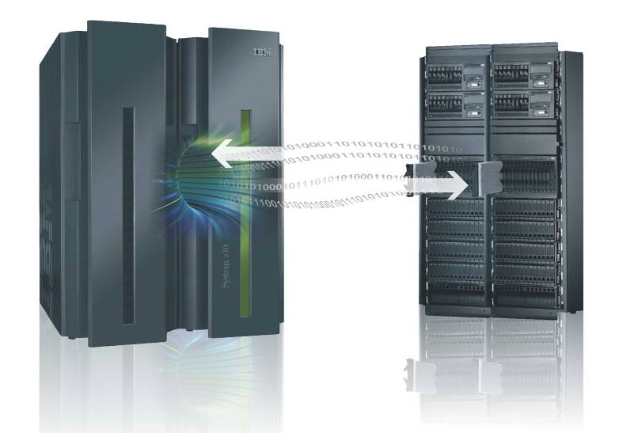
Blink Project
Accelerator technology developed by IBM Almaden Research Center since 2007
Main features
  Storing a compressed copy of
  a (portion of a) data warehouse
  Exploiting (i) large main memories,
  (ii) commodity multi-core processors,
  and (iii) proprietary compression
  Improving the performance of typical
  business intelligence(BI) SQL queries
  by 10 to 100 times
  Not requiring the tuning of indexes, materialized views, etc.
Products offered by IBM based upon Blink
  Informix Warehouse Accelerator: released on March 2011
  IBM Smart Analytics Optimizer for DB2 for z/OS V1.1
    A predecessor to today’s IBM DB2 Analytics Accelerator for DB2 for z/OS

Slide 4

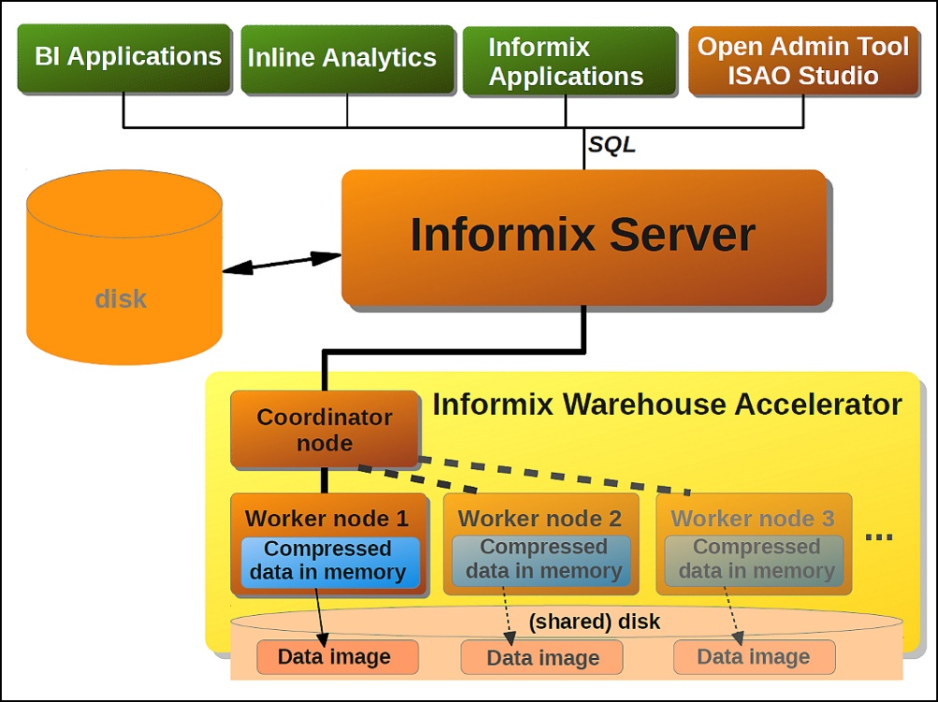
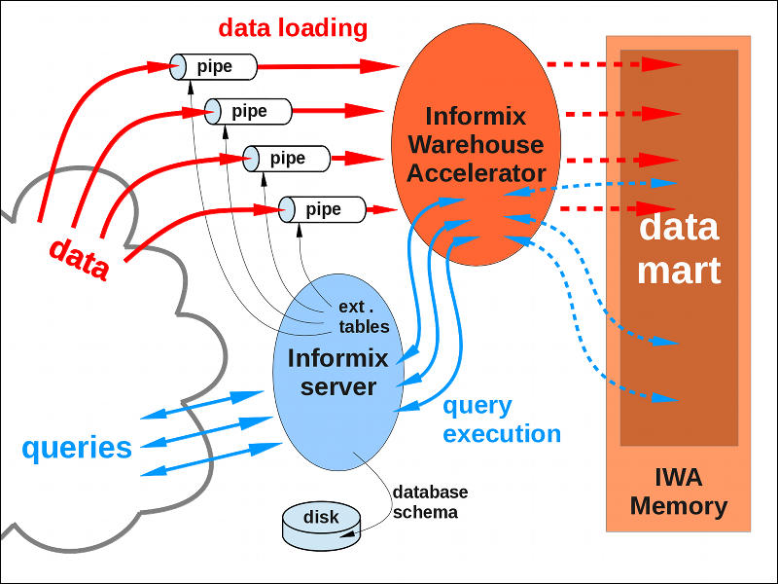
Informix Warehouse Accelerator(IWA)
A main-memory accelerator to the disk-based Informix database server product, packaged as the Informix Ultimate Warehouse Edition(IUWE)
System Architecture Data Loading and Query Execution

Slide 5
Main Features Related to Joins
Performing joins directly on encoded data
  Join method: hash joins
  Encoding method: dictionary encoding
Handling join columns encoded differently: encoding translation
Partitioning a column to support incremental updates and achieve better compression: frequency partitioning
Encoding non-join(payload) columns on the fly

Slide 6
Hash Joins
Build phase
  Scan each dimension table, applying local predicates
  Hash to an empty bucket in the hash table
  Store the values of join columns as well as “payload” columns
Probe phase
  Scan the fact table, applying local predicates
  Look up the hash table with the foreign key per dimension
  Retrieve the values of payload columns
Example
  A simple join query between
  LINEITEM and ORDERS
Fact
Group by, Aggregation
Dimension
Look up the values of O_OrderDate
Hash Table
O_OrderKey O_OrderDate
σ(L_OrderKey IN …)
σ(O_OrderDate …)
σ(L_ShipDate …)
scan(ORDERS)
scan(LINEITEM)

Slide 7
Dictionary Encoding
A value of a column is replaced by an encoded value requiring only a few bits
  Example
States
California
California
California
Alabama
California
Arizona
Arizona
…
States
000101
000101
000101
000001
000101
000011
000011
…
Alabama | 000001
Alaska | 000010
Arizona | 000011
Arkansas | 000100
California | 000101
Colorado | 000110
… | …
10bytes
6bits
Encoding
Dictionary

Slide 8
Table of Contents
Introduction
Partitioning Column Domains
Encoding Join Columns
Encoding Non-Join Columns
Experiment Results
Conclusions

Slide 9
Updates in Dictionary Encoding
Option 1: leaving room for future values
  Downside: overestimation of the number of future values will waste bits; underestimation will require re-encoding all values to add additional ones beyond the capacity
Option 2: partitioning the domain and creating separate dictionaries for each partition ⇒ our approach
  Upside: the impact of adding new values can be isolated from the dictionaries of any existing partitions
  New values are simply added to a partition that will be created on the fly, as values arrive
  We leave the values in that partition unencoded

Slide 10
Frequency Partitioning
Achieving better compression: approximate Huffman
Defining fixed-length codes within a partition
  Example
Sales
Column partitions
China, USA: 1bit
EU: 5bits
Rest: 8bits
1M, 100K, 10K occurrences
of each group
Frequency partitioning=
8bits for all countries=
vol | prod | origin
China
USA
GER,
FRA,
…
Rest
origin
Top 64
traded goods
–6 bit code
Cell 1
Cell 3
Cell 4
1.58Mbits
8.88Mbits
Rest
product
Cell 2
Cell 5
Cell 6

Slide 11
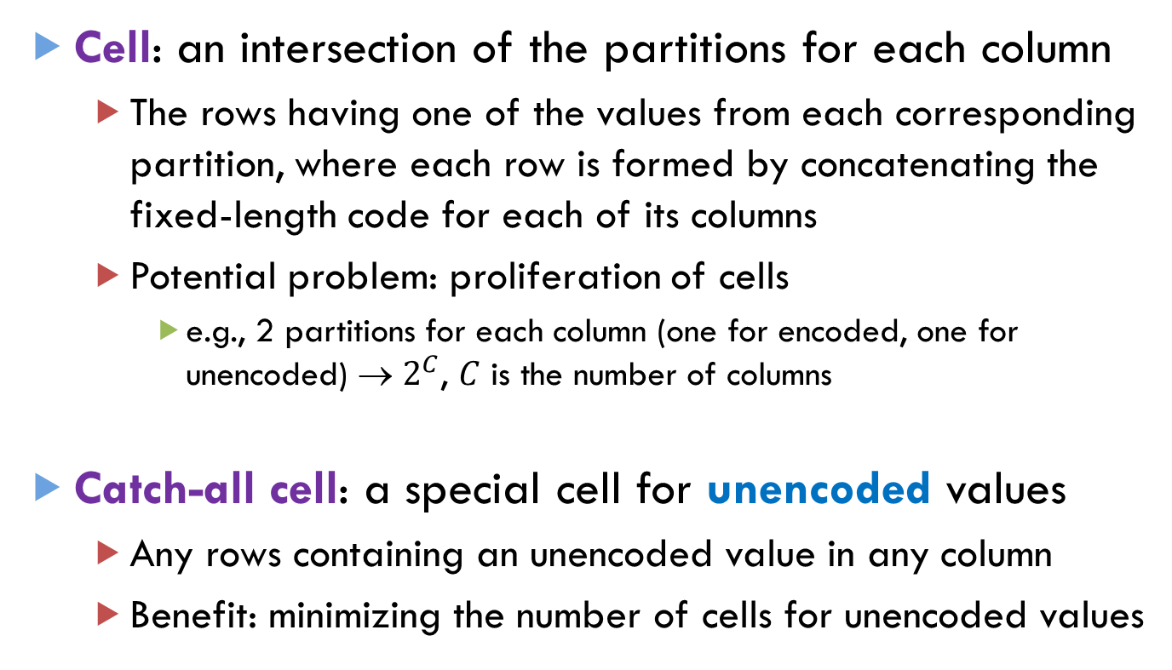
Catch-All Cell (1/2)
Cell: an intersection of the partitions for each column
  The rows having one of the values from each corresponding partition, where each row is formed by concatenating the fixed-length code for each of its columns
  Potential problem: proliferation of cells
    e.g., 2 partitions for each column (one for encoded, one for unencoded) → $2^{C}$, $C$ is the number of columns
Catch-all cell: a special cell for unencoded values
  Any rows containing an unencoded value in any column
  Benefit: minimizing the number of cells for unencoded values

Slide 12
Catch-All Cell (2/2)
  Example
    Containing the 5th and 6th rows in unencoded form
LINEITEM
Cell 0: K0 X D0
L_OrderKey L_ShipDate
L_OrderKey L_ShipDate
0
0
0
1
100
200
100
300
100
400
8/2/2010
9/4/2010
9/4/2010
8/2/2010
5/1/2010
8/2/2010
Cell 1: K1 X D0
Encoding
0
1
1
0
same value
Catch-All Cell
unencodable
100
400
5/1/2010
8/2/2010
Dictionary of LINEITEM
L_OrderKey
Partition K0: 100
Partition K1: 200 300
L_ShipDate
Partition D0: 8/2/2010 9/4/2010

Slide 13
Table of Contents
Introduction
Partitioning Column Domains
Encoding Join Columns
Encoding Non-Join Columns
Experiment Results
Conclusions

Slide 14

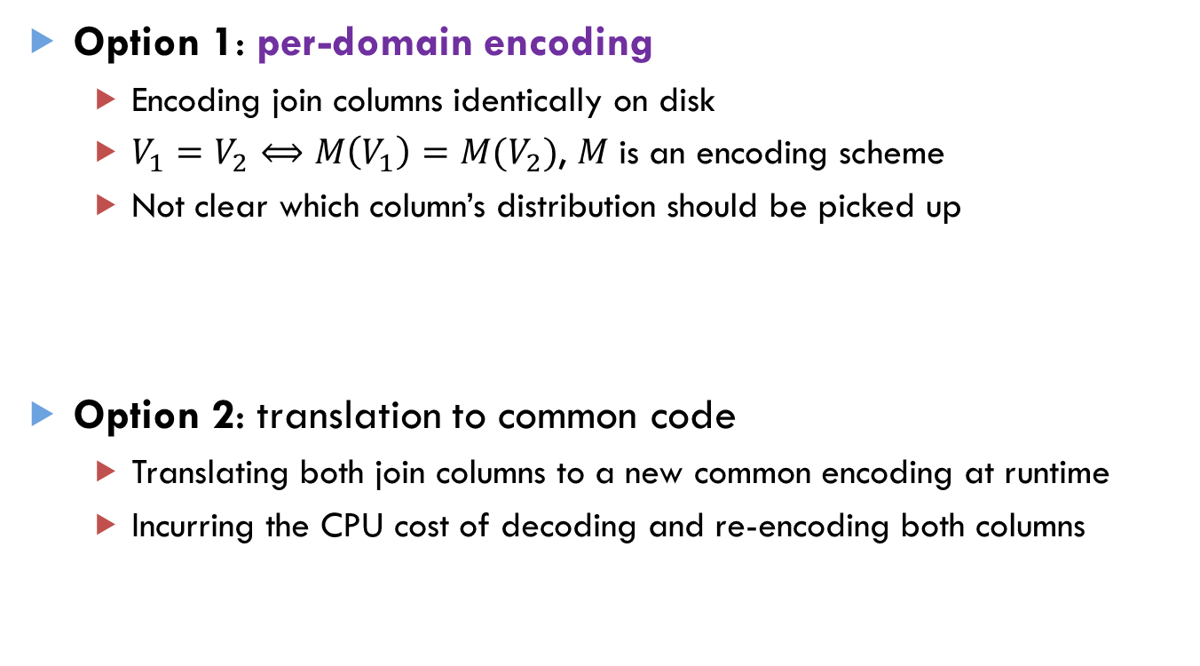


Joins on Encoded Values (1/2)
Option 1: per-domain encoding
  Encoding join columns identically on disk
  $V_{1}=V_{2}⟺M\left(V_{1}\right)=M(V_{2})$, $M$ is an encoding scheme
  Not clear which column’s distribution should be picked up
Option 2: translation to common code
  Translating both join columns to a new common encoding at runtime
  Incurring the CPU cost of decoding and re-encoding both columns
Encoded using the same scheme
$$⊳⊲$$
$$⊳⊲$$
$$⊳⊲$$

Slide 15

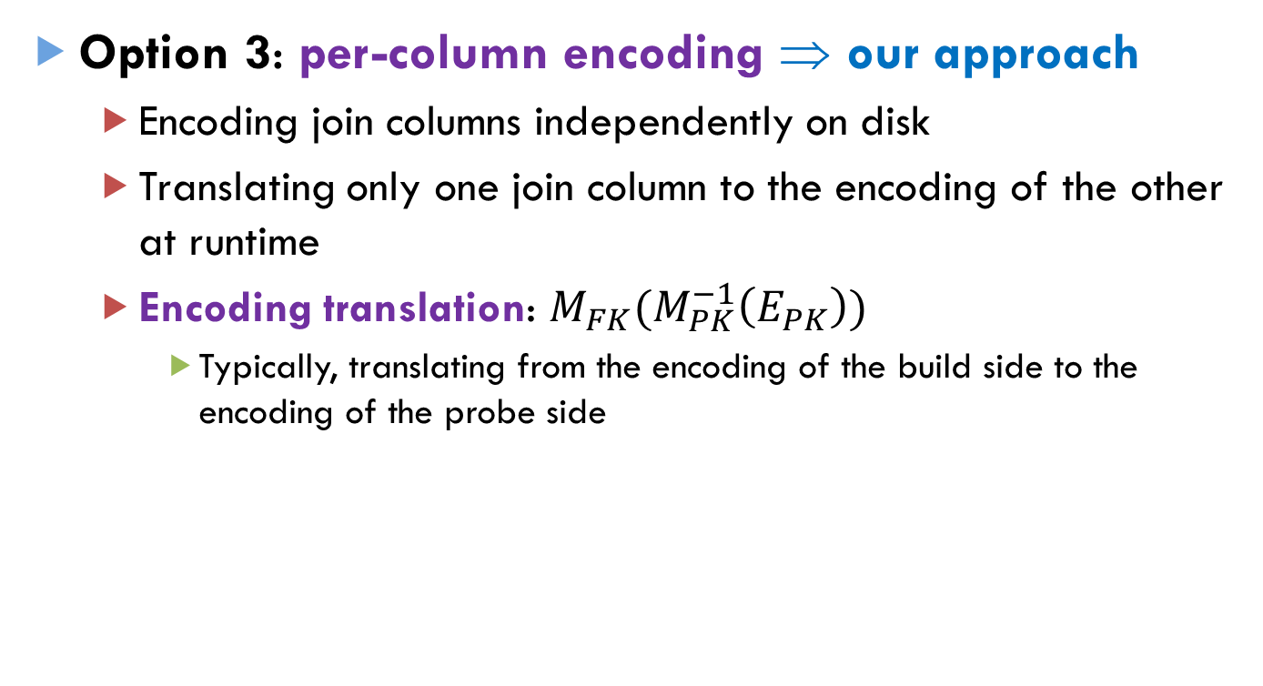

Joins on Encoded Values (2/2)
Option 3: per-column encoding ⇒ our approach
  Encoding join columns independently on disk
  Translating only one join column to the encoding of the other at runtime
  Encoding translation: $M_{FK}(M_{PK}^{−1}\left(E_{PK}\right))$
    Typically, translating from the encoding of the build side to the encoding of the probe side
build probe build probe
$$⊳⊲$$
$$⊳⊲$$
Encoding Translation

Slide 16
Advantages of Per-Column Encoding
Better compression
  The ideal encoding for one column may not be ideal for the other (see next page)
Flexible reorganization
  Any tables sharing a common dictionary are inextricably linked
Ad hoc querying
  Which columns might be joined in a query may not be known when the data is encoded

Slide 17
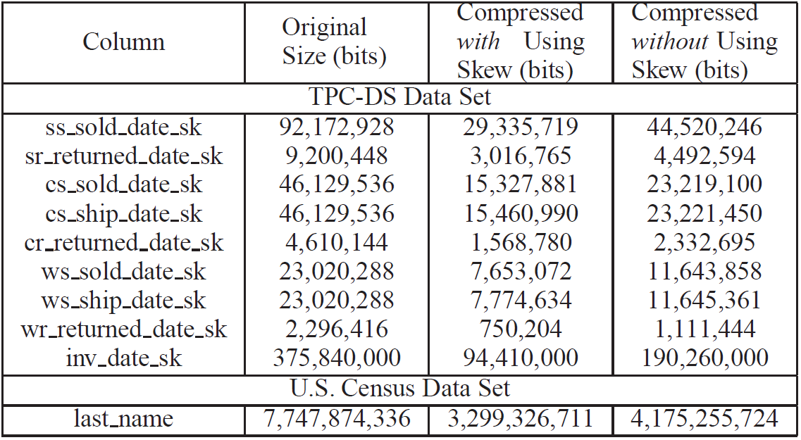
Better Compression of Skewed Data
per-column per-domain
33~50% gain
21% gain

Slide 18

Encoding Translation
Challenge
  Dealing with the multiple representations
  of the same value caused by the catch-all cell
    At least, one encoded and one unencoded
Two variants
  DTRANS(Dimension TRANSlation)
    Resolving the multiple representations in the dimension-table scan
    Reducing the overhead of the probe phase
  FTRANS(Fact TRANSlation)
    Resolving the multiple representations during the fact-table scan
    Reducing the overhead of the build phase

Slide 19
Encoding Translation: DTRANS
1 hash table per fact-table partition
ORDERS
O_OrderKey O_OrderStatus
HT[0] HT[1] HT[2]
100
200
300
400
500
"S"
"S"
"S"
"S"
"R"
0
0
1
100
200
300
400
Build Phase:
Probe Phase:
Hash Tables
Having all qualifying key values in unencoded form
Partition 0
0
0
HT[0] HT[1] HT[2]
Partition 1
0
0
1
100
200
300
400
0
1
Direct Probes
Catch-All Cell
Encodable
Unencodable
100
400
Hash Tables
Data

Slide 20
Encoding Translation: FTRANS
1 hash table per fact-table partition
ORDERS
O_OrderKey O_OrderStatus
HT[0] HT[1] HT[2]
100
200
300
400
500
"S"
"S"
"S"
"S"
"R"
0
0
1
400
Build Phase:
Probe Phase:
Hash Tables
Having only unencodable key values
Partition 0
0
0
HT[0] HT[1] HT[2]
Partition 1
0
0
1
400
0
1
Catch-All Cell
Encodable
Unencodable
Encoding
100
400
0
Fail: 400
Hash Tables
Data
Testing encodability

Slide 21
Table of Contents
Introduction
Partitioning Column Domains
Encoding Join Columns
Encoding Non-Join Columns
Experiment Results
Conclusions

Slide 22
On-the-Fly(OTF) Encoding (1/2)
Reasons for encoding payload columns
  The join key is usually just an integer, whereas the payloads are often wider strings → higher impact of compression
Benefits of the on-the-fly(OTF) encoding
  Updates: a mixture of encoded and unencoded payloads are hard to maintain using hash tables
  Expressions: the results of an expression, e.g., MONTH(ShipDate), can be encoded very compactly
  Correlation: correlated columns in a query, e.g., City, State, ZIPCode, and Country, can be used to create a tighter code
  Predicates: local/join predicates will likely reduce the cardinality of each column, allowing a more compact representation

Slide 23
On-the-Fly(OTF) Encoding (2/2)
Mechanism
  Use a mapping table that consists of a list of hash tables
  Return an index into the bucket where the value was inserted → an OTF code
    The OTF code is not changed, even if the hash table is resized
  Example
    600+1024+2048+40=3712
Size:
4096
Size:
2048
40
value
Size:
600
Size:
1024
Original Dictionary
Hash Tables

Slide 24
Table of Contents
Introduction
Partitioning Column Domains
Encoding Join Columns
Encoding Non-Join Columns
Experiment Results
Conclusions

Slide 25



Experimental Setting
Five alternative configurations
Data set and queries: a simplified TPC-H data set and queries
Measure: time for (i) build phase, (ii) probe phase, and (iii) scan
Name | Description
DTRANS | Encoding translation during dimension query processing
FTRANS | Encoding translation during fact query processing
DECODE | Run-time decoding before joining
1DICT | Per-domain encoding, i.e., using only one dictionary without encoding translation
UNENCODED | No encoding at all
$$t_{build}$$
$$t_{probe}$$
$$t_{base}$$

Slide 26
Per-Domain vs. Per-Column
DTRANS(per-column) outperforms:
DECODE in query performance
1DICT(per-domain) in compression ratio

Slide 27
When Does DTRANS Win?
DTRANS outperforms FTRANS when:
Dimension tables are small , OR
High ratio of rows are left unencoded
wall clock time (sec)
Varying the dimension size Varying the ratio of unencoded rows

Slide 28
Summary of the Results
DTRANS or FTRANS outperform traditional DECODE for most cases by up to 40% of query performance
DTRANS or FTRANS improve the compression ratio by at least 16%(or up to 50% in skewed data), with negligible overhead in query processing, in comparison with having one dictionary for both join columns(1DICT)
DTRANS is preferred when dimension tables are small
FTRANS is preferred when a fact table is small or local predicates on a fact table are very selective
DTRANS is preferred when high ratio of unencoded rows

Slide 29
Table of Contents
Introduction
Partitioning Column Domains
Encoding Join Columns
Encoding Non-Join Columns
Experiment Results
Conclusions

Slide 30
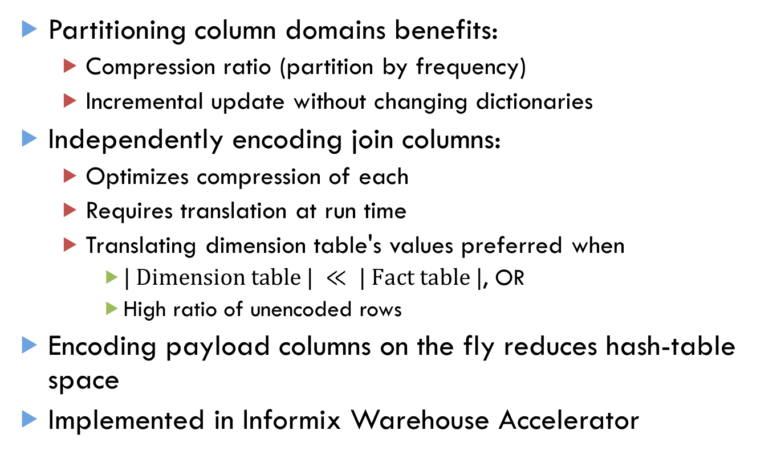
Conclusions
Partitioning column domains benefits:
  Compression ratio (partition by frequency)
  Incremental update without changing dictionaries
Independently encoding join columns:
  Optimizes compression of each
  Requires translation at run time
  Translating dimension table's values preferred when
    $| Dimension table | ≪ | Fact table |$, OR
    High ratio of unencoded rows
Encoding payload columns on the fly reduces hash-table space
Implemented in Informix Warehouse Accelerator

Slide 31
Blink Refereed Publications
Jae-Gil Lee et al.: Joins on Encoded and Partitioned Data. PVLDB 7(13): 1355-1366 (2014)
Vijayshankar Raman et al.: DB2 with BLU Acceleration: So Much More than Just a Column Store. PVLDB 6(11): 1080-1091 (2013)
Lin Qiao, Vijayshankar Raman, Frederick Reiss, Peter J. Haas, Guy M. Lohman: Main-memory scan sharing for multi-core CPUs. PVLDB 1(1): 610-621 (2008)
Ryan Johnson, Vijayshankar Raman, Richard Sidle, Garret Swart: Row-wise parallel predicate evaluation. PVLDB 1(1): 622-634 (2008)
Vijayshankar Raman, Garret Swart, Lin Qiao, Frederick Reiss, Vijay Dialani, Donald Kossmann, Inderpal Narang, Richard Sidle: Constant-Time Query Processing. ICDE 2008: 60-69
Allison L. Holloway, Vijayshankar Raman, Garret Swart, David J. DeWitt: How to barter bits for chronons: compression and bandwidth trade offs for database scans. SIGMOD Conference 2007: 389-400
Vijayshankar Raman, Garret Swart: How to Wring a Table Dry: Entropy Compression of Relations and Querying of Compressed Relations. VLDB 2006: 858-869

Slide 32
Thank You!
Any Questions?

