Slide 1
CIKM (Full Research Paper)
Carpe diem: Seize the Samples “at the Moment” for Adaptive Batch Selection
Hwanjun Song (PhD Student, KAIST), Minseok Kim (KAIST), Sundong Kim (IBS), and Jae-Gil Lee (KAIST)

Slide 2
Introduction

Slide 3
Training Deep Neural Networks
Stochastic Gradient Descent (SGD) with mini-batch
“Randomly select mini-batch samples”
Mini-Batch $B_{t}$
Training Data $𝒟$
Default update rule for classification
$$Θ_{t+1}=Θ_{t}−η\sum_{\left(x,y\right)∈B_{t} }{ℒ\left(f\left(x;Θ_{t}\right);y\right)}$$
$$x:data feature, y:data label$$
Empirical risk (or loss) on mini-batch
3

Slide 4
Difficult-based Selection
Preferring easy samples
Selecting small-loss training samples with high probability
(Pros) Achieving a more accurate and robust network when outliers or noisy labels exist
(Cons) Slowing down the training by causing small gradients
Preferring hard samples
Emphasizing large-loss training samples with high probability
(Pros) Accelerating the training convergence of SGD
(Cons) Resulting in poor generalization on test data by exacerbating the overfitting issue
Two opposing difficulty-based methods work well in different situation $→$ Need to cover all the scenarios for practicality
4

Slide 5
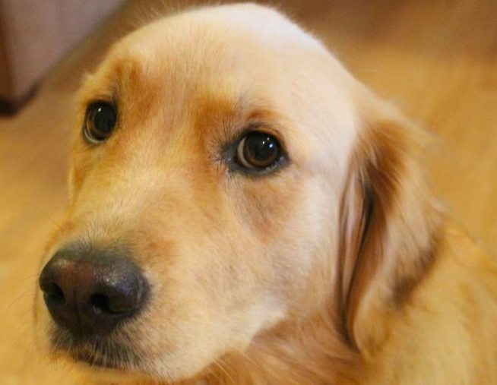
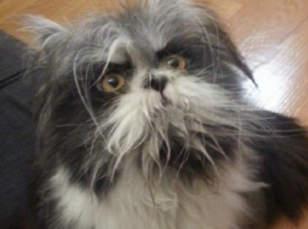
Uncertainty-based Selection
Preferring uncertain samples whose previous predictions were inconsistent
A recent approach: Active Bias [NIPS’17]
Historical predictions (e.g., predicted label or softmax prob. of target label)
Selection
Prob.
$$t_{1}$$
$$t_{2}$$
$$t_{3}$$
$$t_{4}$$
$$t_{5}$$
dog
dog
dog
dog
dog
Certain
Dog
Consistent predictions
$$t_{1}$$
$$t_{2}$$
$$t_{3}$$
$$t_{4}$$
$$t_{5}$$
cat
dog
cat
dog
cat
Uncertain
Cat-like dog
Inconsistent predictions
5

Slide 6
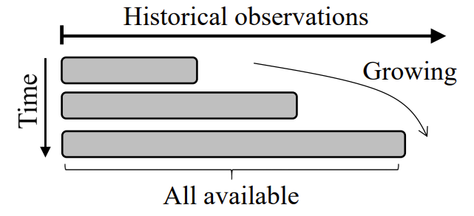
Limitation of Active Bias
Growing window scheme in Active Bias
Estimate uncertainty for the entire history of past predictions
But, older predictions could be outdated
Misclassification due to the outdated predictions
Sample
Uncertainty
Method
High
Active Bias
High
Active Bias slows down the training by emphasizing uninformative samples, too easy or too hard, at the moment
6

Slide 7
Goal of Paper
Method | Fast training | Better generalization
Preferring easy samples | X | O
Preferring hard samples | O | X
Preferring uncertain samples with growing window | X | O
Recency Bias | O | O
Not only (1) accelerate the training speed and but also (2) improve the generalizability of the model
7

Slide 8
Key Idea of Recency Bias
Emphasizing only the samples recently uncertain by using a sliding window
Sample
Uncertainty
Method
Low
Recency Bias
Low
Challenge 1 (C1)
Criterion to evaluate the samples uncertain at the current moment
Challenge 2 (C2)
Computing the sampling probability based on the uncertainty
8

Slide 9
C1: Uncertainty Criterion
Samples are determined to be truly uncertain when their recent label predictions are highly inconsistent
Predictive uncertainty
Manage a sliding window that stores the predicted labels at the previous $q$ epochs
Use empirical entropy to quantify the sample uncertainty for the predictions in the current sliding window
Previous predictions
…
cat
dog
cat
dog
dog
Cat-like dog
Current sliding window $ℋ$
$U\left(x\right)=−\sum_{y∈\left\{dog, cat\right\}}{p\left(y | x\right)\log{p\left(y | x\right)}}$.
$$P\left(dog | x\right)=3/4$$
$$P\left(cat | x\right)=1/4$$
Empirical Entropy
9

Slide 10
C2: Sampling Probability
Quantizing the uncertainty $U(x)$ into the integer index (0< Index < N; less than the number of samples)
Exponentially decaying with the quantized index (Adopted from Online Batch Selection [ICLR’16])
Step Size:
High
Uncertainty
$$…$$
Low
Uncertainty
Quantized Index
$$0$$
$$1$$
$$2$$
$$3$$
$$4$$
$$5$$
$$6$$
$$…$$
$$N−2$$
$$N−1$$
Exponential decaying factor
Quantized Index
Normalization Term
10

Slide 11
Decaying Selection Pressure
Highlighting only some part of training data exacerbates the overfitting problem at a late stage of training
Decaying the selection pressure $s_{e}$($≥$1) to include more training samples as the training progresses
The pressure affects the probability gap between the most and the least uncertain samples
Adaptive sampling when $s_{e}$>1, but random sampling $s_{e}$=1
11

Slide 12
Experimental Configuration
Trained DenseNet for the two independent tasks (1) image classification and (2) fine tuning
Used five benchmark datasets for the two tasks
Classification: MNIST, CIFAR-10, and CIFAR-100
Fine tuning: MIT-67 and FOOD-100
Compared four batch selection algorithms
Random Batch (Baseline)
Online Batch: Hardness-based method
Active Bias: Uncertainty-based method using a growing window
Recency Bias (Ours): Uncertainty-based using a sliding window
12

Slide 13
Task I: Image Classification
Convergence curves of training loss (training speed)
Convergence curves of test error (generalization)
Slowing down
Slowing down
Slowing down
13

Slide 14
Task II: Fine Tuning
Results on test error
Recency Bias reduced the test error by 2.88% and 1.81% in MIT-64 and Food-101, respectively
Results on training time (taken to reach the same error)
Recency Bias improved the training time by 24.57% and 26.13% in MIT-64 and Food-101, respectively
14

Slide 15
Conclusions
Existing methods did not support both (1) fast training and (2) better generalization
We proposed Recency Bias, which supports both of them by emphasizing predictively uncertain samples
Uncertain samples at the moment are selected with high probability for the next mini-batch
Recency Bias indeed accelerated the training speed while achieving better generalization
15

Slide 16
Thank you

