Slide 1
AAAI 2021 | Virtual Conference
PREMERE: Meta-Reweighting via Self-Ensembling for Point-of-Interest Recommendation
Minseok Kim, Hwanjun Song, Doyoung Kim, Kijung Shin, Jae-Gil Lee KAIST, Korea

Slide 2
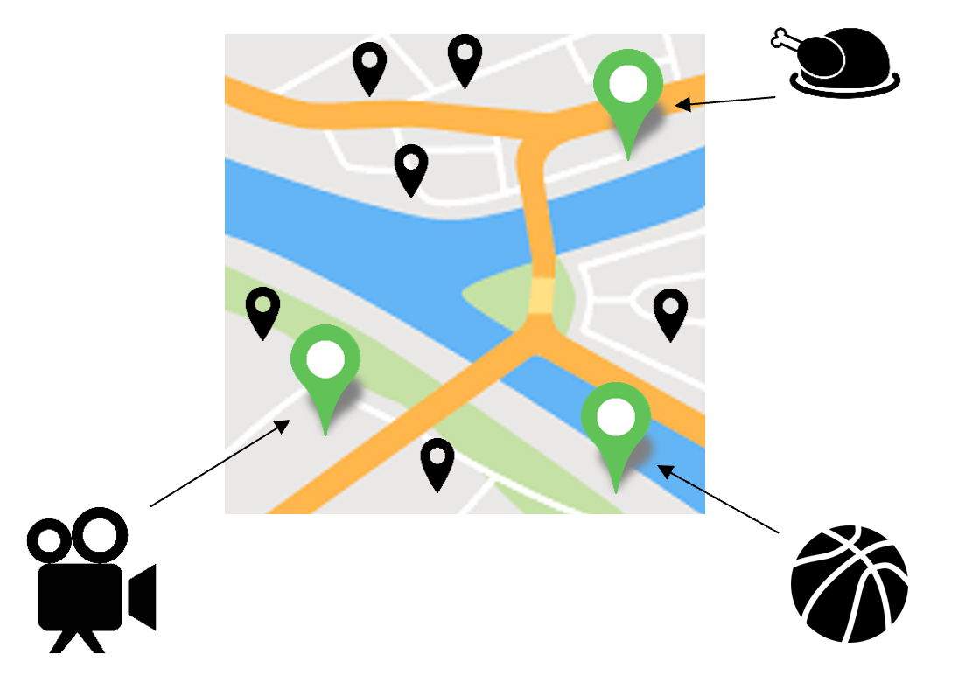
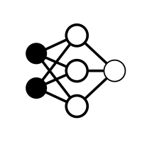
Point-of-Interest Recommendation
Given user-related information, a point-of-interest (POI) recommender system
suggests POIs that a user likes to visit
Where to visit next?
User-related info
Recommender
Visit suggestions

Slide 3
Real-world POI Recommendations
POI recommendation usages
Real-world service providers

Slide 4
Motivation: Missing User Check-in
A recommender needs to know visited places to catch users’ interest
However, users leave only a few check-ins, and often forget or skip check-ins
$→$ The recommender learns incorrect user preference on unvisited POIs,
as the recommender does not know whether the user visited the POI
Scarce!
Case 1.
Visit & check-in
Recommender
System
Visit POI
Record check-in
Visited
Server
Noisy!
Case 2.
Visit, no check-in
Recommender
System
Visit POI
But skip check-in
Unvisited? Visited?
Server
Case 3.
No visit, no check-in
Recommender
System
No visit
No check-in
Unvisited? Visited?
Server

Slide 5
Previous Studies & Limitations
Previous studies learn more or less of the sample via sample reweighting But its fixed design does not address different characteristics of users/POIs
Meta-learning approach was introduced in training image classifiers where they require meta-data (i.e., unbiased clean validation set) which is hard to obtain in recommender systems
$→$ Our intuition: adaptive sample weighting without meta-data

Slide 6
Meta-Data Generation Idea
Ground Truth
Train Label
Meta Label
User Visit?
3. Update $θ$
Noise
$$⋯$$
$$θ_{t}$$
$$θ_{t+1}$$
$$⋯$$
Meta-model ($θ$)
1. Update $w$
$$⋯$$
$$w_{t−1}$$
$$w_{t}$$
$$⋯$$
Recommender ($w$)
Recommender Prediction
$$⋯$$
Consistent!
2. Self-Supervision
$$t−q$$
$$t−1$$
$$t$$
Figure: PREMERE Idea

Slide 7
Meta-Model Structure
The meta-model receives various contexts and a recommender’s loss and decides sample weight according to whether a user visited a POI
s
Positive Sample Weight $z^{(p)}$
Data
FC Layer
True
$$Θ^{(p)}$$
Context
$$⋮$$
X=
Negative Sample Weight $z^{(n)}$
s
Learning
Degree$z^{(l)}$
False
s
$$+$$
Sample Weight
Loss
$$Θ^{(l)}$$
Positive?
$$Θ^{(n)}$$
Figure: Meta-Model PREMERE-Net Architecture

Slide 8
Meta-Model Inputs
User/POI context
User visit entropy: concentration of user visits
Geographical similarity: visit likelihood in the location perspective
Temporal similarity: visit likelihood in the time perspective
Check-in count
Recommender’s loss

Slide 9
Model Update Procedure
Meta-Model Update
Recommender Update
Recommender
Meta-Model
Step 1.
$$t$$
$$R(w_{t})$$
$${Loss}_{train}∙f(I_{x};Θ_{t})$$
$$R(\tilde{w})$$
$${Loss}_{meta}$$
$${Loss}_{train}∙f(I_{x};Θ_{t+1})$$
Step 2.
Step 3.
$$t+1$$
$$R(w_{t+1})$$
$${Loss}_{train}∙f(I_{x};Θ_{t+1})$$
$$R(\tilde{w})$$
$${Loss}_{meta}$$
$${Loss}_{train}∙f(I_{x};Θ_{t+2})$$
$$⋮$$
$$⋮$$
$$⋮$$

Slide 10
Baseline Algorithms
4 deep neural network based algorithms
CDAE [ICWSM’ 16] + Heuristic Rule, PREMERE
PACE [KDD’ 17]
SAE-NAD [CIKM’ 18] + Heuristic Rule, PREMERE
APOIR [WWW’ 19]
7 conventional machine learning based algorithms

Slide 11
Evaluation Settings
3 metrics: precision, recall, mean average precision (MAP)
Evaluate each metric with top 5, 10, 20, 50 recommendation result
3 real-world datasets
Randomly select 80% as train data, and 20% as test data
Exclude users and POIs having few check-ins
Table: Dataset Descriptions

Slide 12
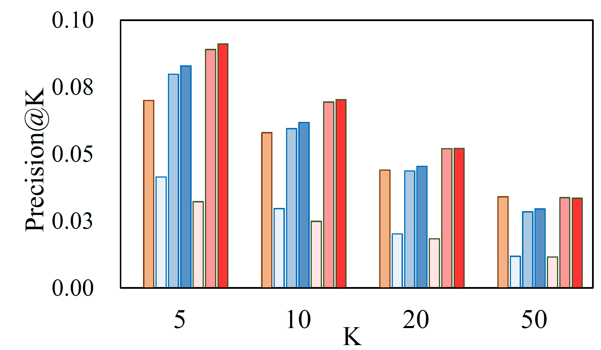
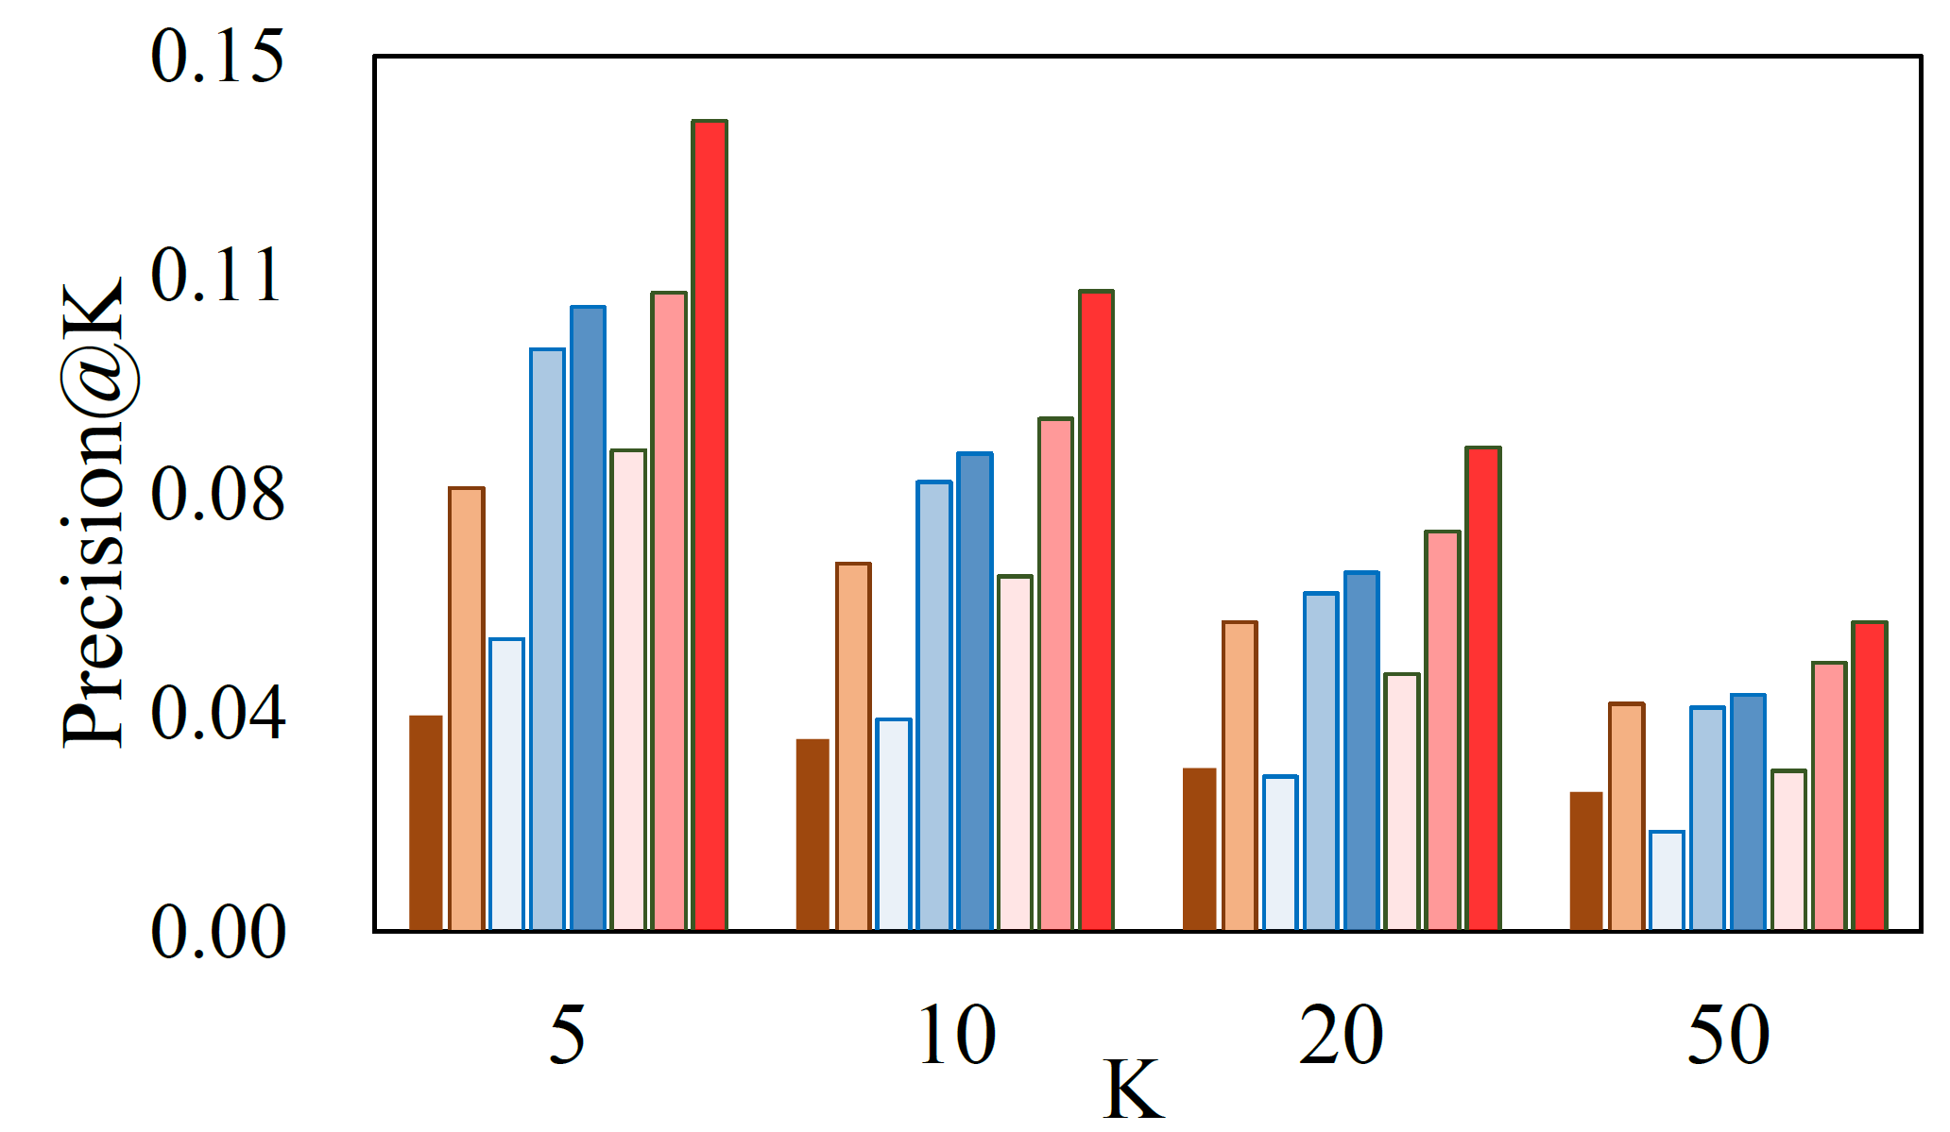
Evaluation Results - Precision
Premere provides 2.36 ~ 26.9% performance improvement in Precision@5
2.36% Improved
26.9% Improved
Precision@K result on Foursquare Dataset
Precision@K result on Gowalla Dataset

Slide 13
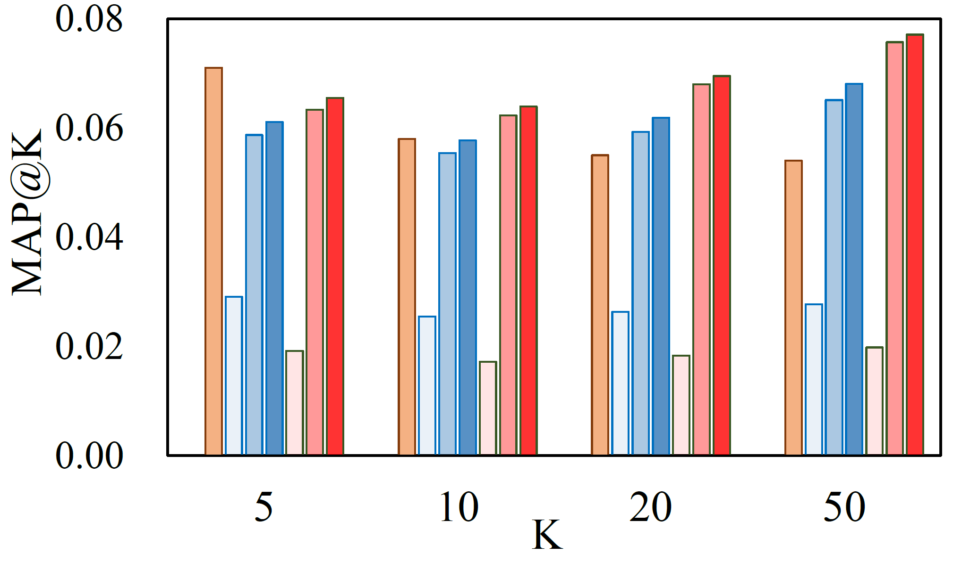
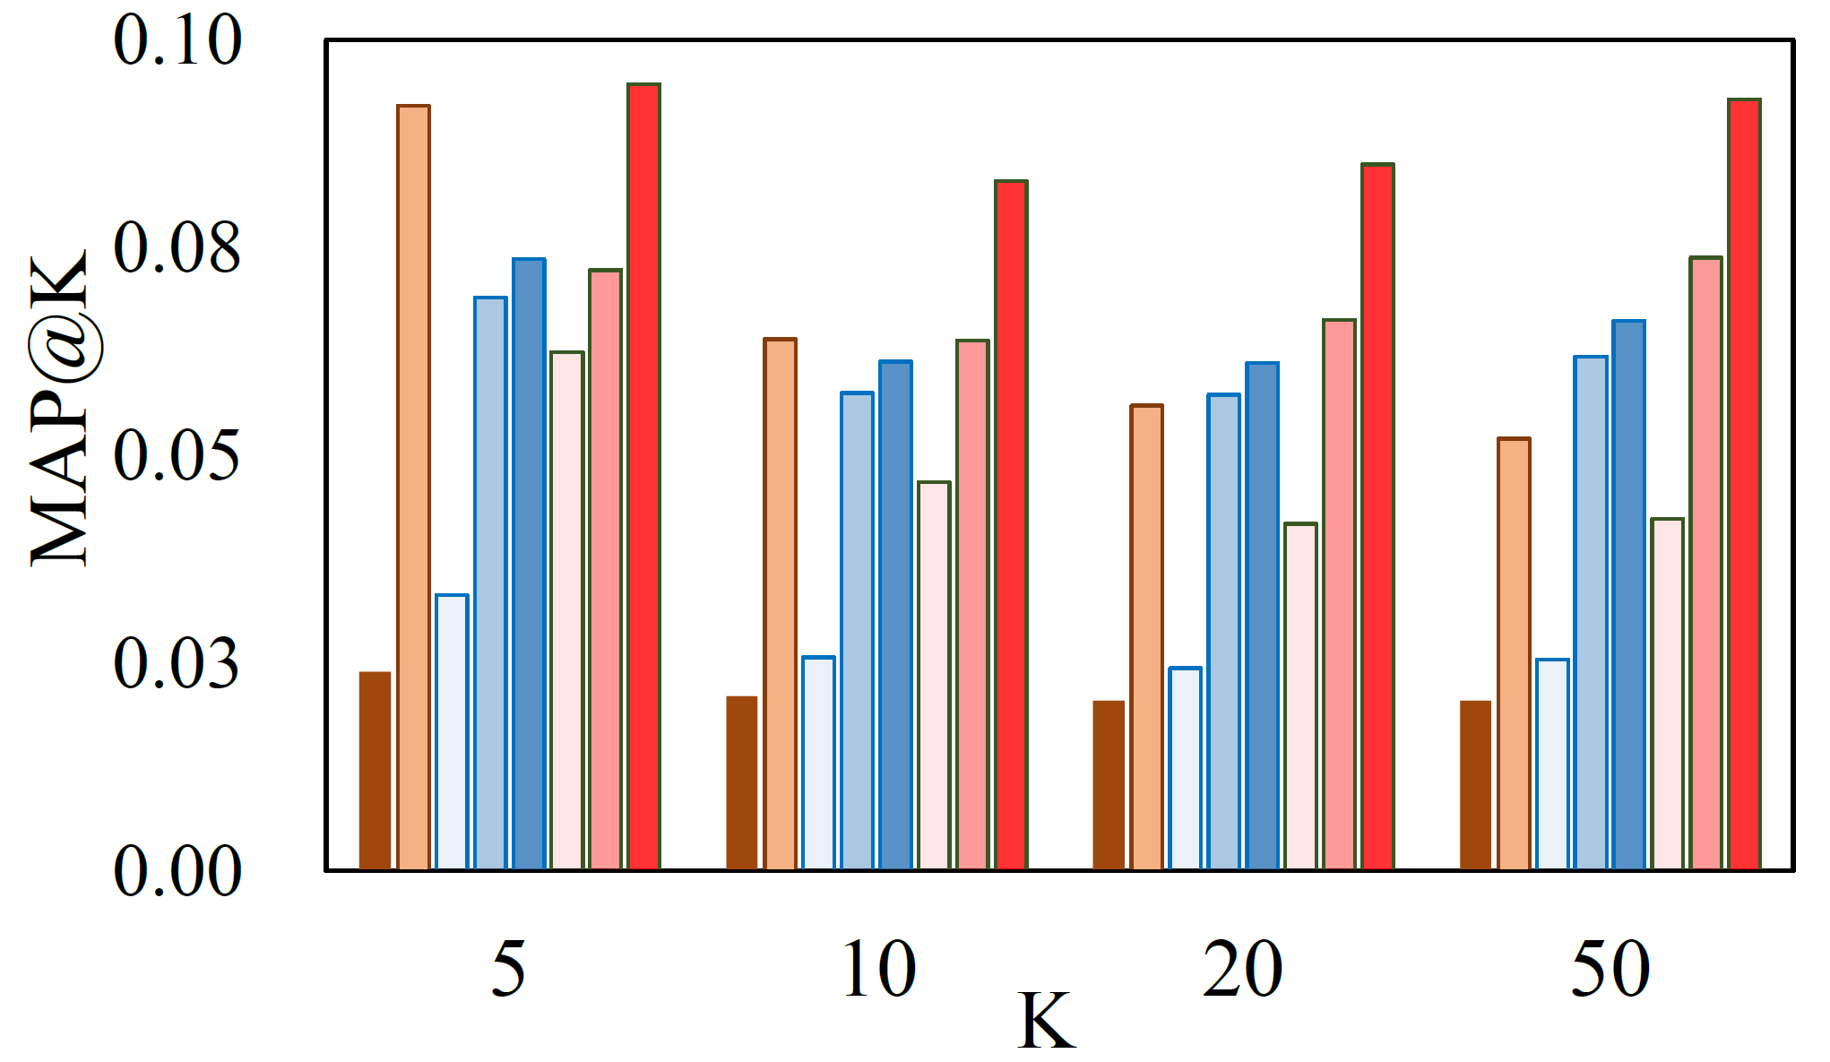
Evaluation Results - MAP
Premere also provides performance improvement as seen in other metrics
MAP@K result on Foursquare Dataset
MAP@K result on Gowalla Dataset

Slide 14
Conclusion
PREMERE address the sparse & missing check-in in POI recommendation which are critical problems for training a model to understand user interest To this end, we suggest PREMERE with two key components
Self-ensemble based meta-data generation
PREMERE-Net for sample reweighting
Extensive experiment results support the effectiveness of PREMERE

