Slide 1

Label Adaptation
August 5 & 08:00-10:00

Slide 3



Mitigating Source Label Dependency
in Time-Series Domain Adaptation
under Label Shifts
RESEARCH
TRACK
Jihye Na, Youngeun Nam, Junhyeok Kang, Jae-Gil Lee*
Presenter: Jihye Na
Notes:
Good morning, everyone. Today, I'll present our research titled "Mitigating Source Label Dependency in Time-Series Domain Adaptation under Label Shifts". My name is Jihye Na.
---------------------------------------------------------------------------------------------------------------------
Rtfb0764
https://kdd2025.kdd.org/author-presentation-instructions/
Each author receives 15 minutes for their presentation and 5 minutes for Q&A and transition – 20 minutes in total.

Slide 4
1. Introduction
2. Method
3. Experiments
4. Case Study
5. Conclusion
OVERVIEW
Notes:
This is today’s contents.
---------------------------------------------------------------------------------------------------------------------
Rtfb0764
https://kdd2025.kdd.org/author-presentation-instructions/
Each author receives 15 minutes for their presentation and 5 minutes for Q&A and transition – 20 minutes in total.

Slide 5


Time-series Domain Adaptation under Label Shifts
Time-series Domain Adaptation (TS-UDA) is a type of transfer learning that leverages labeled data from a source domain to train models on unlabeled data from a target domain in time-series.
In TS-UDA, domain-specific behaviors lead to different label distributions.
🏋️
Source domain
: physically active employee
👨‍💼
Target domain
: sedentary office worker
Label
Distribution
Label
Distribution
🏃‍♂️
🏃‍♂️
VS
🏃‍♂️
🏃‍♂️
Source
Time-Series
Target
Time-Series
Introduction
Notes:
Time-Series Unsupervised Domain Adaptation (TS-UDA) leverages labeled data from a source domain to adapt to unlabeled data in a target domain. However, the challenge arises due to domain-specific behaviors causing different label distributions between domains.
For example, in human activity data, a sedentary office worker mostly sits, while a physically active employee mostly runs.

Slide 6




Limitation of Previous Works
Reliance on source labels skews the predicted target label distribution toward the source label distribution.
Previous Works
: Source + Target Refinement
Misclassified
Source samples
Target samples
Feature
Space
$$c_{0}$$
Source Classifier
$$c_{1}$$
Cluster Boundary
Cluster $C_{0}$
Cluster $C_{1}$
~
~
← Despite the circle class having a greater proportion than the triangle class in the target domain, both classes could be erroneously predicted as having equal proportions by those existing studies.
Label
Distribution
True Source
Predicted Target
True Target
Introduction
Notes:
Traditional methods typically rely heavily on source labels, skewing the predicted target label distribution toward the source distribution. This dependence limits the performance, especially under significant label shifts.

Slide 7




Key Idea 1. Target-only Information
Alleviating dependency on source labels by leveraging target-only information is indeed crucial.
However, in TS-UDA settings, there is no target label information to refine initial predicted target labels.
Previous Works
: Source + Target Refinement
TA4LS (OURS)
: Target-only Refinement
Misclassified
Feature
Space
$$c_{1}$$
Refine
$$c_{1}$$
$$c_{0}$$
VS
$$c_{0}$$
~
After
Refinement
Source samples
~
~
Target samples
~
Label
Distribution
VS
Source Classifier
Cluster Boundary
Cluster $C_{0}$
True Source
Predicted Target
True Target
Predicted Target
Cluster $C_{1}$
Introduction
Notes:
Our first key idea is to leverage target-only information. Unlike previous methods that refine using both source and target domains, our approach, TA4LS, focuses purely on the target domain.

Slide 8










Key Idea 2. Inherent Structures
To extract target-only information, TA4LS leverages the target characteristics in the trend, detrend, and frequency components, which are known to hold unique features of the time series across different classes.
Trend Detrend Frequency
Source
Target Feature-Driven
Clusters
Target Aggregated Clusters
Class
Target
$$c_{1}^{tr}$$
$$c_{0}^{tr}$$
$$c_{1}^{de}$$
$$c_{0}$$
$$c_{1}$$
Target
$$c_{0}^{de}$$
$$c_{1}^{fr}$$
$$c_{0}^{fr}$$
Class
Source
Source samples
Cluster $C_{0}$
Target samples
Cluster $C_{1}$
Introduction
Notes:
Specifically, TA4LS uses the inherent structures of time-series data, such as trend, detrend, and frequency components, which carry distinct class-specific characteristics.

Slide 9
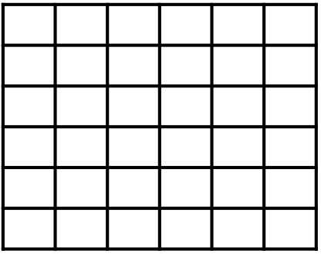






























TA4LS: Time-series Adaptation for mitigating Label Shifts
The proposed approach, TA4LS, consists of two stages: training and inference stages.
[Training Stage]
[Inference Stage]
$$c_{1}^{agg}$$
$$c_{0}^{agg}$$
Existing DA
5
3
Source
Labels
$$Y^{src}$$
Class Balanced
Sampler
$$Y^{{src}^{′}}$$
6
Refine
$$X^{trg}$$
f
$$Z^{trg}$$
g
$${\hat{Y}}^{trg}$$
2
4
$${\hat{Y}}^{trg}$$
Source
Time-series
$$X^{src}$$
$$X^{{src}^{′}}$$
Existing Domain
Adaptation
$$g$$
1
Target
Time-series
$$X^{trg}$$
(b) Find Cluster Probability
(c) Find Refined Candidates
Target Aggregated Cluster Probability
Initially-Predicted labels
Refinement Candidates
(a) Extract Target Feature-Driven Clusters
1
2
4
Co-association Matrix
$$ID$$
$$P\left(C_{0}^{agg}\right) P(C_{1}^{agg})$$
3
5
6
Trend
Clustering
1
[1.0, 0.0]
[1.0, 0.0]
[0.9, 0.1]
[0.8, 0.2]
$P({\hat{y}}_{4}= |x_{4}$)=0.4
$$c_{0}^{agg}$$
2
$c_{dom}^{agg}$( )
$c_{dom}^{agg}$( )
$P({\hat{y}}_{4}= |x_{4}$)=0.6
$c_{0}^{tr}$,
$$c_{1}^{tr}$$
0 2 3 3 0 0
3
2 0 3 3 0 0
Detrend
$c_{0}^{de}$,
3 3 0 2 0 1
4
1
2
5
$$\underset{k′∈[ , ]}{argmax}{\{P({\hat{y}}_{4}=k′ |x_{4})}$$
$$c_{1}^{de}$$
3 3 2 0 1 1
[0.3, 0.7]
[0.5, 0.5]
3
4
$$c_{1}^{agg}$$
6
…
0 0 0 1 0 2
$$c_{1}^{agg}$$
5
$$c_{0}^{agg}$$
$$∗ P(C_{dom}^{agg}(k′)|x_{4})\}$$
$c_{0}^{fr}$,
0 0 1 1 2 0
6
Target Aggregated Cluster
Frequency
$$c_{1}^{fr}$$
“Multi-view Feature Consistency”
“Target Cluster Consistency”
Method
Notes:
The proposed approach, TA4LS, consists of two stages: training and inference stages.
During the training stage, we generate feature-driven clusters.
During the inference stage, multi-view feature consistency helps refine initial predictions to ensure clusters contain similar characteristics.

Slide 10











[Training Stage]
Source
Labels
$$Y^{src}$$
Class Balanced
Sampler
$$Y^{{src}^{′}}$$
Target features are clustered into three distinct types: trend, detrend, and frequency clusters.
Source
Time-series
$$X^{{src}^{′}}$$
Existing Domain
Adaptation
$$X^{src}$$
Target
Time-series
$$X^{trg}$$
(a) Extract Target Feature-Driven Clusters
Trend
Clustering
$c_{0}^{tr}$,
$$c_{1}^{tr}$$
Detrend
$c_{0}^{de}$,
$$c_{1}^{de}$$
…
Frequency
$c_{0}^{fr}$,
$$c_{1}^{fr}$$
Method
Notes:
During training, TA4LS utilizes an existing domain adaptation method combined with a class-balanced sampler to mitigate bias arising from imbalanced source class distributions.
Crucially, we independently extract and cluster three distinct target-domain features: trend, detrend, and frequency components. These feature-driven clusters capture the inherent structure unique to the target domain, effectively reducing reliance on source labels and enabling more robust label adaptation under significant distribution shifts.

Slide 11



















[Inference Stage]
Multi-view feature consistency ensures that target test instances are clustered with similar overall trends, detrends, and frequencies. As a result, TA4LS refines initially-predicted target labels based on target cluster consistency, ensuring that the instances in the same class have similar clusters.
$$c_{1}^{agg}$$
$$c_{0}^{agg}$$
Existing DA
5
3
6
Refine
$$X^{trg}$$
f
$$Z^{trg}$$
g
$${\hat{Y}}^{trg}$$
4
$${\hat{Y}}^{trg}$$
$$g$$
2
1
(b) Find Cluster Probability
(c) Find Refined Candidates
Target Aggregated Cluster Probability
Initially-Predicted labels
Refinement Candidates
$$ID$$
$$P\left(C_{0}^{agg}\right) P(C_{1}^{agg})$$
1
2
5
4
Co-association Matrix
3
6
1
[1.0, 0.0]
[1.0, 0.0]
[0.9, 0.1]
[0.8, 0.2]
$c_{dom}^{agg}$( )
$c_{dom}^{agg}$( )
$P({\hat{y}}_{4}= |x_{4}$)=0.4
0 2 3 3 0 0
$$c_{0}^{agg}$$
2
$P({\hat{y}}_{4}= |x_{4}$)=0.6
2 0 3 3 0 0
3
3 3 0 2 0 1
4
1
2
5
$$\underset{k′∈[ , ]}{argmax}{\{P({\hat{y}}_{4}=k′ |x_{4})}$$
3 3 2 0 1 1
$$c_{1}^{agg}$$
5
[0.3, 0.7]
[0.5, 0.5]
$$c_{0}^{agg}$$
3
4
$$c_{1}^{agg}$$
6
0 0 0 1 0 2
$$∗ P(C_{dom}^{agg}(k′)|x_{4})\}$$
0 0 1 1 2 0
6
Target Aggregated Cluster
“Multi-view Feature Consistency”
“Target Cluster Consistency”
Method
Notes:
Next, I'll explain the inference stage. Here, TA4LS leverages the previously obtained target feature-driven clusters to refine initial predictions. First, we compute a co-association matrix based on how consistently instances cluster together across the three feature types. Using this matrix, we create target aggregated clusters, ensuring multi-view feature consistency.
Then, we identify refinement candidates—instances whose initially-predicted labels do not match the dominant clusters for their classes. Finally, we refine these predictions based on the joint probabilities of class assignments and cluster memberships, enforcing target cluster consistency. This approach effectively reduces the source-label bias and results in predictions that better reflect the true characteristics of the target domain.

Slide 12
Experimental Setup: Datasets
Natural Label Shifts: To examine the impact of natural label shifts, we select ten source-target pairs exhibiting the highest JS divergence among the pairs within each of the four datasets.
Simulated Label Shifts: To assess TS-UDA performance under severe label shift conditions, we simulate varying levels of label shifts between source and target pairs. Specifically, we randomly select five source and target pairs from each dataset by varying the hyper-parameter 𝛼 of the Dirichlet distribution. We produce datasets with JS divergence ranging from 0.1 to 0.2 by adjusting 𝛼 and introduce shifts in label distribution at 0.01 intervals.
Experiments
Notes:
For evaluation, we considered two settings: natural and simulated label shifts. We used datasets exhibiting varying levels of Jensen-Shannon (JS) divergence to effectively simulate real-world label shift conditions.

Slide 13
Experimental Setup: Baselines
To alleviate performance degradation under severe label shifts, we evaluate both the original UDA algorithm and six label shift handling modules that can be integrated into existing UDA frameworks: BBSE, PseudoBalance, RLSbench, PseudoCal, TeacherModel, and Correction.
We adopt their respective modules to address label shifts. Therefore, we refer to the module of SENTRY as PseudoBalance, the module of SLARDA as TeacherModel, and the module of RAINCOAT as Correction to implement baselines.
Experiments
Notes:
Our approach was compared against six established label shift handling modules integrated within existing UDA frameworks, such as BBSE, PseudoBalance, RLSbench, PseudoCal, TeacherModel, and Correction.

Slide 14
Experiments: Natural Label Shifts
We select ten source-target pairs with the highest JS divergence. TA4LS achieves the highest average F1 score across all datasets. But, in WISDM and EEG rank second-best or third-best in accuracy.
Datasets | Original UDA |  | BBSE |  | PseudoBalance |  | RLSbench |  | PseudoCal |  | TeacherModel |  | Correction |  | TA4LS(Ours)
 | F1 | ACC | F1 | ACC | F1 | ACC | F1 | ACC | F1 | ACC | F1 | ACC | F1 | ACC | F1 | ACC
HAR | 0.873 | 0.883 | 0.852 | 0.869 | 0.678 | 0.707 | 0.893 | 0.906 | 0.618 | 0.649 | 0.631 | 0.660 | 0.800 | 0.814 | 0.924 | 0.928
HHAR | 0.901 | 0.899 | 0.891 | 0.890 | 0.613 | 0.640 | 0.890 | 0.890 | 0.625 | 0.649 | 0.665 | 0.685 | 0.758 | 0.773 | 0.905 | 0.903
WISDM | 0.421 | 0.501 | 0.394 | 0.487 | 0.406 | 0.431 | 0.448 | 0.485 | 0.329 | 0.423 | 0.359 | 0.457 | 0.382 | 0.506 | 0.474 | 0.500
EEG | 0.439 | 0.573 | 0.397 | 0.566 | 0.433 | 0.518 | 0.507 | 0.639 | 0.356 | 0.509 | 0.340 | 0.493 | 0.427 | 0.552 | 0.544 | 0.627
# of 1st best | 2 | 3 | 0 | 0 | 2 | 1 | 1 | 5 | 1 | 0 | 1 | 1 | 0 | 1 | 18 | 14
Average score | 0.658 | 0.714 | 0.633 | 0.703 | 0.533 | 0.574 | 0.684 | 0.730 | 0.482 | 0.557 | 0.499 | 0.574 | 0.592 | 0.661 | 0.712 | 0.739
Table 1. Average F1 score and accuracy with standard deviation across four datasets under natural label shifts. The highest scores are in bold.
Experiments
Notes:
In experiments under natural label shifts, TA4LS consistently achieved the highest average F1 scores across datasets, highlighting its superior performance, particularly in handling class imbalance.

Slide 15
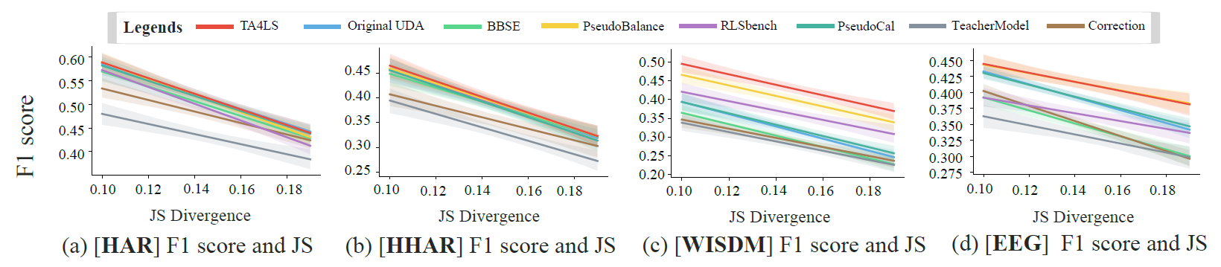
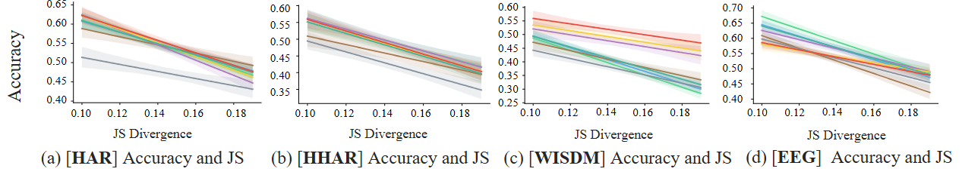
Experiments: Simulated Label Shifts
We simulate varying levels of label shifts between source and target pairs. The primary objective of this comparison is to show that TA4LS’s slope is more gradual as the label shift becomes severe.
Plot 1. Linear plots of the F1 score and 95% confidence intervals based on JS divergence under simulated shifts.
Plot 2. Linear plots of the accuracy and 95% confidence intervals based on JS divergence under simulated shifts.
Experiments
Notes:
Under simulated severe label shifts, TA4LS demonstrated resilience, exhibiting a more gradual decline in performance compared to baseline methods. This highlights its robustness against increasing label distribution discrepancies.

Slide 16
Ablation Studies: Effects of TA4LS
Table 2 shows the effects of ‘three’ target feature-driven clusters.
Table 3 shows that ‘target’ aggregated clusters are the most effective than other combinations.
Trend | Detrend | Frequency | Avg F1 | Avg Acc
O |  |  | 0.9112 | 0.9150
 | O |  | 0.9167 | 0.9213
 |  | O | 0.8881 | 0.8968
O | O |  | 0.9228 | 0.9263
O |  | O | 0.9208 | 0.9246
 | O | O | 0.9225 | 0.9270
O | O | O | 0.9235 | 0.9275
Training Domain Data | Avg F1 | Avg Acc
Source Only | 0.9176 | 0.9201
Source + Target | 0.9194 | 0.9164
Target Only (Ours) | 0.9235 | 0.9275
Table 3. Average F1 score and accuracy depending on training domain data for clustering under TA4LS in the HAR dataset.
Table 2. Average F1 scores and accuracy for combinations of target feature-driven clusters in the HAR dataset.
Notes:
Ablation studies revealed that each of the feature-driven clusters—trend, detrend, and frequency—significantly contributes to performance improvements, indicating the importance of considering diverse time-series characteristics.
Also, Table 3 shows that effectiveness of `target’-only information than other training domain data for clustering.

Slide 17
Ablation Studies: Sensitivities
Backbone Sensitivity: TA4LS consistently enhances performance regardless of the backbone architectures.
Hyper-parameter Sensitivity: We evaluate the hyperparameter sensitivity using the fraction 𝜌, representing the proportion of the total time stamps used as neighbors. Results indicate that TA4LS consistently surpasses the original UDA method, regardless of the chosen fraction 𝜌.
Backbone | Original UDA |  | TA4LS (Ours)
 | Avg F1 | Avg Acc | Avg F1 | Avg Acc
CNN | 0.874 | 0.883 | 0.915 | 0.919
TCN | 0.833 | 0.840 | 0.869 | 0.875
RESNET18 | 0.809 | 0.817 | 0.849 | 0.856
Table 4. Performance comparison between original UDA and TA4LS under three backbones in the HAR dataset.
Figure 1. Performance comparison between original UDA and TA4LS with respect to five hyper-parameter values in the HAR dataset.
Experiments
Notes:
Further sensitivity analyses showed that TA4LS consistently outperformed original UDA across various backbone architectures and hyper-parameter settings, emphasizing its adaptability and robustness.

Slide 18
Case Study
The predicted target label distribution from the original UDA in (c) is similar to the true source in (a).
The predicted target from TA4LS in (d) aligns more closely with Figure (b), the true target distribution.
This case demonstrates that TA4LS effectively mitigates bias toward the source label distribution, leading to predictions that better reflect the true target distribution.
Ratio
W J I T U D
W J I T U D
W J I T U D
W J I T U D
(a) True Source
(b) True Target
(c) Target Predictions [O]
(d) Target Predictions [T]
Figure 2. Comparison of label distributions among the true source, true target, and predicted targets. Note that ‘W’ is ‘walk’, ‘J’ is ‘jog’, ‘I’ is ‘sit’, ‘T’ is ‘stand’, ‘U’ is ‘upstairs’, ‘D’ is ‘downstairs’, ‘[O]’ is ‘original UDA’, and ‘[T]’ is ‘TA4LS’ in WISDM dataset. Note: 12th domain is the source and the 19th domain is the target with DIRT as the original UDA.
Case Study
Notes:
In our case study, TA4LS effectively adjusted the predicted target label distribution to better match the true target distribution, significantly mitigating biases from source labels.

Slide 19
Conclusions
To mitigate the performance degradation caused by label shifts, we propose TA4LS with multi-view feature consistency and target cluster consistency.
Our research highlights the potential for significant label shifts in TS-UDA scenarios attributable to the nature of time series. As a results, our approach enhances F1 scores well under high label shifts.
TA4LS excels in applying UDA on sensor data from individual humans characterized by significant label shifts and in scenarios requiring balanced class predictions.
Conclusions
Notes:
In conclusion, our approach, TA4LS, mitigates the performance degradation caused by significant label shifts by leveraging multi-view feature consistency and target cluster consistency.
Our contributions include a novel target-only refinement approach, demonstrated performance advantages under severe label shifts, and easy integration as a plug-in module for existing UDA frameworks.

Slide 20



THANK YOU!
Q&A
Official Github
Notes:
Thank you for your attention. I'm now happy to answer any questions you may have.

Slide 21
Experiments: Natural Label Shifts in the HAR dataset
TA4LS achieves the highest average F1 score and accuracy in HAR datasets.
Datasets | Original UDA |  | BBSE |  | PseudoBalance |  | RLSbench |  | PseudoCal |  | TeacherModel |  | Correction |  | TA4LS(Ours)
 | F1 | ACC | F1 | ACC | F1 | ACC | F1 | ACC | F1 | ACC | F1 | ACC | F1 | ACC | F1 | ACC
DANN | 0.885 | 0.887 | 0.865 | 0.874 | 0.915 | 0.918 | 0.905 | 0.918 | 0.881 | 0.886 | 0.885 | 0.891 | 0.859 | 0.866 | 0.918 | 0.924
DIRT | 0.902 | 0.907 | 0.870 | 0.884 | 0.731 | 0.777 | 0.900 | 0.914 | 0.756 | 0.778 | 0.743 | 0.765 | 0.875 | 0.886 | 0.954 | 0.952
CoDATS | 0.875 | 0.882 | 0.858 | 0.87 | 0.913 | 0.923 | 0.899 | 0.909 | 0.886 | 0.894 | 0.880 | 0.890 | 0.801 | 0.815 | 0.924 | 0.930
HoMM | 0.899 | 0.904 | 0.886 | 0.895 | 0.389 | 0.435 | 0.913 | 0.921 | 0.109 | 0.189 | 0.113 | 0.189 | 0.799 | 0.808 | 0.917 | 0.922
DSAN | 0.861 | 0.875 | 0.844 | 0.869 | 0.489 | 0.522 | 0.909 | 0.920 | 0.464 | 0.501 | 0.557 | 0.582 | 0.872 | 0.878 | 0.951 | 0.953
SASA | 0.815 | 0.841 | 0.789 | 0.825 | 0.634 | 0.666 | 0.832 | 0.852 | 0.609 | 0.644 | 0.607 | 0.642 | 0.594 | 0.631 | 0.877 | 0.884
Avg. | 0.873 | 0.883 | 0.852 | 0.869 | 0.678 | 0.707 | 0.893 | 0.906 | 0.618 | 0.649 | 0.631 | 0.660 | 0.800 | 0.814 | 0.924 | 0.928
(± std) | ±0.12 | ±0.11 | ±0.12 | ±0.11 | ±0.24 | ±0.23 | ±0.11 | ±0.1 | ±0.31 | ±0.28 | ±0.3 | ±0.28 | ±0.17 | ±0.16 | ±0.1 | ±0.09
Table A-1. Average F1 score and accuracy with standard deviation across four datasets under natural label shifts with respect to different UDA methods (DANN, DIRT, CoDATS, HoMM, DSAN, and SASA). The highest scores are in bold.

Slide 22
Experiments: Natural Label Shifts in the HHAR dataset
TA4LS achieves the highest average F1 score and accuracy in HHAR datasets.
Datasets | Original UDA |  | BBSE |  | PseudoBalance |  | RLSbench |  | PseudoCal |  | TeacherModel |  | Correction |  | TA4LS(Ours)
 | F1 | ACC | F1 | ACC | F1 | ACC | F1 | ACC | F1 | ACC | F1 | ACC | F1 | ACC | F1 | ACC
DANN | 0.906 | 0.905 | 0.898 | 0.897 | 0.890 | 0.890 | 0.903 | 0.901 | 0.880 | 0.879 | 0.895 | 0.894 | 0.765 | 0.774 | 0.918 | 0.916
DIRT | 0.937 | 0.937 | 0.936 | 0.936 | 0.464 | 0.513 | 0.932 | 0.933 | 0.520 | 0.565 | 0.518 | 0.562 | 0.913 | 0.913 | 0.943 | 0.943
CoDATS | 0.886 | 0.884 | 0.876 | 0.876 | 0.893 | 0.891 | 0.872 | 0.875 | 0.905 | 0.899 | 0.905 | 0.904 | 0.735 | 0.750 | 0.887 | 0.885
HoMM | 0.880 | 0.878 | 0.861 | 0.862 | 0.394 | 0.451 | 0.856 | 0.855 | 0.402 | 0.449 | 0.442 | 0.479 | 0.588 | 0.641 | 0.887 | 0.884
DSAN | 0.917 | 0.915 | 0.911 | 0.909 | 0.469 | 0.512 | 0.918 | 0.917 | 0.471 | 0.514 | 0.662 | 0.685 | 0.883 | 0.879 | 0.916 | 0.914
SASA | 0.879 | 0.877 | 0.863 | 0.862 | 0.569 | 0.586 | 0.858 | 0.86 | 0.571 | 0.586 | 0.571 | 0.586 | 0.664 | 0.684 | 0.878 | 0.877
Avg. | 0.901 | 0.899 | 0.891 | 0.890 | 0.613 | 0.640 | 0.890 | 0.89 | 0.625 | 0.649 | 0.665 | 0.685 | 0.758 | 0.773 | 0.905 | 0.903
(± std) | ±0.08 | ±0.08 | ±0.09 | ±0.09 | ±0.23 | ±0.21 | ±0.1 | ±0.09 | ±0.23 | ±0.21 | ±0.22 | ±0.2 | ±0.19 | ±0.17 | ±0.08 | ±0.08
Table A-2. Average F1 score and accuracy with standard deviation across four datasets under natural label shifts with respect to different UDA methods (DANN, DIRT, CoDATS, HoMM, DSAN, and SASA). The highest scores are in bold.

Slide 23
Experiments: Natural Label Shifts in the WISDM dataset
TA4LS achieves the highest average F1 score in WISDM datasets.
Datasets | Original UDA |  | BBSE |  | PseudoBalance |  | RLSbench |  | PseudoCal |  | TeacherModel |  | Correction |  | TA4LS(Ours)
 | F1 | ACC | F1 | ACC | F1 | ACC | F1 | ACC | F1 | ACC | F1 | ACC | F1 | ACC | F1 | ACC
DANN | 0.393 | 0.476 | 0.375 | 0.467 | 0.470 | 0.503 | 0.428 | 0.468 | 0.408 | 0.496 | 0.417 | 0.494 | 0.349 | 0.479 | 0.463 | 0.478
DIRT | 0.403 | 0.557 | 0.379 | 0.552 | 0.435 | 0.497 | 0.478 | 0.548 | 0.347 | 0.496 | 0.373 | 0.515 | 0.419 | 0.555 | 0.489 | 0.547
CoDATS | 0.429 | 0.478 | 0.403 | 0.466 | 0.456 | 0.479 | 0.449 | 0.487 | 0.376 | 0.49 | 0.386 | 0.498 | 0.380 | 0.488 | 0.498 | 0.514
HoMM | 0.441 | 0.495 | 0.411 | 0.475 | 0.394 | 0.403 | 0.450 | 0.462 | 0.254 | 0.350 | 0.256 | 0.362 | 0.360 | 0.486 | 0.470 | 0.484
DSAN | 0.468 | 0.533 | 0.460 | 0.529 | 0.401 | 0.411 | 0.451 | 0.473 | 0.324 | 0.384 | 0.449 | 0.545 | 0.426 | 0.550 | 0.453 | 0.479
SASA | 0.392 | 0.468 | 0.333 | 0.434 | 0.283 | 0.295 | 0.429 | 0.475 | 0.266 | 0.319 | 0.27 | 0.325 | 0.359 | 0.476 | 0.472 | 0.495
Avg. | 0.421 | 0.501 | 0.394 | 0.487 | 0.406 | 0.431 | 0.448 | 0.485 | 0.329 | 0.423 | 0.359 | 0.457 | 0.382 | 0.506 | 0.474 | 0.500
(± std) | ±0.15 | ±0.15 | ±0.15 | ±0.16 | ±0.16 | ±0.18 | ±0.15 | ±0.18 | ±0.14 | ±0.16 | ±0.15 | ±0.18 | ±0.15 | ±0.17 | ±0.15 | ±0.17
Table A-3. Average F1 score and accuracy with standard deviation across four datasets under natural label shifts with respect to different UDA methods (DANN, DIRT, CoDATS, HoMM, DSAN, and SASA). The highest scores are in bold.

Slide 24
Experiments: Natural Label Shifts in the EEG dataset
TA4LS achieves the highest average F1 score in EEG datasets.
Datasets | Original UDA |  | BBSE |  | PseudoBalance |  | RLSbench |  | PseudoCal |  | TeacherModel |  | Correction |  | TA4LS(Ours)
 | F1 | ACC | F1 | ACC | F1 | ACC | F1 | ACC | F1 | ACC | F1 | ACC | F1 | ACC | F1 | ACC
DANN | 0.472 | 0.600 | 0.426 | 0.593 | 0.554 | 0.635 | 0.533 | 0.659 | 0.474 | 0.592 | 0.452 | 0.58 | 0.461 | 0.577 | 0.561 | 0.643
DIRT | 0.376 | 0.536 | 0.316 | 0.515 | 0.434 | 0.543 | 0.466 | 0.607 | 0.298 | 0.470 | 0.272 | 0.433 | 0.381 | 0.518 | 0.522 | 0.618
CoDATS | 0.431 | 0.552 | 0.374 | 0.537 | 0.528 | 0.593 | 0.520 | 0.649 | 0.430 | 0.556 | 0.404 | 0.528 | 0.425 | 0.546 | 0.523 | 0.611
HoMM | 0.489 | 0.622 | 0.458 | 0.624 | 0.445 | 0.516 | 0.508 | 0.657 | 0.422 | 0.558 | 0.400 | 0.544 | 0.475 | 0.599 | 0.555 | 0.646
DSAN | 0.392 | 0.530 | 0.372 | 0.538 | 0.437 | 0.509 | 0.485 | 0.595 | 0.40 | 0.540 | 0.404 | 0.540 | 0.406 | 0.528 | 0.535 | 0.602
SASA | 0.473 | 0.597 | 0.431 | 0.591 | 0.204 | 0.313 | 0.532 | 0.670 | 0.111 | 0.337 | 0.109 | 0.335 | 0.414 | 0.546 | 0.566 | 0.644
Avg. | 0.439 | 0.573 | 0.397 | 0.566 | 0.433 | 0.518 | 0.507 | 0.639 | 0.356 | 0.509 | 0.34 | 0.493 | 0.427 | 0.552 | 0.544 | 0.627
(± std) | ±0.09 | ±0.09 | ±0.1 | ±0.11 | ±0.16 | ±0.16 | ±0.11 | ±0.11 | ±0.15 | ±0.14 | ±0.14 | ±0.13 | ±0.08 | ±0.09 | ±0.11 | ±0.1
Table A-4. Average F1 score and accuracy with standard deviation across four datasets under natural label shifts with respect to different UDA methods (DANN, DIRT, CoDATS, HoMM, DSAN, and SASA). The highest scores are in bold.

Slide 25
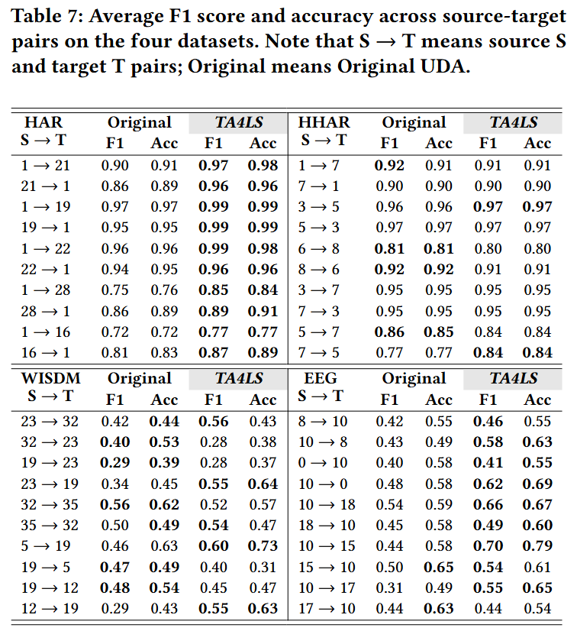
Experiments: Natural Label Shifts w.r.t. pairs
Table 7 compares the original UDA and TA4LS for each source- target pair under natural label shifts. TA4LS outperforms source-target pairs on the HAR and EEG datasets. On the HHAR and WISDM datasets, the performance improvements are marginal.
Table B. Average F1 score and accuracy across source-target pairs on the four datasets. Note that S → T means source S and target T pairs.

Slide 26
Ablation Studies: Effects of Target Feature driven Clusters
Table C-1 shows effects of target feature-driven clusters.
Table C-2 shows that target aggregated clusters are effected.
Trend | Detrend | Frequency | Avg F1 | Avg Acc
O |  |  | 0.5167 | 0.5996
 | O |  | 0.5258 | 0.6088
 |  | O | 0.5199 | 0.6016
O | O |  | 0.5253 | 0.6084
O |  | O | 0.5238 | 0.6068
 | O | O | 0.5240 | 0.6068
O | O | O | 0.5437 | 0.6270
Training Data | Avg F1 | Avg Acc
Source Only | 0.4993 | 0.5835
Source + Target | 0.5011 | 0.5840
Target Only (Ours) | 0.5437 | 0.6273
Table C-2. Average F1 score and accuracy depending on training domain data for clustering under TA4LS in the EEG dataset.
Table C-1. Average F1 scores and accuracy for combinations of target feature-driven clusters in the EEG dataset.
Notes:
Target Feature-driven Clusters:
The best performance is achieved when using all three components (trend + detrend + frequency). These findings suggest that employing multiple time-series components is helpful, serving as target-only information for refinement.

Slide 27
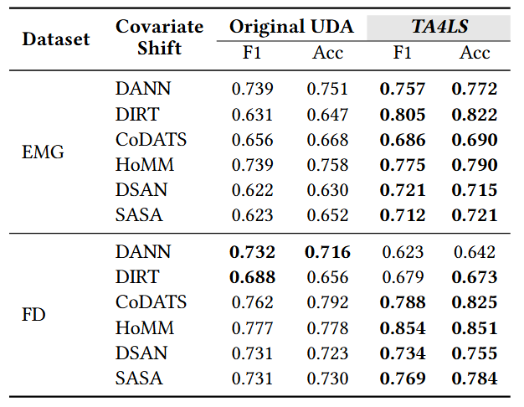
Experiments: Natural Label Shifts in new datasets
To find out whether TA4LS can mitigate natural label shifts regardless of data types, we conduct experiments on the EMG and FD datasets. The EMG dataset is an electromyography dataset for gesture recognition, and the FD dataset is a machine fault diagnosis dataset. TA4LS outperforms the original UDA in most cases on both the sampled EMG and FD datasets under natural label shifts. This result shows that TA4LS can also perform well on high-frequency signal datasets.
Table D. Average F1 score and accuracy in new datasets.

Slide 28
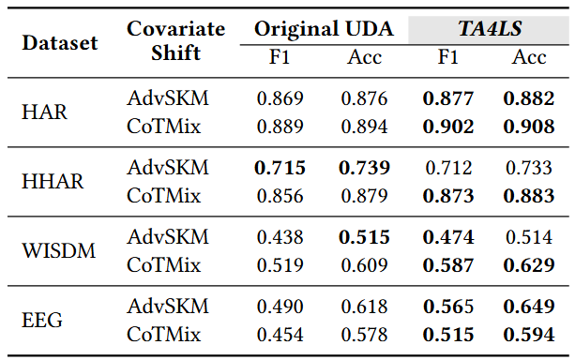
Experiments: Natural Label Shifts in new UDAs
Table F shows the comparison between the original UDA and TA4LS on the four datasets with respect to two new UDA methods: AdvSKM and CoTMix. TA4LS outperforms, especially in the HAR and EEG datasets. Although the performance of the original AdvSKM is better on the HHAR and WISDM datasets, the performance disparity is minimal. However, AdvSKM with TA4LS significantly surpasses on the HAR and EEG datasets.
Table F. Average F1 score and accuracy in new datasets.

