Slide 1
Meta-Learning for Online Update of Recommender Systems
AAAI 2022
Minseok Kim¹, Hwanjun Song², Yooju Shin¹, Dongmin Park¹, Kijung Shin¹, Jae-Gil Lee¹
¹KAIST, ²NAVER AI Lab

Slide 2
Index
1. Introduction
2. Methodology
3. Experiment

Slide 3
1. Introduction

Slide 4
Recommender System
-
-
Recommender system
-
User-item interactions
Item recommendations to users
Introduction
Methodology
Experiment

Slide 5
Recommender System in Everyday Life
$$⋮$$
$$⋮$$
Introduction
Methodology
Experiment

Slide 6
Topic: Catching Up-to-Date User Interest
User interest evolves over time
Recommenders should catch it via online update
…
-
-
Past
Now
Introduction
Methodology
Experiment

Slide 7
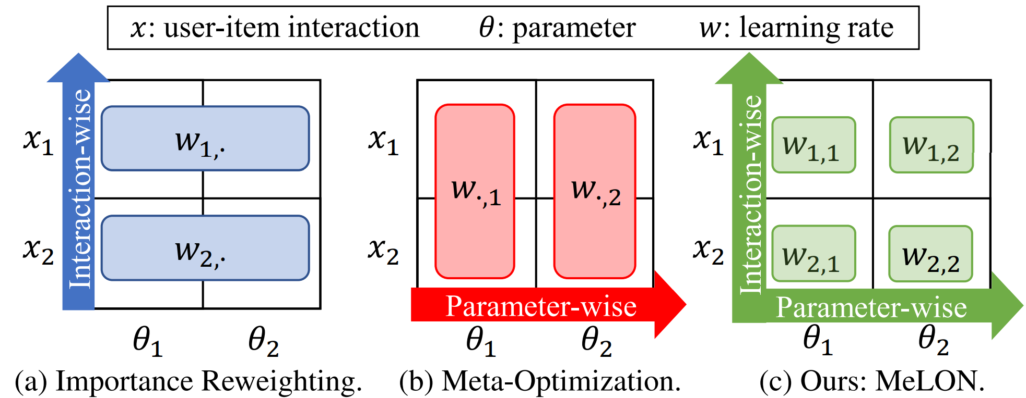
Issue: Quick Update on Sparse User Signals
Model update on new user-item interactions which are very sparse
Two existing main directions
Importance reweighting: how important each interaction for update?
Meta-optimization: how much each parameter should learn?
Introduction
Methodology
Experiment

Slide 8
Challenge: Update is Not Flexible Enough
Each parameter has different relevance to each user-item interaction
However, previous studies cannot cover both perspectives
$→$ Insufficient flexibility leads to sub-optimal recommendation
Introduction
Methodology
Experiment

Slide 9
Idea: Two-Directionally Flexible Update
Solution: MeLON (Meta-Learning for ONline recommender update)
Provides a learning rate for each parameter-interaction pair
Learns to update adaptively via meta-learning
Introduction
Methodology
Experiment

Slide 10
2. Methodology

Slide 11
Default Recommender Update
parameter
learning rate
interaction importance
Learning rate matrix:
learning rate + interaction importance
Two perspectives in learning: learning rate, interaction importance
How to decide $W$affects update of a recommender $Θ_{t}$
* Default: equally $\frac{η}{n}$ for all
Introduction
Methodology
Experiment

Slide 12
Previous Studies Handle Either Perspective
Importance reweighting handles interactions, but not parameters
Meta-optimization handles parameters, but not interactions
Introduction
Methodology
Experiment

Slide 13
MeLON: Handles Both Perspectives
MeLON adapts to both interactions and parameters via meta-learning
Introduction
Methodology
Experiment

Slide 14
Theory Supports MeLON’s Flexbility
As MeLON can handle both training perspectives, MeLON has more flexibility than previous studies
$→$Performance enhancement by MeLON
Introduction
Methodology
Experiment

Slide 15
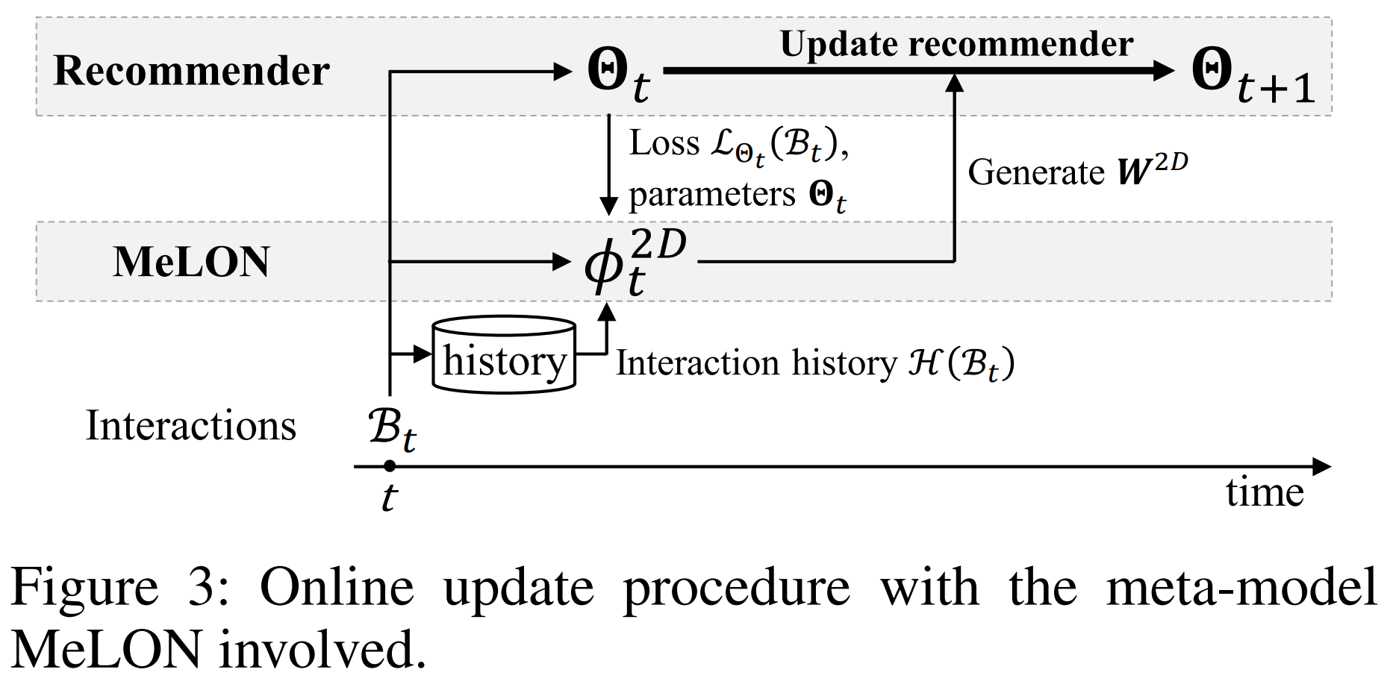
Recommender Update with MeLON
Given a new user-item interaction batch, MeLON provides a learning rate for each interaction-parameter pair
MeLON learns how the recommender performs update (see appendix)
Introduction
Methodology
Experiment

Slide 16
3. Experiment

Slide 17
Experiment Outline
We validate the effectiveness of MeLON via experiments
Performance: can MeLON improve recommender performance?
Consistency: does MeLON maintain performance over time?
Flexibility: does the two-directional flexibility of MeLON help?
Speed: is MeLON quick enough for online update?
Introduction
Methodology
Experiment

Slide 18
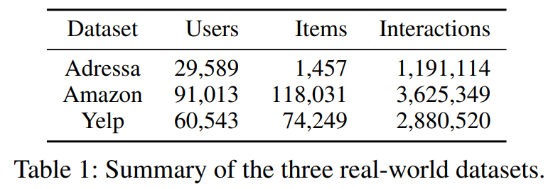
Experimental Settings: Data and Metrics
Three online service datasets
Evaluation metrics under top 5, 10, 20 recommendations
Hit rate (HR)
Normalized discounted cumulative gain (NDCG)
Introduction
Methodology
Experiment

Slide 19
Experimental Settings: Algorithms
Two recommender algorithms: BPR [1], NCF [2]
Seven update strategies:
Default update
Importance reweighting: eALS [3], MWNet [4]
Meta-optimization: SML [5], MetaSGD [6], S ² Meta [7]
MeLON
[1] BPR: Bayesian personalized ranking from implicit feedback, UAI 2009
[2] Neural collaborative filtering. TheWebConf 2017
[3] Fast matrix factorization for online recommendation with implicit feedback. SIGIR 2016
[4] Meta-Weight-Net: Learning an explicit mapping for sample weighting. NeurIPS 2019
[5] Sequential scenario-specific meta learner for online recommendation. KDD 2019
[6] Meta-SGD: Learning to Learn Quickly for Few-Shot Learning, arXiv 2017
[7] How to retrain recommender system? A sequential meta-learning method. SIGIR 2020
Introduction
Methodology
Experiment

Slide 20
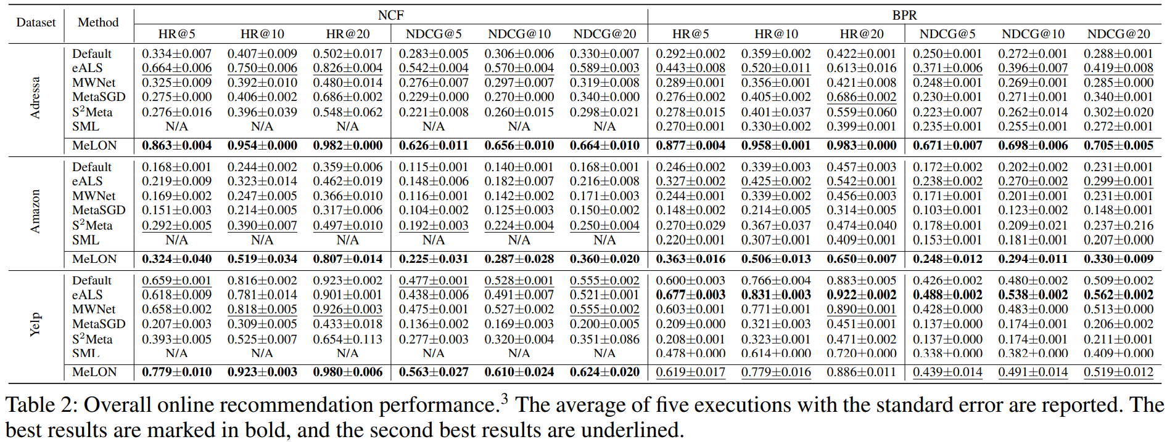
Performance: MeLON Always Works
MeLON outstands especially when user interest changes quickly (e.g., Adressa)
Introduction
Methodology
Experiment

Slide 21
Consistency: MeLON Stably Works
MeLON adheres to highest performance during online update
When user interest changes quickly, MeLON outstands more
Introduction
Methodology
Experiment

Slide 22
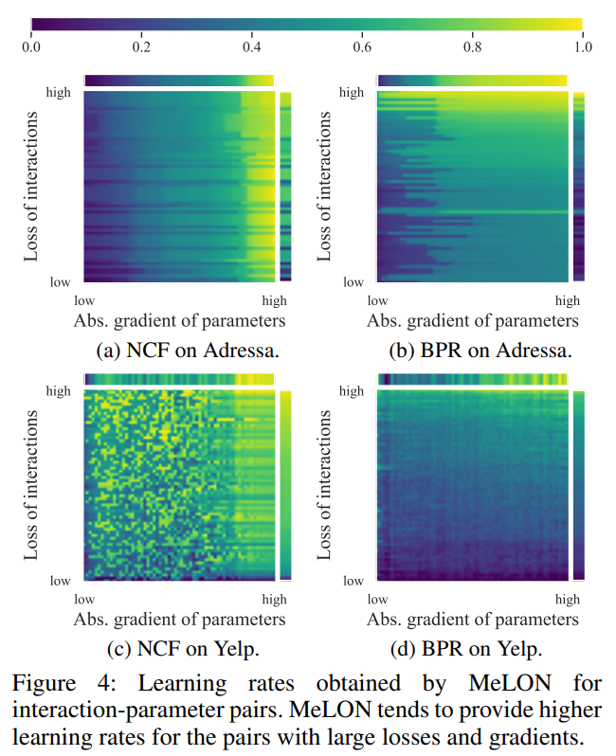
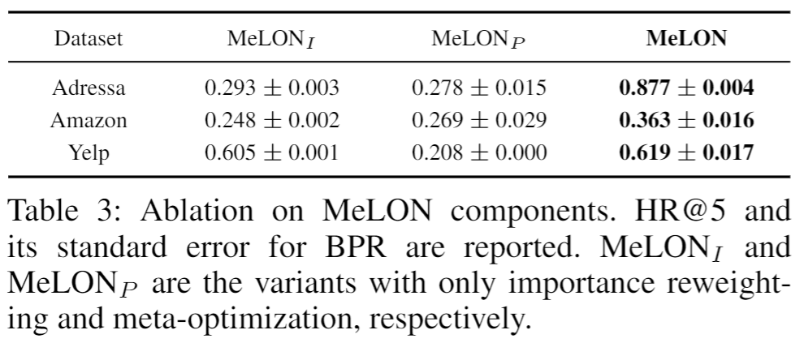
Flexibility: MeLON Leverages Both Sides
Two ablations demonstrate the necessity of considering both training perspectives:
Model ablation
Learning rate visualization
Introduction
Methodology
Experiment

Slide 23
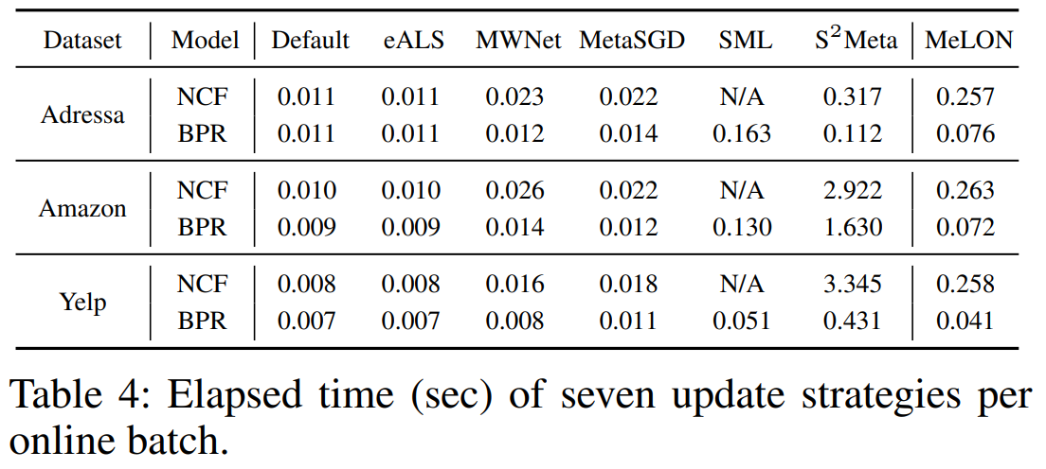
Speed: MeLON is Efficient for Online Update
MeLON can perform multiple updates within a second
Elapsed time is stable for update strategies except S ² Meta
Introduction
Methodology
Experiment

Slide 24
Takeaway: MeLON for Online Update
In online service, user interest evolves over time
Recommenders should constantly catch it, but incoming user-item interactions are too sparse
Previous studies are not flexible enough for online update
MeLON handles both two learning perspectives adaptively to provide flexible update
Extensive experiments show MeLON works well for online update

Slide 25
Appendix
Online training algorithm pseudocode
Meta-model update

Slide 26
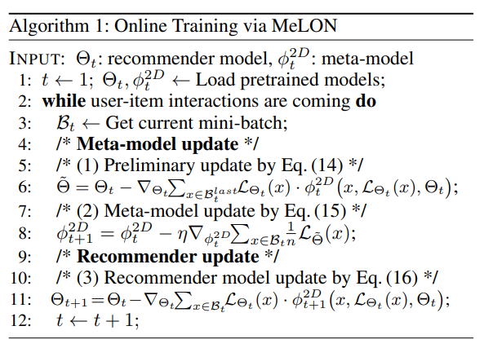
Online Training Algorithm Pseudocode

Slide 27
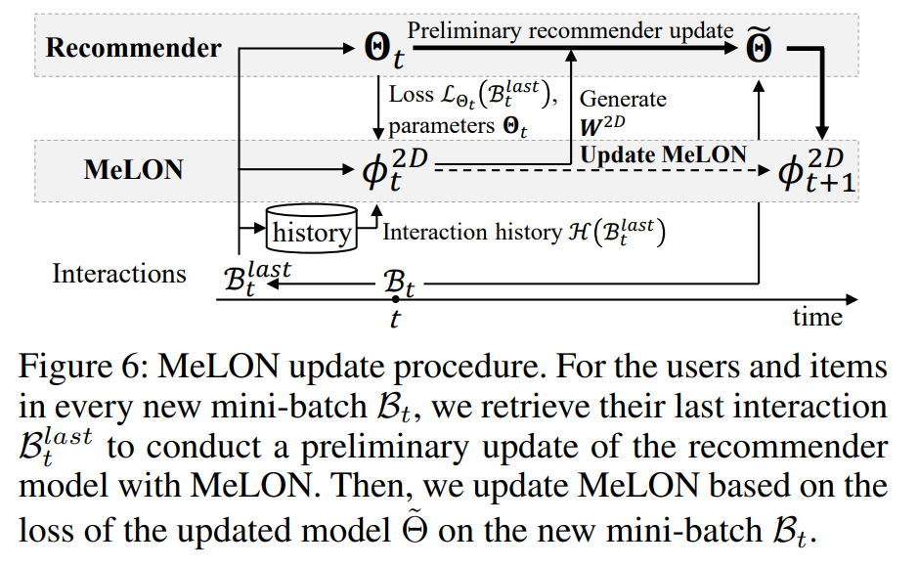
Meta-Model Update

