Slide 1


TRAP: Two-level Regularized Autoencoder-based Embedding for Power-law Distributed Data
Session: SON-A (1)
Paper No. 1519
Dongmin Park, Hwanjun Song, Minseok Kim, Jae-Gil Lee*
Data Mining Lab, Graduate School of Knowledge Service Engineering
22-Apr, 2020

Slide 2

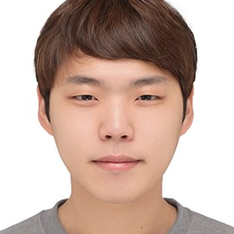
Authors
Dongmin Park (Presenter)
dongminpark@kaist.ac.kr
sites.google.com/view/dongmin
Hwanjun Song
songhwanjun@kaist.ac.kr
hwanjun.me/
Minseok Kim
minseokkim@kaist.ac.kr
Jae-Gil Lee*
jaegil@kaist.ac.kr
https://dm.kaist.ac.kr/jaegil/
4/37

Slide 3
Index
1. Introduction
2. Related Work
3. Motivation - Polarization
4. Methodology - TRAP
5. Experiments
6. Conclusion

Slide 4







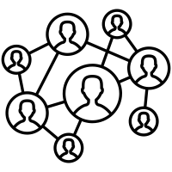

AE-based Embedding & Contribution
Contribution
#
 | 1 |  | 1
1 |  |  | 1
 |  |  | 1 | 1
Power-law
z
sparsity
Two-level
Regularizer
|z-E(z)|
 | 1 |  | 1
1
 |  |  | 1
1 |  | 1
Polarized
sparsity
Sparse
Matrices
AE-based Embeddings
Problem:
Polarization
Solution:
TRAP
Graph Data
4/37

Slide 5



Graph Data: User-Item Transactions
Users
Items
transaction
5/37

Slide 6



Graph Data: Social Relationships
friendship
user
6/37

Slide 7






Graph Data: A lot more
Page References
Paper Citations
7/37

Slide 8
Sparse Matrices
Graph
Adjacency Matrix
 | 1 |  | 1
1 |  |  | 1
 |  |  | 1 | 1
user i
item j
8/37

Slide 9


Problem: Less-informative Input
1M+ products
... | 1 | ... | ... | 1 | ...
High-dimensionality
High-sparsity
2B+ users
40B+ pages
⇒ Difficult to directly use
in machine learning tasks
9/37

Slide 10
Solution: Embedding Methods
low-dimensional
space
Embedding
Input for
ML tasks
... | 1 | ... | 1 | ...
10/37

Slide 11
Related Work

Slide 12
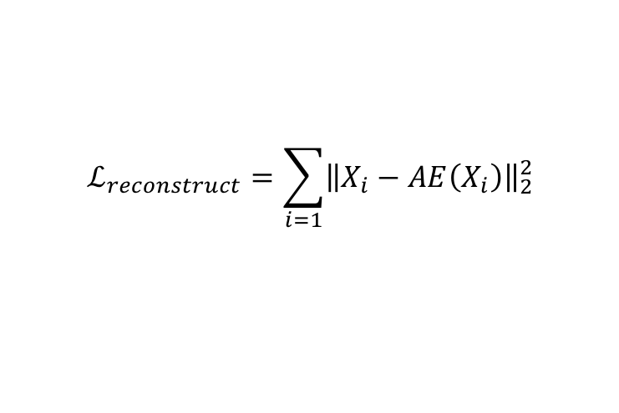
Preliminary: Autoencoder (AE)
It is well known that reconstructing input vectors enforces the neural network to capture the data manifold smoothly and find useful embeddings
Encoder
f
Decoder
g
Low-dimensional Embedding
Reconstructed
Input
Input
$$ℒ_{reconstruct}=\sum_{i=1}{{\left\|X_{i}−AE\left(X_{i}\right)\right\|}_{2}^{2}}$$
12/37

Slide 13
Task1: Top-k Recommend w/ User-Item Embedding
-
Recommend
-
k=2
-
13/37

Slide 14









Task1: Top-k Recommend w/ User-Item Embedding
non-linearity
$$Items$$
1 | 1 | 0 | 1 | 1 | 0
1
0
1
0
$$f(i_{3})$$
1
0
1
0
1 | 0 | 1 | 1 | 1 | 1
1 | 1 | 0 | 1 | 1 | 0
0 | 0 | 1 | 0 | 0 | 0
0 | 1 | 0 | 0 | 0 | 0
$$f(u_{2})$$
$$f(u_{2})$$
$$Users$$
=
$$×$$
$$f(i_{3})$$
1 | 1 | 0 | 1 | 1 | 0
$$Item$$
$$User$$
(a) Matrix Factorization
(b) AutoEncoder
AutoRec [WWW15]
CDAE [WSDM16]
MultiVAE [WWW18]
JCA [WWW19]
MF [09]
Many variants
14/37

Slide 15
Task2: Node Classification w/ Node Embedding
Classify
C=2
15/37

Slide 16









Task2: Node Classification w/ Node Embedding
$$Previous Node$$
$$Next Node$$
$Node$s
0 | 1 | 1 | 0 | 0
1 | 0 | 1 | 0 | 0
1 | 1 | 0 | 1 | 1
0 | 0 | 1 | 0 | 0
0 | 0 | 1 | 0 | 0
0 | 1 | 0 | 0 | 0
0 | 0 | 0 | 1 | 0
0 | 1 | 0 | 0 | 0
1 | 0 | 0 | 0 | 0
$$Nodes$$
$$f(δ_{n_{2}})$$
$$f(δ_{n_{2}})$$
$$δ=Onehot Encoding$$
0 | 1 | 0 | 0 | 0
$$n_{2}$$
0 | 1 | 0 | 0 | 0
$$δ_{n_{2}}$$
$$Node$$
(a) Skip Gram
non-linearity
(b) AutoEncoder
DeepWalk [KDD14]
LINE [WWW15]
Node2Vec [KDD16]
Struct2Vec [KDD17]
SDNE [KDD16]
DANE [IJCAI18]
ProGAN [KDD19]
16/37

Slide 17
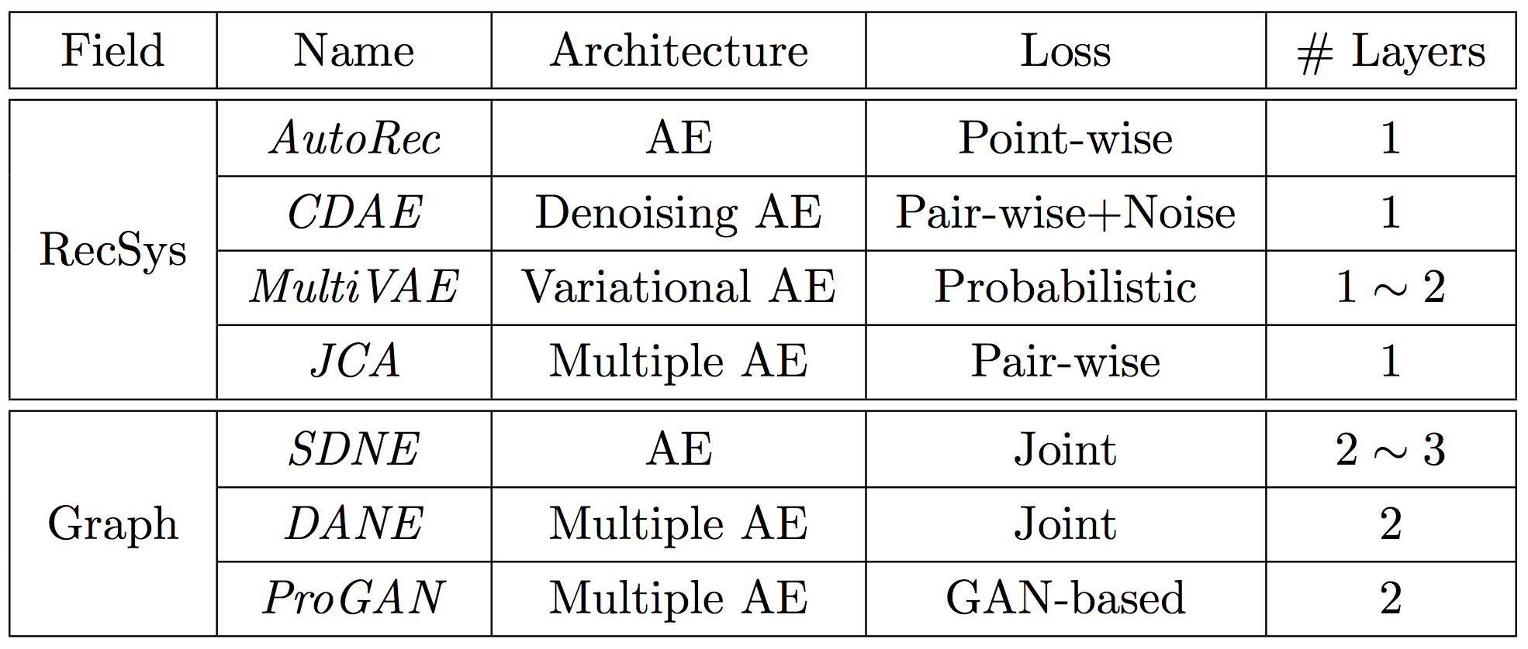
Summary of AE-based Embedding
Existing methods mainly change the architecture and loss function to enhance the performance of each task
Note that all methods use shallow layered AE to prevent the overfitting
17/37

Slide 18
Motivation
polarization

Slide 19
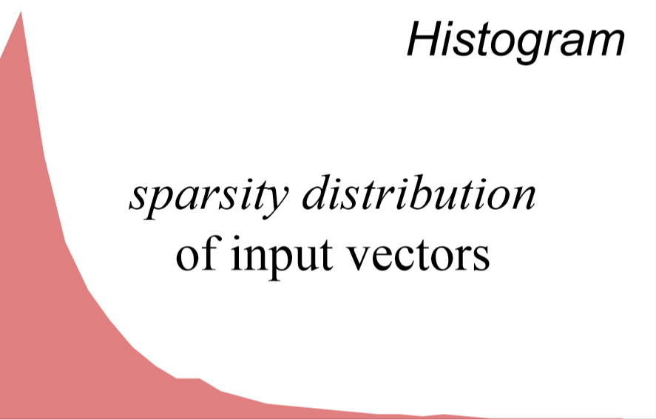
Power-law Distribution w.r.t Sparsity
Dataset : movielens-1M
Histogram
Huge Sparsity Difference
# of users
Most users buy relatively small amount of items, while a few users buy relatively large amount of items
# of ratings per user
19/37

Slide 20








Polarization: Theoretical Support
Theorem 3.9 Let $f\left(X\right)$ be a multi-layer AE with the ReLu activation, Then, $totvar\left(f(X_{s})\right)<totvar\left(f(X_{d})\right)$
Two Types of Inputs
Same AE Parameters
Polarization
$$z_{2}$$
Dense
Sparse
$$Z_{i}=f\left(X\right)=σ\left(WX_{i}+b\right)$$
1
1
1
1
0
1
0
0
0
0
$$X_{i}=$$
$$or$$
$$z_{1}$$
$$z_{1}$$
$$z_{2}$$
$$totvar\left(X_{s}\right)<totvar\left(X_{d}\right)$$
$$totvar\left(f(X_{s})\right)<totvar\left(f(X_{d})\right)$$
*total variance ($totvar(X$)) : a measure of dispersion of a random vector $X$ in a real-space ($ℝ^{n})$
20/37

Slide 21
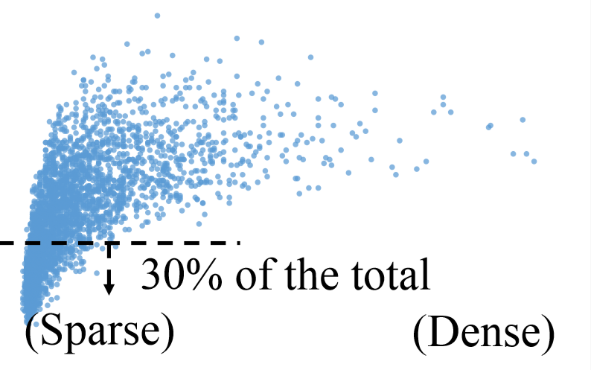

Polarization: Empirical Support
Dataset : Movielens-1M, Method: AutoRec
Implication
Dense inputs tend to be located far from sparse ones regardless of the correlation between dense and sparse inputs
$|Z$-$𝔼\left(Z\right)|$
Negative Effect
Recommenders, which exploit the mutual preference between similar users, may inaccurately estimate the user’s preference
# of ratings per user
21/37

Slide 22
Methodology
TRAP

Slide 23
TRAP: Two-level Regularizer
Two-level Regularized AE-based embedding for Power-law distributed data
(i) Macroscopic and (ii) Macroscopic regularizers
A meta-algorithm via simple modification of the loss and AE architecture
23/37

Slide 24
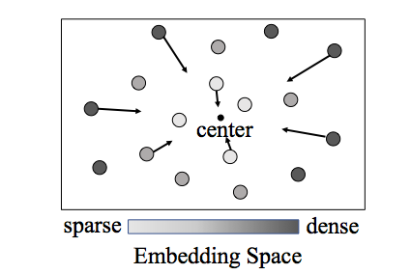
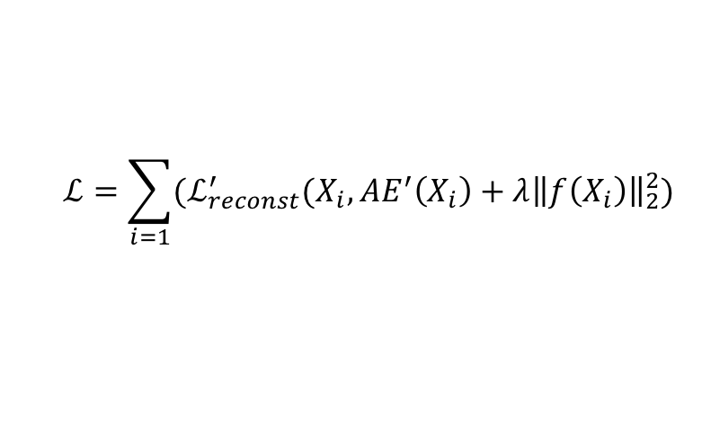
(i) Macroscopic Regularizer
Goal : to generally make sparse and dense objects closer to each other
Method : add a regularization term in the loss function
$$ℒ=\sum_{i=1}{(ℒ_{reconst}^{′}(X_{i}, AE^{′}\left(X_{i}\right)+λ{\left\|f\left(X_{i}\right)\right\|}_{2}^{2})}$$
l2-regularizer on the embeddings
24/37

Slide 25


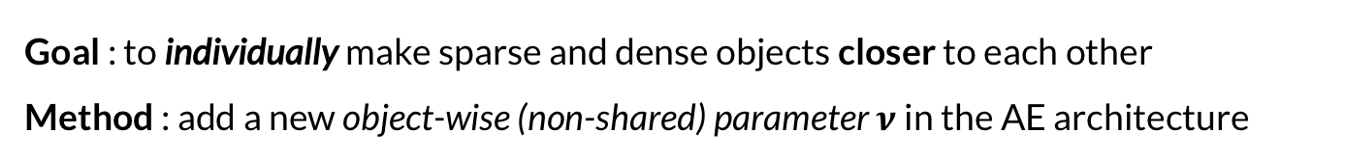
(ii) Microscopic Regularizer
Goal : to individually make sparse and dense objects closer to each other
Method : add a new object-wise (non-shared) parameter $ν$ in the AE architecture
$$ν_{i}$$
$$ν_{j}$$
Adjusting the norm of each layer embedding for each object
25/37

Slide 26






Synergistic Effect: Intuition
The macroscopic regularizer forces the non-shared parameters for the microscopic regularizer to be $ν_{s}>ν_{d}$ to void the polarization problem
Non-shared AE Parameters
Two Types of Inputs
Final Embeddings
Dense
Sparse
$$Z_{i}=f\left(X\right)=σ\left((WX_{i}+b)°v_{i}\right)$$
1
1
1
1
0
1
0
0
0
0
$$X_{i}=$$
$$or$$
$$z_{1}$$
$$z_{1}$$
$$z_{2}$$
$$totvar\left(X_{s}\right)<totvar\left(X_{d}\right)$$
$$totvar\left(f_{TRAP}(X_{s})\right)≮totvar\left(f_{TRAP}(X_{d})\right)$$
26/37

Slide 27
Experiments

Slide 28
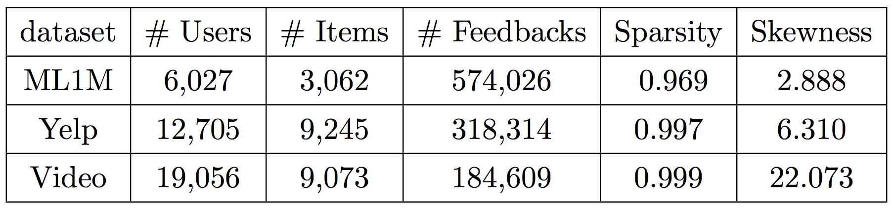
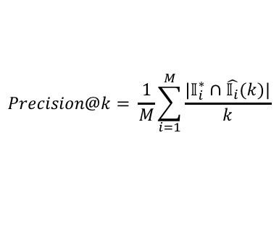
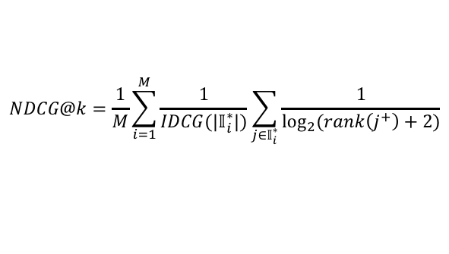

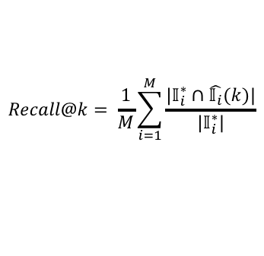
User Embedding: Top-k Recommendation
Datasets
Baselines
MF [09]
NCF [WWW17]
AutoRec [WWW15]
CDAE [WSDM16]
MultiVAE [WWW18]
JCA [WWW19]
Non-AE
Evaluation
AE
$$Precision@k= \frac{1}{M}\sum_{i=1}^{M}{\frac{|𝕀_{i}^{∗}∩\hat{𝕀_{i}}(k)|}{k}}$$
$$F1@k= \frac{2⋅P@k⋅R@k}{P@k+R@k}$$
$$Recall@k= \frac{1}{M}\sum_{i=1}^{M}{\frac{|𝕀_{i}^{∗}∩\hat{𝕀_{i}}(k)|}{|𝕀_{i}^{∗}|}}$$
$$NDCG@k=\frac{1}{M}\sum_{i=1}^{M}{\frac{1}{IDCG(|𝕀_{i}^{∗}|)}\sum_{j∈𝕀_{i}^{∗}}{\frac{1}{\log_{2}{(rank\left(j^{+}\right)+2)}}}}$$
28/37

Slide 29
User Embedding: Top-k Recommendation
TRAP combined with four AE models, in general, improves the performance of the baseline models
(% improve)
20.38
6.28
13.83
2.35
15.11
4.81
10.61
1.53
12.42
4.85
1.66
3.96
precision@k
MovieLens-1M
29/37

Slide 30
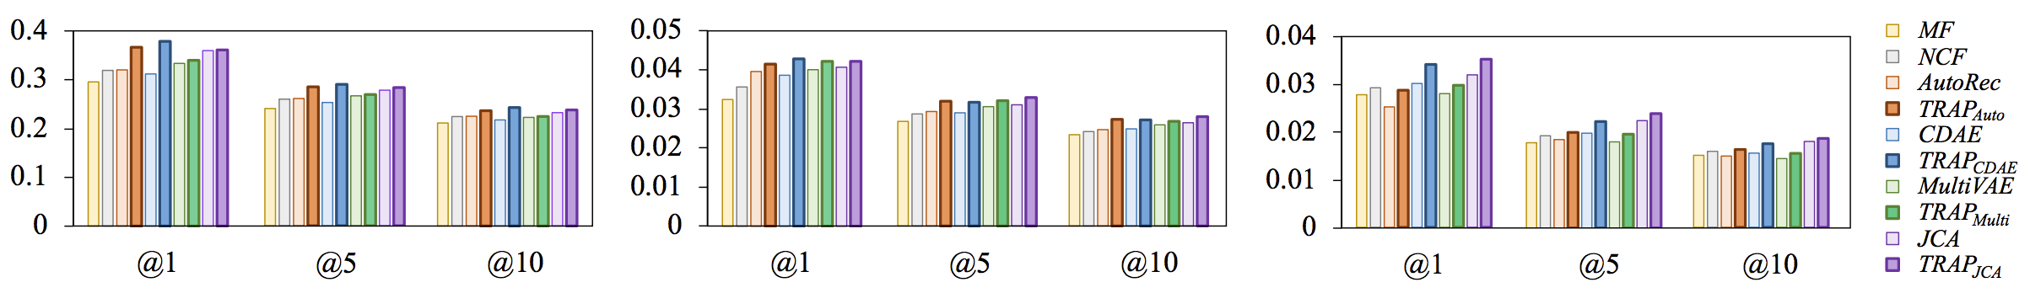
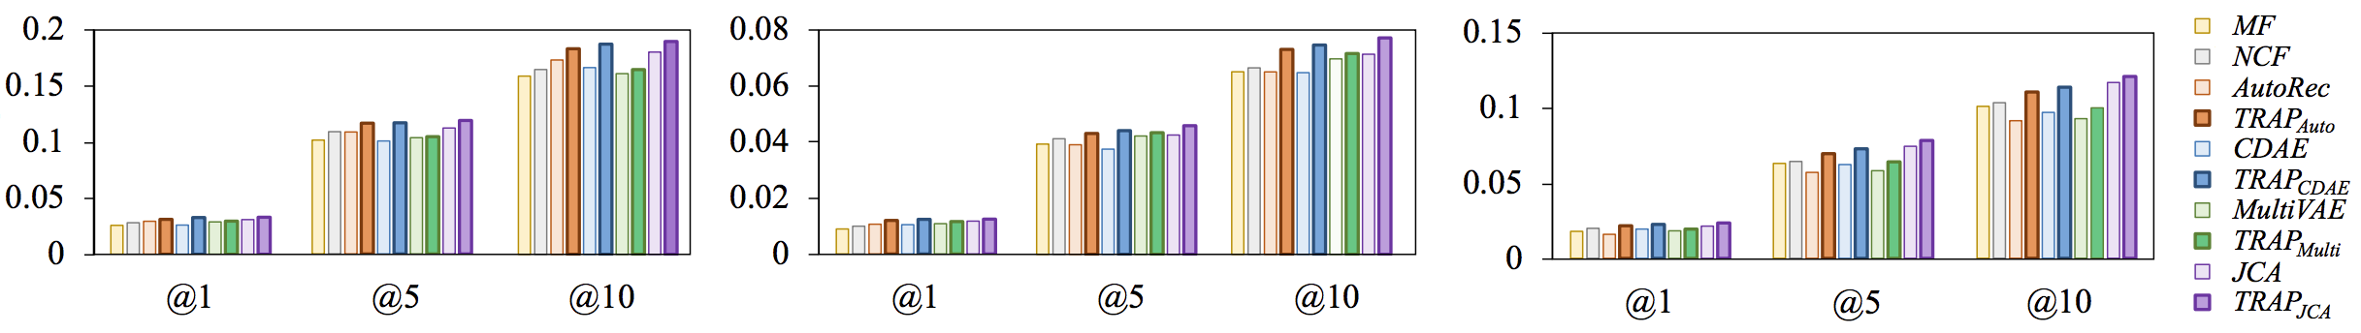
User Embedding: Top-k Recommendation
For all three datasets and metrics, TRAP boosts the performance of the AE-based baseline models
precision@k
recall@k
ML1M
Yelp
VideoGame
30/37

Slide 31
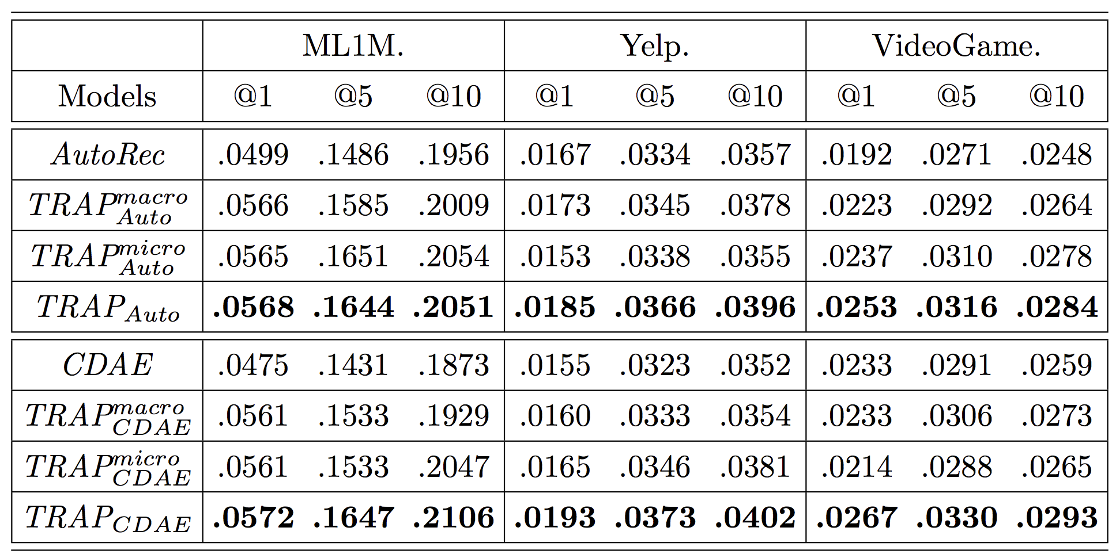
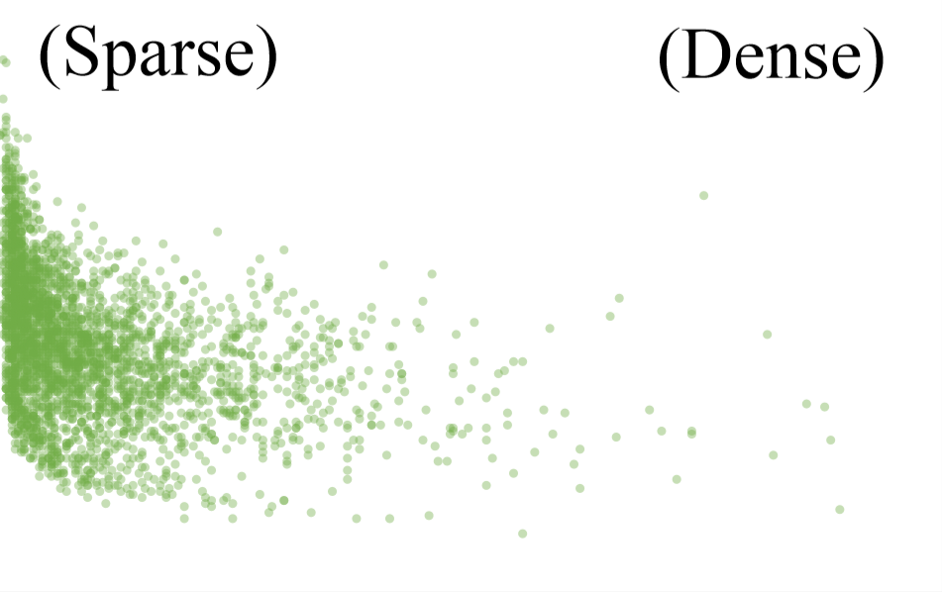




Ablation Study
Both regularizers are all effective
The best performance of the model using both regularizers together shows the synergistic effect between the two regularizers
$$ν_{s}>ν_{d}$$
$$ν_{i}$$
: TRAP w/ the macroscopic regularizer
$$TRAP_{Auto}^{macro}$$
# of ratings
: TRAP w/ the microscopic regularizer
$$TRAP_{Auto}^{micro}$$
31/37

Slide 32
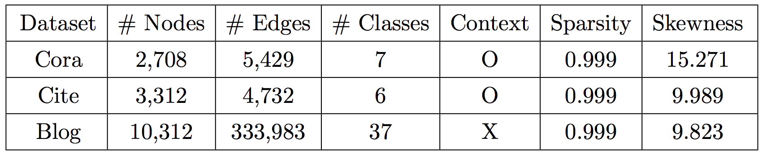
Node Embedding: Node Classification
Datasets
Baselines
DeepWalk [KDD14]
LINE [WWW15]
Node2Vec [KDD16]
Struct2Vec [KDD17]
SDNE [KDD16]
DANE [IJCAI18]
Non-AE
Evaluation
AE
Micro-f1 score
Average f1-score
Macro-f1 score
Average score of per-class f1-score
Using context information
32/37

Slide 33
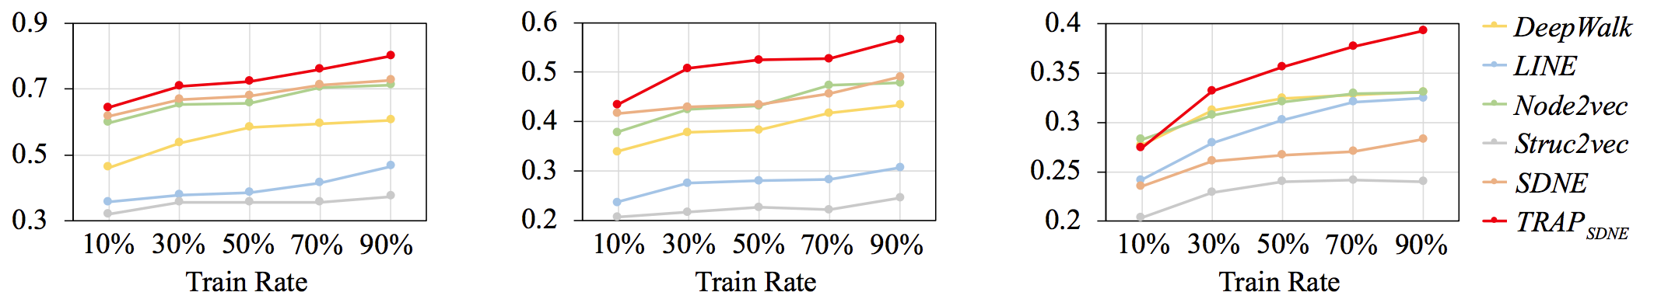
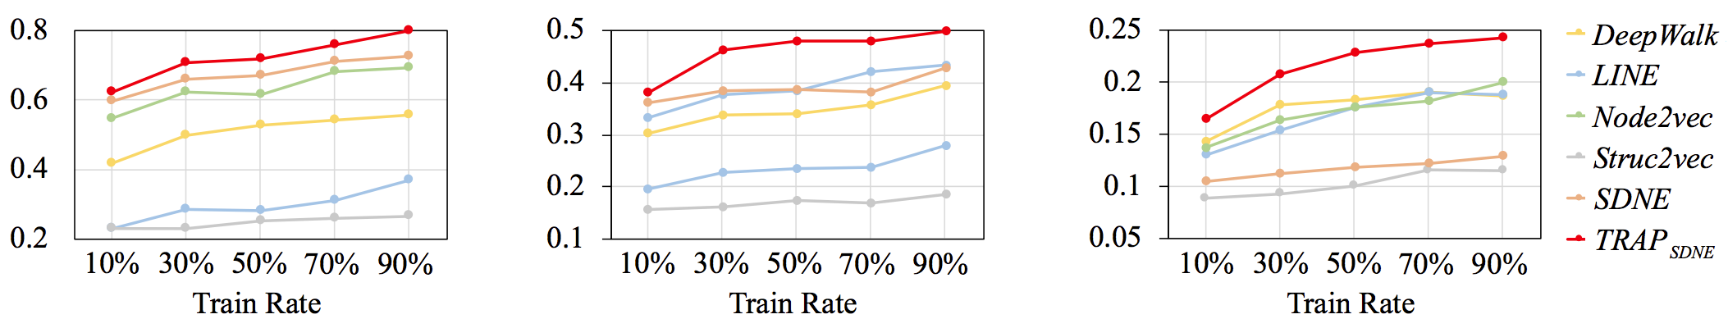
Node Embedding: Node Classification
TRAP combined with SDNE improves the performance for all three datasets
(% improve)
Micro-f1
94.99
Macro-f1
Cora
Citeseer
BlogCatalog
33/37

Slide 34
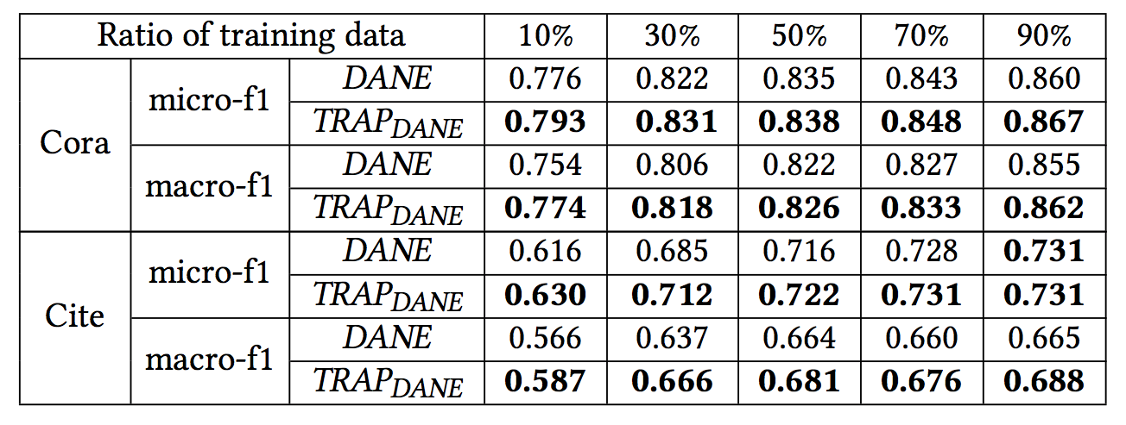
Node Embedding: Node Classification
TRAP combined with DANE improves the performance and achieves the state-of-the-art performance for two datasets
34/37

Slide 35
Conclusion

Slide 36
Conclusion
Clarified that the power-law distribution of input vectors’ sparsity causes the polarization problem, which severely hurts the quality of AE-based embedding
Proposed a novel two-level regularizer TRAP, which can be easily combined with existing AE-based methods, to alleviate the polarization problem
Provided theoretical formulation for the polarization problem and the synergistic effect of the proposed two-level regularizers
Significantly improved the performance of two representative tasks by up to 31.53% and 94.99% respectively
36/37

Slide 37
THANK YOU!
Any Question?

