Slide 1
Robust Learning by Self-Transition for Handling Noisy Labels
KDD 2021
Hwanjun Song, Minseok Kim, Dongmin Park, Yooju Shin, Jae-Gil Lee

Slide 2
What are noisy labels and its negative Impact on Learning?
Introduction

Slide 3
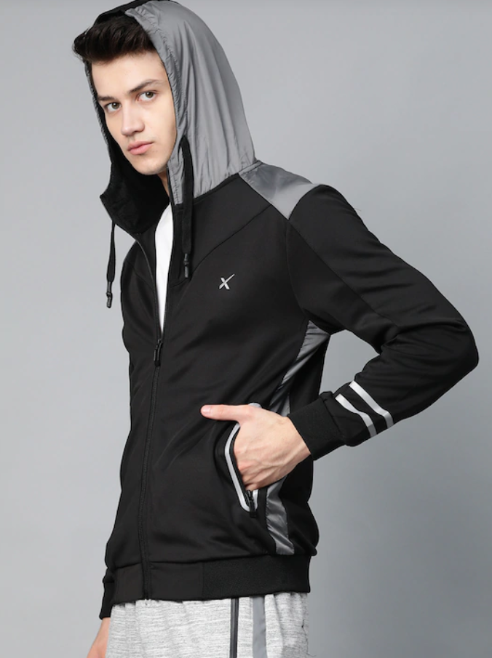
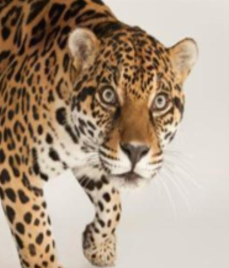
Data Labeling in Data Collection
Standard Supervised Learning with DNNs
Conditioned on the availability of massive data with expert labels
Too expensive and time-consuming
Cheap alternatives: surrounding text, crowdsourced platform, …
“Surrounding text “
“Non-expert labelers”
Best Price: $50
Product Details Black solid bomber jacket, has a hood with mesh …
Labeler 1: Jaguar
Labeler 2: Jaguar
Labeler 3: Cheetah
3

Slide 4
Noisy Labels
Alternatives produce noisy labels that may be corrupted from true ones
Mistakes with subjective labeling (Even expert can make …)
Data corruption – Label flipping attack
Ques. “How many mislabeling occurs?”
– 8.0% - 38.6%
4

Slide 5
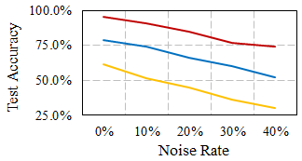
Negative Influence from Noisy Labels
ML Systems show poor generalization (performance) on unseen data
In over-parameterized regime, DNNs totally overfits to corrupted labels
Noise Rate $↑$ Test Accuracy $↓$
CIFAR-10
CIFAR-100
Tiny ImageNet
(Random flipping was used)
5

Slide 6
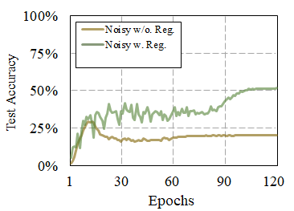
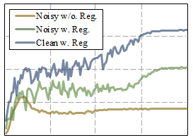
Can Popular Regularization Help?
Dropout, batch norm, weight decay, and data augmentation
Do not completely overcome the overfitting to noisy labels
Gap compared to optimal model
Benefit from regularization
(40% Random flipping was used)
6

Slide 7
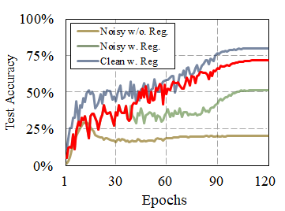
Can Popular Regularization Help?
Dropout, batch norm, weight decay, and data augmentation
Do not completely overcome the overfitting to noisy labels
Our proposed approach
+23%
(40% Random flipping was used)
7

Slide 8
What is good learning directions for robust learning with noisy labels?
Existing Directions for Handling Noisy Labels
Refer to “Learning from Noisy Labels with Deep Neural Networks: A Survey”

Slide 9
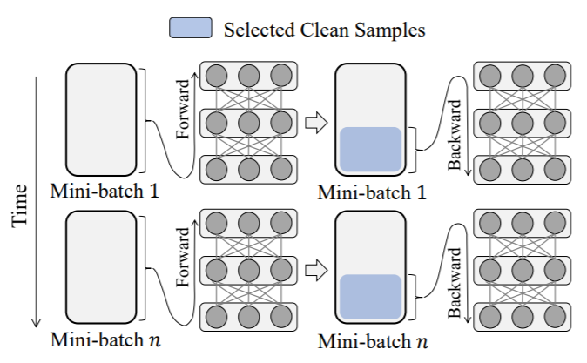
General Pipeline of Sample Selection
For each training iteration t,
Perform forward step on a given mini-batch $ℬ_{t}$
Identify the set of clean examples $𝓢_{t}$ from the noisy mini-batch $ℬ_{t}$
Perform a backward step only using the selected set $𝒮_{t}$
$$ℬ_{1}$$
$$𝒮_{1}$$
$$𝒮_{t}=\left\{\left(x, y\right)∈ℬ_{t}\right| criterion\left(x,y\right)=True\}$$
$$ℬ_{n}$$
$$𝒮_{n}$$
9

Slide 10
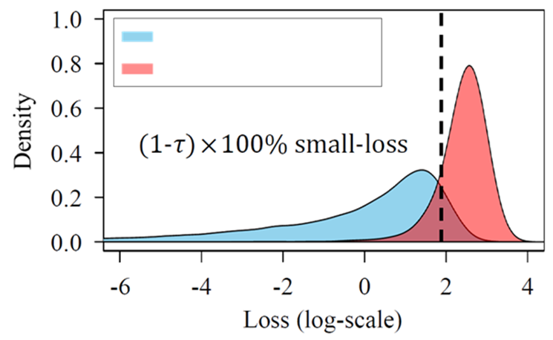
Criterion: Small-loss Trick
Memorization effect of DNNs (Just like human does…)
Learn simple patterns in clean examples first
Next, learn all the irregular patterns in corrupted examples (or outliers)
Connection between training losses and noisy labels
clean examples
Selected examples
via the mall-loss criterion
noise examples
10

Slide 11
Three Limitations
Discarding hard examples
Simply discard all clean examples with large losses, though they have a great impact on generalization
Confirmation bias
Favor the examples selected at the beginning of training
Strong supervision
Need to determine how many examples should be selected
Require a known noise rate or a clean validation set
11

Slide 12
Transitional behaviors exist in the memorization of DNNs
Memorization Nature of DNNs

Slide 13
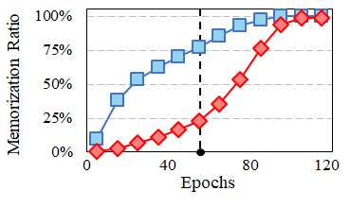
Transitional Memorization Nature
Memorized Example? If majority of its recent predictions coincide with its given label
The memorization nature changes at a certain point from noise-robust to noise-prone
“Noise-robust”
“Noise-prone”
Clean Examples
Noise Examples
We call it the transition point
FOOD-101N Data
13

Slide 14
Design | Incremental Selection w.o. Supervision
Divide a single of training process into two learning phases
Noise-robust Period
Noise-prone Period
Early learning of easy & clean examples
Late learning of hard & noise examples
“Phase I: Seeding”
“Phase II: Evolution”
Accumulate all memorized examples
Build an initial safe set
Expand the initial set to the maximal safe set
(1) exclude incorrected added examples
(2) add more hard clean examples
Self-transition
14

Slide 15
Advantages of Self-transitional Learning
No confirmation bias
The use of all training data in the noise-robust period (Phase I)
Not simply discarding hard examples
Set refinement in the noise-prone period (Phase II)
No requirement of any supervision for sample selection
Progressive sample selection using examples’ memorization
15
Notes:
.

Slide 16
How to find the best transition point? and How to refine the initial set?
MORPH: Self-transitional Learning

Slide 17
Definition of the Best Transition Point
Clean Examples
Noise Examples
Gap
When?
The moment when the memorization gap is maximized
Why?
Little noise from noise examples
Sufficient information from clean examples
Best Trade-off
17

Slide 18
Two Memorization Metrics
(Quality) Little noise from noise examples
(Quantity) Sufficient information from clean examples
Memorization Precision (MP)
Memorization Recall (MR)
$$MP=\frac{\# Memorized Clean Examples}{\# All Memorized Examples}$$
$$MR=\frac{\# Memorized Clean Examples}{\# All Clean Training Examples}$$
Indicator of little noise
Indicator of sufficient clean information
The point that achieves high MP and MR simultaneously
Calculating MP and MR is Infeasible without knowing GT labels
18

Slide 19
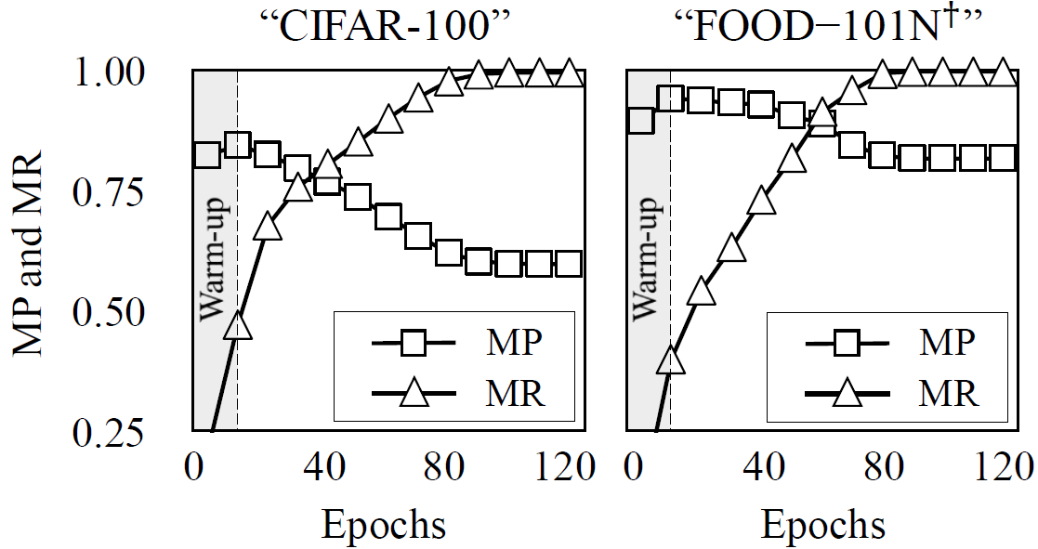
Monotonicity of MP and MR
The point that achieves high MP and MR simultaneously
$≈$The only one cross-point
Simplified final condition
(a) Asymmetric Noise
(b) Real-world Noise
Number of total clean examples
Number of memorized examples at time t
19

Slide 20
Phase I: Seeding
Accumulate all the memorized example until the transition point
“Noise-Robust”
A very good initial set (high MP & MR),
But, not a perfect set
Including more hard & clean samples
Filtering out noisy samples
20

Slide 21
Phase II: Evolution
Undesired memorization is easily forgotten by the robust update [SIGUA: Forgetting may make learning with noisy labels more robust, ICML’20] [An empirical study of example forgetting during deep neural network learning, ICLR'20]
Evolution Procedure: Three steps
(1) Robust update only for the current set $S_{t}$
(2) Update $S_{t}→S_{t+1}$ by reflecting the memorization change from (1)
(3) Repeat (1) and (2) during the remaining schedule
$θ_{t+1}=θ_{t}−α∇(\frac{1}{\left|ℬ ∩S_{t}\right|})\left(\sum_{x∈𝓑 ∩S_{t}}{ℒ\left(f(x;θ_{t}),\tilde{y}\right) }\right)$
$R_{new}$: Newly forgotten samples
$C_{new}$: Newly memorized samples
$S_{t+1}=S_{t}−R_{new}+C_{new}$, where
21

Slide 22
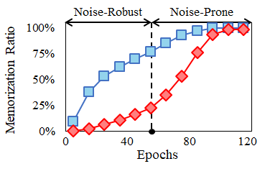
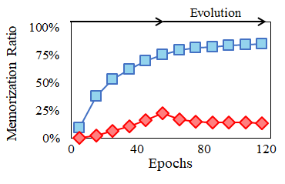
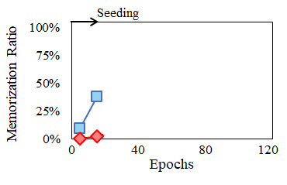
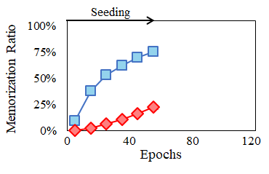
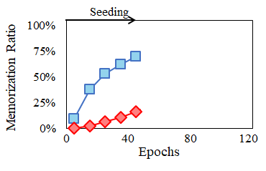
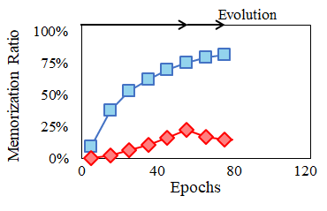
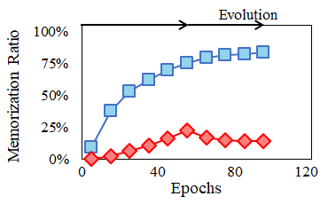
Summary of MORPH
Phase transition
Clean Examples
Noise Examples
$$+C$$
Rapidly
$$− R$$
(a) Default
(b) MORPH
22

Slide 23
Much robust Selection with High Precision and Recall Optimal Transition Point
Experiments

Slide 24
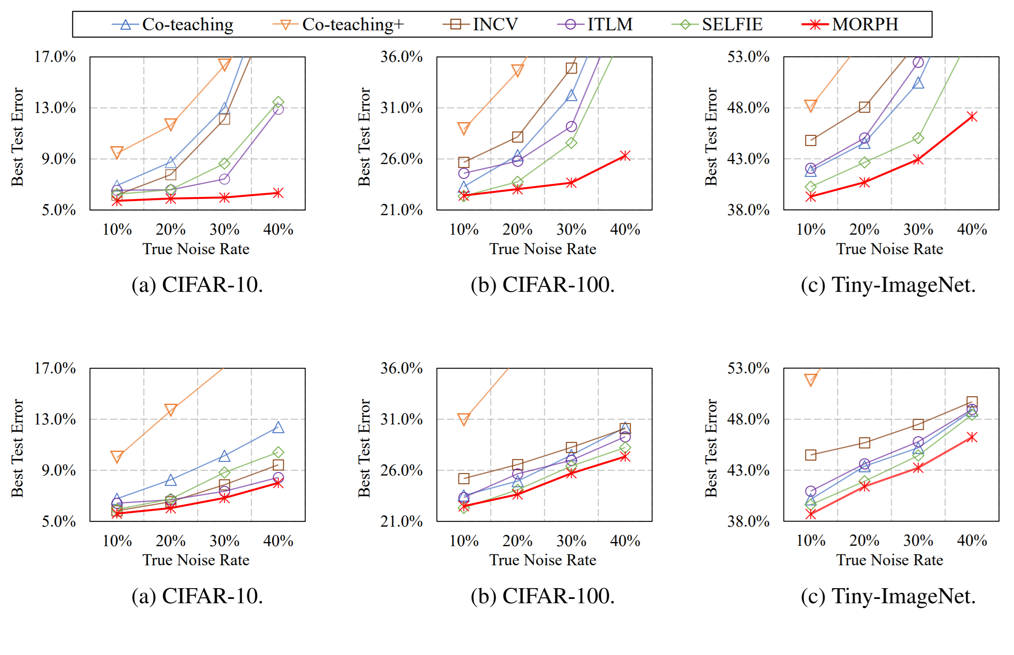
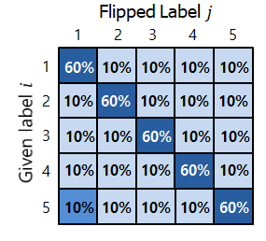
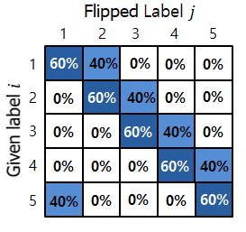
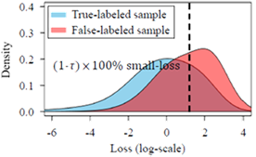
Evaluation | Synthetic Noise
WideResNet 16-8 was trained for 120 epochs
Five recent sample selection methods were compared with MORPH
Symmetric noise
Asymmetric noise
Fig. 1. Best test errors on three datasets with varying asymmetric noise rates
Asymmetric Noise
Fig. 2. Best test errors on three datasets with varying symmetric noise rates
24

Slide 25
Evaluation | Real-world Noise
We followed the same configuration in the recent studies for fair comparison
Two large-scale real-world data were used
WebVision V1: 2.4M training images (noise rate $≈$ 20.0%)
FOOD-101N: 300K training images (noise rate $≈$ 18.4%)
Method | WebVision Val. | ILSVRC2012 Val.
F-correction | 38.88% | 42.64%
Decouple | 37.46% | 41.74%
Co-teaching | 36.42% | 38.52%
MentorNet | 37.00% | 42.20%
D2L | 37.32% | 42.20%
INCV | 34.76% | 38.40%
MORPH (Our) | 28.32% | 31.09%
Method | FOOD-101
Cross-entropy | 18.56
Weakly supervised | 16.57
CleanNet ($w_{hard})$ | 16.53
CleanNet ($w_{soft}$) | 16.05
Guidance Learning | 15.80
MORPH (Our) | 14.71
(+3.85%)
(+10.56%)
(+11.55%)
Table 2. Best test errors on FOOD-101N.
Table 1. Best test errors on WebVision V1.
25

Slide 26
Evaluation | Impact of Set Evolution
Precision: How precisely clean examples are included in the set?
Recall: How many clean examples are included in the set?
We computed them on the clean set selected at each epoch since Phase II begins
Precision
Recall
(a) Selection Precision
(b) Selection Recall
26

Slide 27
Evaluation | Optimality of Phase Transition
Verify the optimality of the best transition point
Investigate the performance change when forcing early and late transition
Table. Best test errors (%) of MORPH with “early” and “late” transition
27

Slide 28
Conclusion

Slide 29
Conclusion
Develop robust a deep learning method for handling noisy labels
The existing small-loss trick has three limitations: (1) confirmation bias, (2) discarding hard examples, and (3) requiring strong supervision
Propose a self-transitional learning: seeding to evolution
Best transition point and alternative set update
Data
Collection
Data Cleaning
Model
Training
Evaluation & Serving
Expensive & time-consuming
29

Slide 30
THANK YOU! Any Question?

