Slide 1
Topical Influence Modeling via
Topic-Level Interests and Interactions on
Social Curation Services
Daehoon Kim¹, Jae-Gil Lee¹, Byung Suk Lee²
¹Department of Knowledge Service Engineering, KAIST
²Department of Computer Science, University of Vermont

Slide 2

Contents
01. Motivation
02. Empirical Study
03. TISC Model
04. Evaluation
05. Conclusion

Slide 3







Topic-Sensitive Social Influence
Quantifying social influence separately for each topic
Design
Fashion

Slide 4











Technical Hurdles
Hard to know the reason for an interaction (e.g., following) in traditional social networking services
⇒ Existing methods typically rely on the common-interest assumption
  The interactions are made between the users having interests in similar topics
User A
why?
User B
Similar?

Slide 5
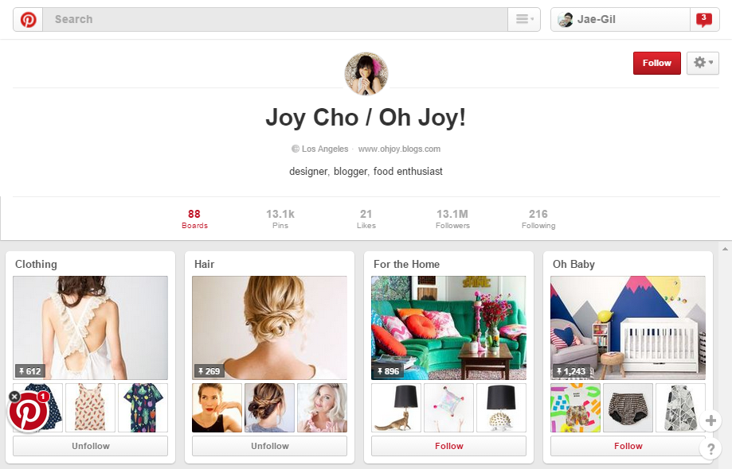
Social Curation Service (1/2)
D
Following This User
(i.e., All Boards)
B
Number of Boards
A
Board
C
Number of Items
E
Following this Board Only

Slide 6








Social Curation Service (2/2)
Combining social media features with content curation features
Following
Users
Creating
Contents
Following
Boards
Explicit topic-level information
in contents and interactions

Slide 7
Key Contributions
We empirically refute the common-interest assumption
We propose a novel model of Topical Influence with Social Curation (TISC) to find influential users from social curation services
The TISC model satisfies:
  Considering both contents and interactions
  Being free from the common-interest assumption
  Being easily parallelizable (on Hadoop or Spark)

Slide 8
Contents
01. Motivation
02. Empirical Study
03. TISC Model
04. Evaluation
05. Conclusion

Slide 9
Interaction Behaviors
Following ratio
  For a follower-followee pair:
# boards followed by the follower
# all boards of the followee
Selective following of the boards
Pinterest
Scoop.it

Slide 10
Refutation of the CI Assumption (1/2)
Topic fraction
  In contents:
  In interactions:
# items of a user on a given topic
# all items of a user
# followings of a user on a given topic
# all followings of a user
Weak correlation!
r = 0.26
r = 0.27
“Design” on Pinterest
“Education” on Scoop.it

Slide 11

Refutation of the CI Assumption (2/2)
Topic difference between contents and interactions
  $topic_diff=\frac{\left|frac_x −frac_y\right|}{max⁡(frac_x,frac_y)}$
Distinct behavior between
creating and following boards
“Design” on Pinterest
“Education” on Scoop.it

Slide 12
Contents
01. Motivation
02. Empirical Study
03. TISC Model
04. Evaluation
05. Conclusion

Slide 13





TISC Model
Test set
$$u_{1}$$
?
Topic
Training set
TISC model
$$u_{2}$$
?
$$u_{3}$$
?
Topic
0.7
Influence
score
Learning
(CCRF)
Influence
model
Influence (ranking)
score
Inference
0.4
0.2
$$u_{1}$$
= 0.3
Topic
$$u_{2}$$
= 0.2
$$u_{3}$$
= 0.5
TISC model formulates the problem of finding influential users as a global ranking problem
  Influence is determined by considering both the contents of users and the interactions between users
The continuous conditional random field (CCRF) is employed to conduct the learning task

Slide 14



Continuous Conditional Random Field (CCRF)
Using both the content information of objects and the relation information between objects for ranking
⇒ Perfect match for our problem!
Vertex Feature (Content)
Social Curation Service
Influence Score
Edge Feature (Interaction)

Slide 15

Details of the CCRF
Vertex Feature
$$P\left(y | X;α,β\right)=\frac{\exp\left(Ψ\right)}{\int_{−∞}^{∞}{\exp\left(Ψ\right)dy}}, where$$
$$Ψ=\sum_{i}{\sum_{k=1}^{K_{1}}{α_{k}f_{k}(y_{i},X)}}+\sum_{i,j}{\sum_{k=1}^{K_{2}}{β_{k}g_{k}(y_{i},y_{j},X)}}$$
Influence Score
Edge Feature
Parameter: importance of each feature
Vertex Feature Function
Edge Feature Function

Slide 16

Feature Functions
Vertex feature function
  $f_{k}\left(y_{i},X\right)=−{\left(y_{i}−x_{i,k}\right)}^{2}$
Edge feature function
  $g_{k}\left(y_{i},y_{j},X\right)=−S_{i,j}^{\left(k\right)}(y_{i}−y_{j})$
Vertex Feature
1) The higher a vertex feature is,
the more influential a user is
Edge Feature
2) The followee has higher influence
than the follower ← status theory

Slide 17

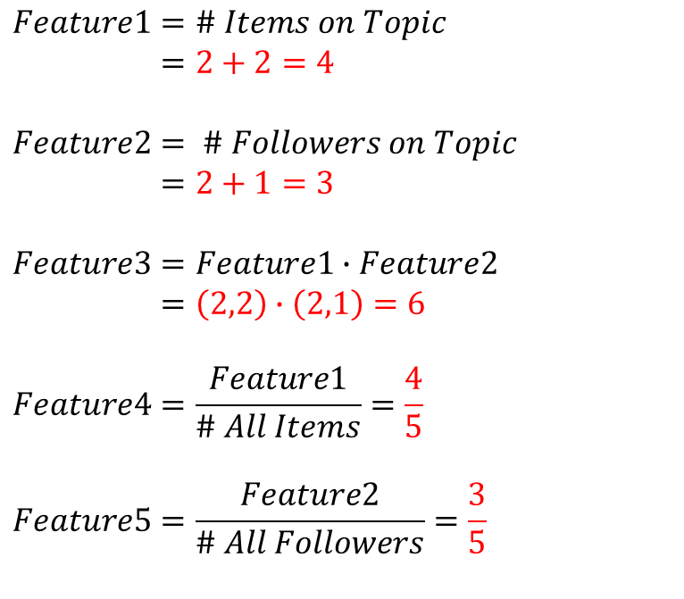


Input Features (1/2)
Vertex features
  To relate the contents of a user to his/her influence on a given topic
$$Feature1=\# Items on Topic \\ =2+2=4$$
$$Feature2= \# Followers on Topic \\ =2+1=3$$
$$Feature3=Feature1∙Feature2 \\ =\left(2,2\right)∙\left(2,1\right)=6$$
$$Feature4=\frac{Feature1}{\# All Items}=\frac{4}{5}$$
$$Feature5=\frac{Feature2}{\# All Followers}=\frac{3}{5}$$
# Followers on Topic
$$\# \text{All} \text{Folowers}$$
Design
Design
Fashion
$$\text{\#} \text{All} \text{Items}$$
# Items on Topic

Slide 18

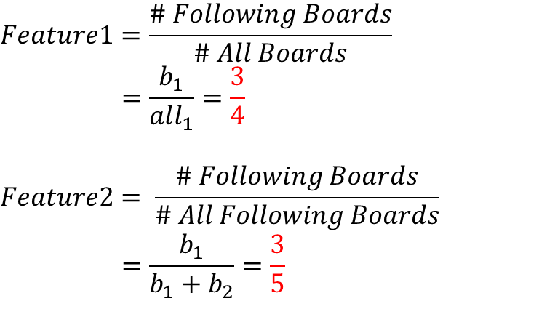
Input Features (2/2)
Edge features
  To relate the interactions of a user to his/her influence on a given topic
Design
Design
Fashion
$$Feature1=\frac{\# Following Boards}{\# All Boards}$$
$$=\frac{b_{1}}{all_{1}}=\frac{3}{4}$$
$$Feature2= \frac{\# Following Boards}{\# All Following Boards}$$
$$=\frac{b_{1}}{b_{1}+b_{2}}=\frac{3}{5}$$
all₁
b₁
Design
Fashion
b₂

Slide 19
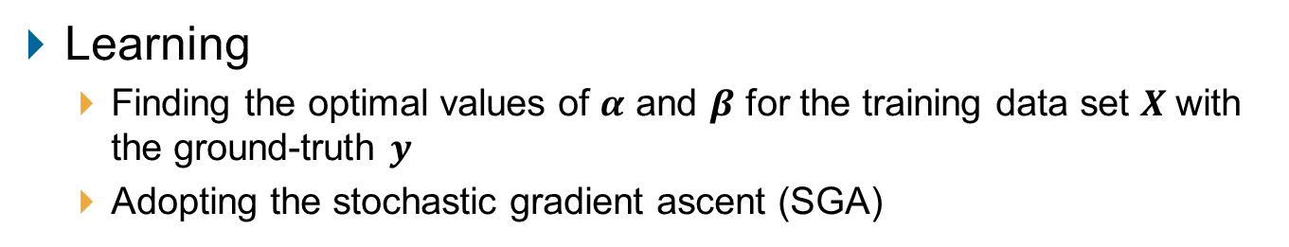
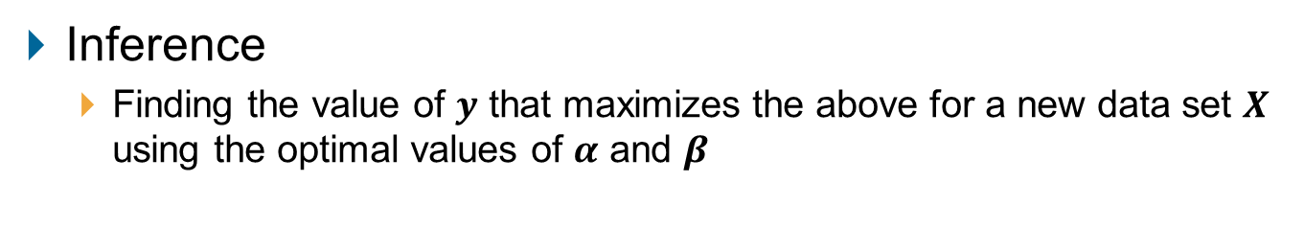
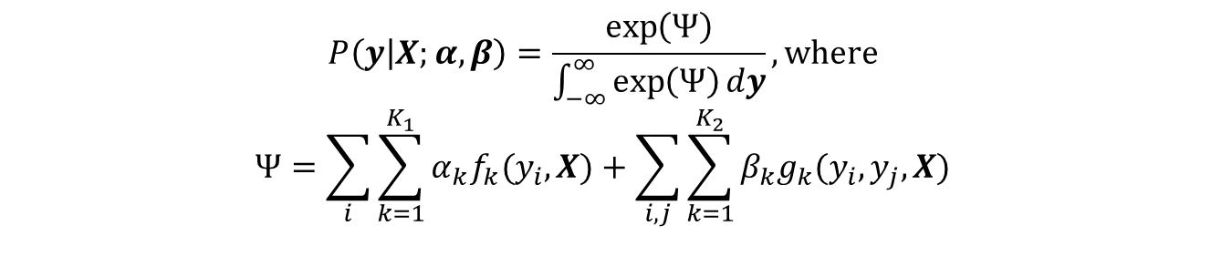
TISC Implementation
Learning
  Finding the optimal values of $α$ and $β$ for the training data set $X$ with the ground-truth $y$
  Adopting the stochastic gradient ascent (SGA)
$$P\left(y | X;α,β\right)=\frac{\exp\left(Ψ\right)}{\int_{−∞}^{∞}{\exp\left(Ψ\right)dy}}, where$$
$$Ψ=\sum_{i}{\sum_{k=1}^{K_{1}}{α_{k}f_{k}(y_{i},X)}}+\sum_{i,j}{\sum_{k=1}^{K_{2}}{β_{k}g_{k}(y_{i},y_{j},X)}}$$
Inference
  Finding the value of $y$ that maximizes the above for a new data set $X$ using the optimal values of $α$ and $β$

Slide 20
Contents
01. Motivation
02. Empirical Study
03. TISC Model
04. Evaluation
05. Conclusion

Slide 21
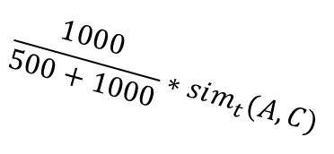
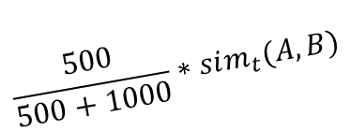
Compared Methods (1/3)
Representative users
on a given topic
Topic-Sensitive PageRank (TSPR) [Haveliwala, 2002]
  Calculating a PageRank vector for a each topic with a topic-based teleportation vector
TwitterRank [Weng et al., 2010]
  Considering both the topical similarity between users and the link structure
Teleport Here!
No Contents
CI Assumption
$$\frac{500}{500+1000}∗sim_{t}(A,B)$$
Publish
500 tweets
User B
User A
$$\frac{1000}{500+1000}∗sim_{t}(A,C)$$
Publish
1000 tweets
User C

Slide 22


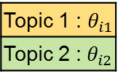







Compared Methods (2/3)
Topic Affinity Propagation for PageRank with Topic-based Influence (TAP-TPRI) [Tang et al., 2009]
  Considering both the topic distribution and the existing network structure
Linear Regression
  Using only vertex features to build a regression model
Global feature
function
Social link
Topic distribution
Nodes that have the highest influence on the current node
$$y_{2}$$
Topic 1 : $θ_{i1}$
Topic 2 :${ θ}_{i2}$
Edge feature
$$y_{4}$$
Edge feature
function
$$y_{1}^{1}=2$$
$$y_{1}^{2}=1$$
$$y_{1}$$
$$y_{3}$$
Node feature
Node feature
function
CI Assumption
$$v_{2}$$
$$v_{4}$$
$$v_{1}$$
$$v_{3}$$
Node/user
$$y_{i}=α_{1}x_{i,1}+α_{1}x_{i,2}+…+α_{k}x_{i,k}+ε_{i}$$
No Interactions
Influence score
Vertex feature

Slide 23
Compared Methods (3/3)
 | Content Use | Interaction Use | No CI Assumption | Learning Method
TSPR | ✕ | O | O | Unsupervised
TwitterRank | △ | O | ✕ | Unsupervised
TAP-TPRI | △ | O | ✕ | Supervised
Regression | O | △ | O | Supervised
TISC | O | O | O | Supervised

Slide 24
Real-World Datasets
Pinterest (https://www.pinterest.com)
  Crawled from June to August in 2015
Scoop.it (http://www.scoop.it)
  Crawled from July to September in 2013
 | Pinterest | Scoop.it
# All Vertices | 4,405,821 | 10,065,778
# Users | 8,624 | 9,325
# Boards | 212,805 | 25,761
# Items | 4,184,392 | 10,030,692
# All Edges | 4,892,902 | 10,338,607
# Following Edges | 495,705 | 282,154
# User → Board Edges | 212,805 | 25,761
# Board → Item Edges | 4,184,392 | 10,030,692

Slide 25
Data Set Preparation
  Training set: 40%, test set: 60%
  Company-provided ground truth (true influence score) of the users in the training set
  A weighted sum of the scores of the boards on the topic, where these scores are offered by the service providers
    Considering relevant keywords, update frequencies, amounts of sharing, numbers of likes, and so on
  5 groups of the users in the test set
Topic difference
0% 20% 40% 60% 80% 100%
G1 | G2 | G3 | G4 | G5

Slide 26














Accuracy Metric
Rationale: The users followed by another user have higher influence than those not followed by that user [Weng et al., 2010]
$Q\left(u_{f},U_{irr}\right)=\frac{\left|\left\{u_{k} | u_{k}∈U_{irr},score\left(u_{k}\right)<score\left(u_{f}\right)\right\}\right|}{|U_{irr}|}$
$$Q\left(u_{f},U_{irr}\right)=\frac{2}{3}$$
User who has
interaction
0.8
$$u_{1}$$
$$u_{1}$$
$$u_{1}$$
$$u_{2}$$
$$u_{2}$$
$$u_{2}$$
0.6
$$u_{3}$$
$$u_{3}$$
$$u_{3}$$
0.5
$$u_{4}$$
$$u_{4}$$
$$u_{4}$$
1.0
Users who do not
have interaction
1) Remove
all interaction edges
2) Calculate
the influence scores of users

Slide 27
Accuracy Result (1/2)
Design
Home Decoration
Women’s Fashion
Food & Drink
Pinterest Data Set
Education
Art
Media
Audio & Video
Scoop.it Data Set

Slide 28
Accuracy Result (2/2)
Average accuracy for the four topics
 | TSPR | TwitterRank | TAP-TPRI | Regression | TISC
G20 | 0.32 | 0.47 | 0.42 | 0.59 | 0.70
G40 | 0.35 | 0.44 | 0.43 | 0.61 | 0.70
G60 | 0.33 | 0.43 | 0.42 | 0.54 | 0.70
G80 | 0.30 | 0.39 | 0.31 | 0.43 | 0.67
G100 | 0.27 | 0.33 | 0.41 | 0.60 | 0.71
Pinterest Data Set
 | TSPR | TwitterRank | TAP-TPRI | Regression | TISC
G20 | 0.26 | 0.52 | 0.41 | 0.57 | 0.69
G40 | 0.27 | 0.47 | 0.32 | 0.65 | 0.73
G60 | 0.27 | 0.46 | 0.36 | 0.62 | 0.68
G80 | 0.21 | 0.46 | 0.33 | 0.64 | 0.72
G100 | 0.25 | 0.37 | 0.34 | 0.53 | 0.67
Scoop.it Data Set

Slide 29
Case Study
Top-5 influencers about each of the four topics
  Content-type errors: the users who created less than 500 items on a given topic
  Interaction-type errors: the users who received less than 100 followings on a given topic
  Correct answers: none of the above
Pinterest Data Set

Slide 30
Scalability and Performance Result
Performance of the learning phase on Spark
  12 Microsoft Azure A3 instances
    4 cores, 7GB main memory, 285GB hard disk per instance
    1 master node, 11 worker nodes, 32 data partitions
Varying the Data Size
(8 cores)
Varying the Number of Cores
(x600)

Slide 31
Contents
01. Motivation
02. Empirical Study
03. TISC Model
04. Evaluation
05. Conclusion

Slide 32
Conclusion
We proposed the TISC model to find influential users from social curation services
We conducted extensive experiments to demonstrate the benefits of our model using two real-world data sets
TISC significantly outperforms other methods in terms of the accuracy of finding prospective followees and the quality of the top-5 influencers
TISC is highly scalable and parallelizable, as proven by its Spark implementation

Slide 33
Thank you

