Slide 1



Traffic Data Classification
March 30, 2011
Jae-Gil Lee

Slide 2
Brief Bio
Currently, an assistant professor at Department of Knowledge Service Engineering, KAIST
  Homepage: http://dm.kaist.ac.kr/jaegil
  Department homepage: http://kse.kaist.ac.kr
Previously, worked at IBM Almaden Research Center and University of Illinois at Urbana-Champaign
Areas of Interest: Data Mining and Data Management

Slide 3
Table of Contents
Traffic Data
Traffic Data Classification
  J. Lee, J. Han, X. Li, and H. Cheng “Mining Discriminative Patterns for Classifying Trajectories on Road Networks”, to appear in IEEE Trans. on Knowledge and Data Engineering (TKDE), May 2011
Experiments

Slide 4

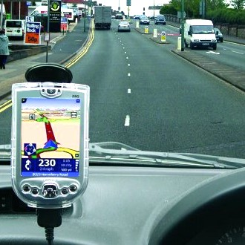
Trillions Traveled of Miles
MapQuest
  10 billion routes computed by 2006
GPS devices
  18 million sold in 2006
  88 million by 2010
Lots of driving
  2.7 trillion miles of travel (US – 1999)
  4 million miles of roads
  $70 billion cost of congestion, 5.7 billion gallons of wasted gas
Notes:
US drivers travel 2.7 trillion miles per year.
There are nearly 4 million miles of roads in the United States.
Traffic congestion in 2001 wasted 3.6 billion hours and 5.7 billion gallons, worth $70 billion, in 75 U.S. urban areas.

Slide 5
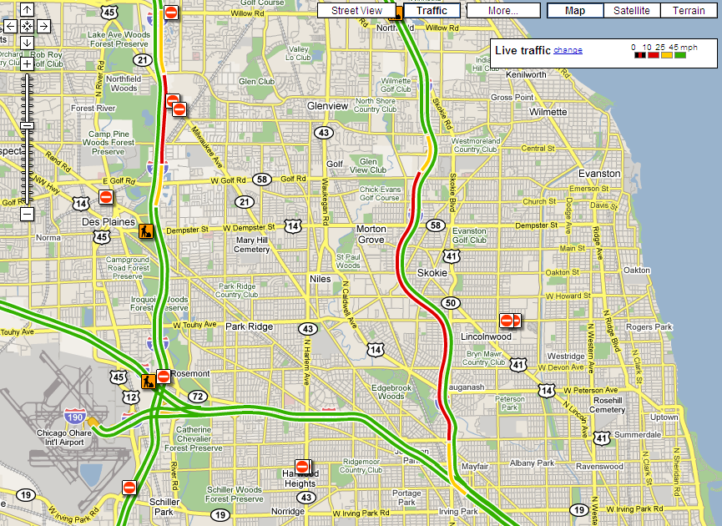
Abundant Traffic Data
Google Maps provides live traffic information
Notes:
Google Maps adds live traffic for US cities. Color coded routes indicate traffic levels for that city. This is the Chicago area.

Slide 6
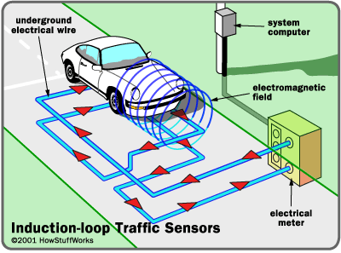
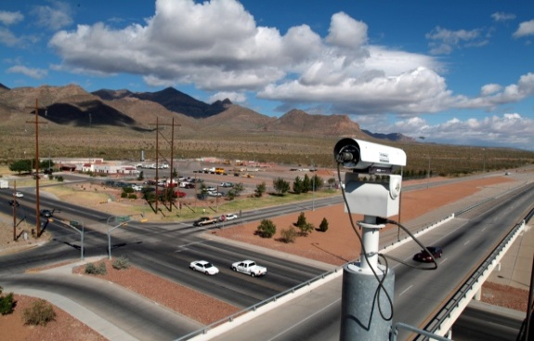
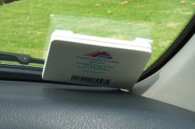
Traffic Data Gathering
Inductive loop detectors
  Thousands, placed every few miles in highways
  Only aggregate data
Cameras
  License plate detection
RFID
  Toll booth transponders
  511.org – readers in CA
Notes:
The preformed or saw-cut loop is buried in the traffic lane. The detector powers the loop causing a magnetic field in the loop area. When a large metal object, such as a vehicle, moves over the loop, the resonate frequency increases. A traffic light detects that a car has pulled up and is waiting for the light to change.
RFID tags are used for electronic toll-collection systems. The tags can be mounted on the inside of the vehicle's windshield. They communicate with reader equipment built into lane-based or open road toll collection lanes.

Slide 7
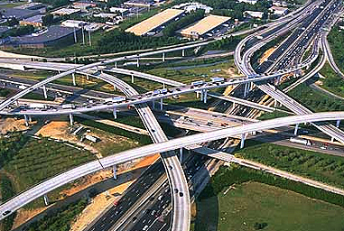
Road Networks
Node: Road
intersection
Edge: Road
segment

Slide 8

Trajectories on Road Networks
A trajectory on road networks is converted to a sequence of road segments by map matching
  e.g., The sequence of GPS points of a car is converted to ⟨O’Farrell St, Mason St, Geary St, Grant Ave⟩
Geary St
O’Farrell St
Mason St
Powell St
Stockton St
Grant Ave

Slide 9
Table of Contents
Traffic Data
Traffic Data Classification
  J. Lee, J. Han, X. Li, and H. Cheng “Mining Discriminative Patterns for Classifying Trajectories on Road Networks”, to appear in IEEE Trans. on Knowledge and Data Engineering (TKDE), May 2011
Experiments

Slide 10
Classification Basics
Scope of this talk
Classifier
Unseen data
(Jeff, Professor, 4, ?)
Features
Feature Generation
Prediction
Training data
Tenured = Yes
Class label

Slide 11
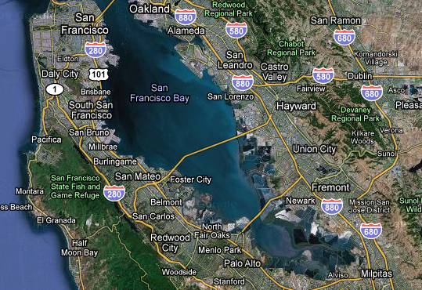
Traffic Classification
Problem definition
  Given a set of trajectories on road networks, with each trajectory associated with a class label, we construct a classification model
Example application
  Intelligent transportation systems
Predicted destination
Future path
Partial path

Slide 12
Single and Combined Features
A single feature
  A road segment visited by at least one trajectory
A combined feature
  A frequent sequence of single features
⇒ a sequential pattern
Single features =
{ e₁, e₂, e₃, e₄, e₅, e₆ }
Combined features =
{ <e₅, e₂, e₁>, <e₆, e₃, e₄> }
e₅
trajectory
e₁
e₂
e₃
e₄
e₆
road

Slide 13
Observation I
Sequential patterns preserve visiting order, whereas single features cannot
  e.g., ⟨e₅, e₂, e₁⟩, ⟨e₆, e₂, e₁⟩, ⟨e₅, e₃, e₄⟩, and ⟨e₆, e₃, e₄⟩ are
  discriminative, whereas e₁ ~ e₆ are not
⇒ Good candidates of features
e₅
: class 1
: class 2
: road
e₁
e₂
e₃
e₄
e₆

Slide 14
Observation II
Discriminative power of a pattern is closely related to its frequency (i.e., support)
  Low support: limited discriminative power
  Very high support: limited discriminative power
low support
very high support
Rare or too common patterns are not discriminative

Slide 15
Our Sequential Pattern-Based Approach
Single features ∪ selection of frequent sequential patterns are used as features
It is very important to determine how much frequent patterns should be extracted—the minimum support
  A low value will include non-discriminative ones
  A high value will exclude discriminative ones
Experimental results show that accuracy improves by about 10% over the algorithm without handling sequential patterns

Slide 16
Technical Innovations
An empirical study showing that sequential patterns are good features for traffic classification
  Using real data from a taxi company at San Francisco
A theoretical analysis for extracting only discriminative sequential patterns
A technique for improving performance by limiting the length of sequential patterns without losing accuracy ⇐ not covered in detail

Slide 17
Overall Procedure
Data
statistics
Derivation of the Minimum Support
trajectories
min_sup
Sequential Pattern Mining
sequential patterns
Feature Selection
single features
a selection of sequential patterns
Classification Model Construction
a classification model

Slide 18
Theoretical Formulation
Deriving the information gain (IG) [Kullback and Leibler] upper bound, given a support value
  The IG is a measure of discriminative power
Information Gain
the upper bound
an IG threshold for good features (well-studied by other researchers)
min_sup
Support
Patterns whose IG cannot be greater than the threshold are removed by giving a proper min_sup to a sequential pattern mining algorithm
Frequent but non-discriminative patterns are removed by feature selection later

Slide 19
Basics of the Information Gain
Formal definition
  IG(C, X) = H(C) – H(C|X), where H(C) is the entropy and H(C|X) is the conditional entropy
Intuition
high entropy due to uniform distribution
low entropy due to skewed distribution
H(C)
H(C|X)
class 1 class 2 class 3
class 1 class 2 class 3
a distribution of all trajectories
a distribution of the trajectories
having a particular pattern
The IG of the pattern is high

Slide 20
The IG Upper Bound of a Pattern
Being obtained when the conditional entropy H(C|X) reaches its lower bound
  For simplicity, suppose only two classes c₁ and c₂
  The lower bound of H(C|X) is achieved when q = 0 or 1 in the formula (see the paper for details)
    P(the pattern appears) = θ
    P(the class label is c₂) = p
    P(the class label is c₂|the pattern appears) = q
H(C|X) = – θqlog₂q – θ(1 – q)log₂(1 – q)
+ (θq – p)log₂
+ (θ(1 – q) – (1 – p))log₂
p – θq
1 – θ
(1 – p) – θ(1 – q)
1 – θ

Slide 21
Sequential Pattern Mining
  Setting the minimum support θ* = argmax (IG_{ub}(θ) ≤ IG₀)
Confining the length of sequential patterns in the process of mining
  The length ≤ 5 is generally reasonable
Being able to employ any state-of-the-art sequential pattern mining methods
  Using the CloSpan method in the paper

Slide 22
Feature Selection
Primarily filtering out frequent but non-discriminative patterns
Being able to employ any state-of-the-art feature selection methods
  Using the F-score method in the paper
F-score of features (i.e., patterns)
F-score
Possible thresholds
Ranking of features

Slide 23

Classification Model Construction
Using the feature space (single features $∪$selected sequential patterns)
Deriving a feature vector such that each dimension indicates the frequency of a pattern in a trajectory
Providing these feature vectors to the support vector machine (SVM)
  The SVM is known to be suitable for (i) high-dimensional and (ii) sparse feature vectors

Slide 24
Table of Contents
Traffic Data
Traffic Data Classification
  J. Lee, J. Han, X. Li, and H. Cheng “Mining Discriminative Patterns for Classifying Trajectories on Road Networks”, to appear in IEEE Trans. on Knowledge and Data Engineering (TKDE), May 2011
Experiments

Slide 25
Experiment Setting
Datasets
  Synthetic data sets with 5 or 10 classes
  Real data sets with 2 or 4 classes
Alternatives
Symbol | Description
Single_All | Using all single features
Single_DS | Using a selection of single features
Seq_All | Using all single and sequential patterns
Seq_PreDS | Pre-selecting single features
Seq_DS | Using all single features and a selection of sequential features ⇐ our approach

Slide 26
Synthetic Data Generation
Network-based generator by Brinkhoff
(http://iapg.jade-hs.de/personen/brinkhoff/generator/)
  Map: City of Stockton in San Joaquin County, CA
Two kinds of customizations
  The starting (or ending) points of trajectories are located close to each other for the same class
  ﻿Most trajectories are forced to pass by a small number of hot edges―visited in a given order for certain classes, but in a totally random order for other classes
Ten data sets
  D1~D5: five classes
  D6~D10: ten classes

Slide 27
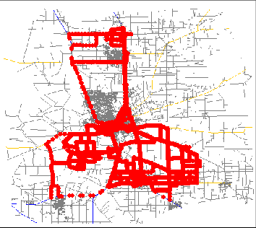
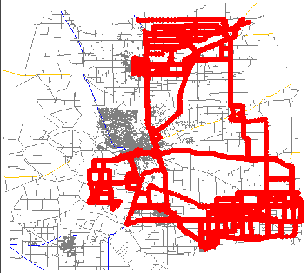
Snapshots of Data Sets
Snapshots of 1000 trajectories for two different classes

Slide 28
Classification Accuracy (I)
Single_All Single_DS Seq_All Seq_PreDS Seq_DS
D1 84.88 84.76 77.76 82.32 94.72
D2 82.72 83.08 84.84 82.92 95.68
D3 86.68 92.40 76.84 89.36 93.24
D4 78.04 76.20 78.44 76.44 89.60
D5 68.60 68.60 75.64 67.88 84.04
D6 78.18 78.40 73.10 77.88 91.34
D7 80.56 82.16 77.84 81.88 91.26
D8 80.00 81.02 70.26 80.04 88.34
D9 70.04 69.68 69.08 67.90 83.18
D10 73.38 74.98 68.84 74.86 86.96
AVG 78.31 79.13 75.26 78.15 89.84

Slide 29
Effects of Feature Selection
Optimal
Results:
Not every sequential pattern is discriminative. Adding sequential patterns more than necessary would harm classification accuracy.

Slide 30
Effects of Pattern Length
Results:
By confining the pattern length (e.g., 3), we can significantly improve feature generation time with accuracy loss as small as 1%.

Slide 31
Taxi Data in San Francisco
24 days of taxi data in the San Francisco area
  Period: during July 2006
  Size: 800,000 separate trips, 33 million road-segment traversals, and 100,000 distinct road segments
  Trajectory: a trip from when a driver picks up passengers to when the driver drops them off
Three data sets
  R1: two classes―Bayshore Freeway ↔ Market Street
  R2: two classes―Interstate 280 ↔ US Route 101
  R3: four classes, combining R1 and R2

Slide 32
Classification Accuracy (II)
Our approach performs the best
R1
R2
R3

Slide 33
Conclusions
Huge amounts of traffic data are being collected
Traffic data mining is very promising
Using sequential patterns in classification is proven to be very effective
As future work, we plan to study mobile recommender systems

Slide 34
Thank You!
Any Questions?

